Slide 1
Code with Confidence (Scores) Using AI
Braden J. Hosch, Vice President of Educational & Institutional Effectiveness
Ahmed Belazi, Executive Director for Analytics & Technology, Div. of Student Affairs
Robert L. Miller, Director of Institutional Research, Planning & Effectiveness

Slide 2
Overview
Introduction and Context
Pulse survey background
AI for thematic analysis
AI for coding

Slide 3
Introduction

Slide 4


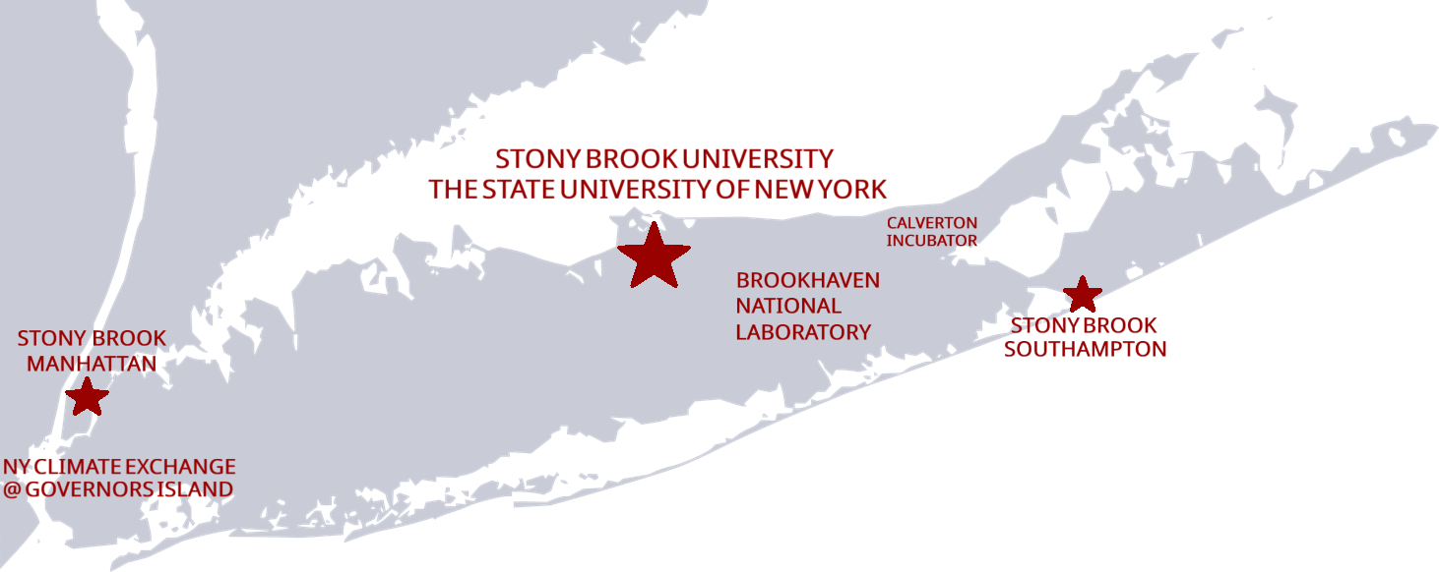
27,200 Fall 2025 Headcount Enrollment | 52% of Undergraduates Live on Campus
68% 32% Undergrad Graduate | 1 out of 3 First Generation
41% 39% 22% Asian White Underrep Minority | 40%+ Pell Grant Recipients Fall 2025
67% 76% 4-year 6-year grad rate grad rate | $4.58 B $340 M FY25 Operating FY25 Research Budget Expenditures
17,500 3,200 Employees Faculty including hospital | AAU Member Since 2001
$93,894 Median earnings (bachelor’s deg) 10 years after graduation | 1 of just 21 R1 Universities to be designated an Opportunity University 2025 Carnegie Classifications

Slide 5

Mission: To enable the University to improve through the collection, analysis and use of data
https://www.stonybrook.edu/effectiveness/

Slide 6
Pulse Survey

Slide 7
PROBLEMS WITH PAST SURVEY ACTIVITIES
Cross-sectional survey research is too slow
Cycle time is too long
Lengthy instruments
Declining response rates
High burden for analysis
Confidential & Proprietary |
7
Notes:
AB

Slide 8
What is a pulse survey
Short, focused questionnaire designed to quickly gather feedback from students
Administered weekly
Captures real-time sentiments or reactions to recent changes, event, or initiatives
Provides immediate insights that support rapid decision-making and continuous improvement

Slide 9
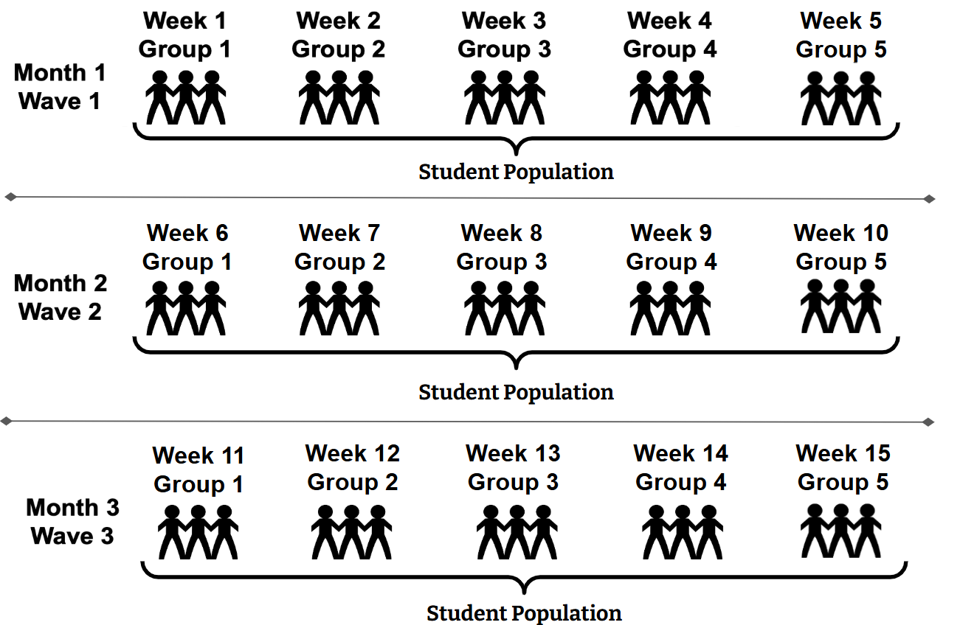
Administration approach
Academic Semester
About 5,300 students per group

Slide 10
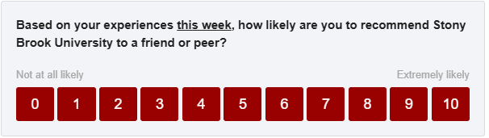
Invitation to pulse survey
Dear Ahmed,
We want your feedback! Using the Campus Pulse Survey, our goal is to listen and understand more about your current experiences at Stony Brook University. Your feedback will help us improve our services and your experience. Your participation is voluntary and the survey is only one question (with an option to share additional feedback as a comment).
You can participate by responding to the question below:
Or to respond via your web browser, you can click here or copy and paste the following URL into your browser:
https://stonybrookuniversity.co1.qualtrics.com/jfe/form/SV_2iy3WVHFwajp3im?Q_DL=QKNIpR5uiezXFpw_2iy3WVHFwajp3im_CGC_I0rwwd8SAedJiPE&Q_CHL=email
We know you have a lot going on so as a thank you for your participation, any student who participates will be entered into a monthly raffle for some awesome SBU swag pictured below!

Slide 11
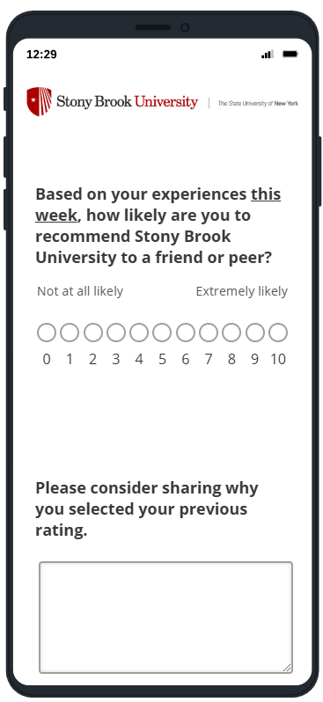
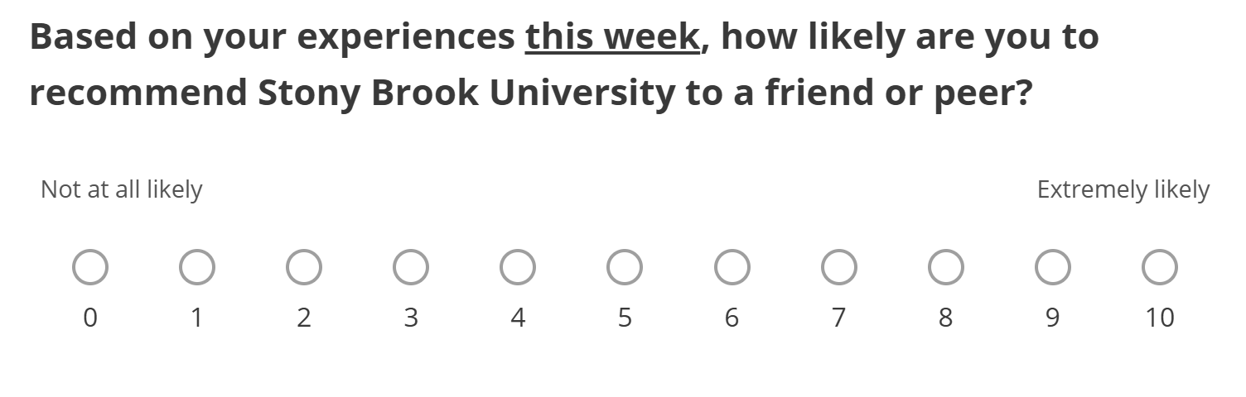
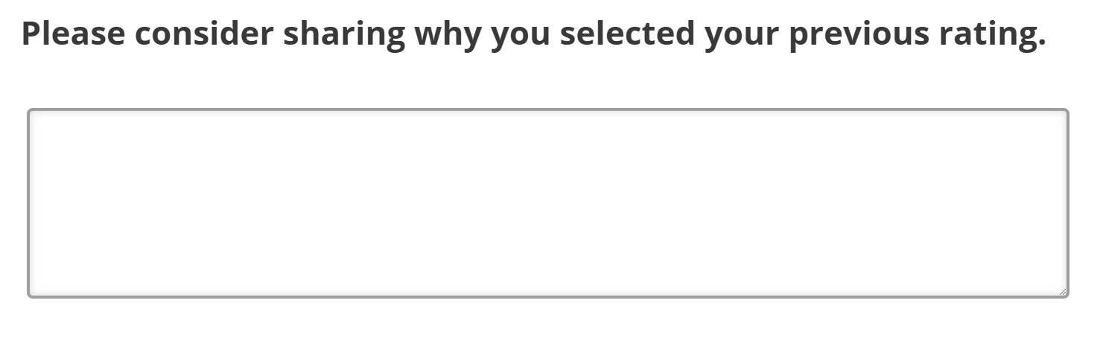
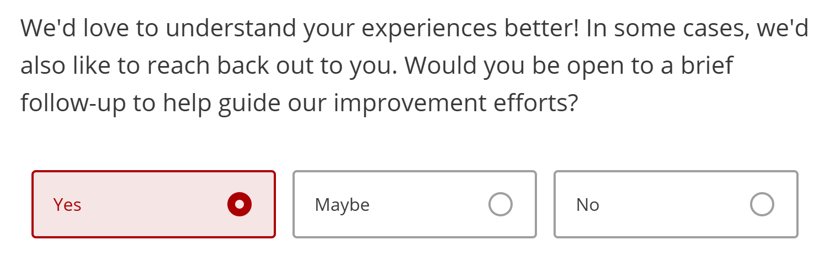
Survey instrument in qualtrics

Slide 12
Net promoter score (NPs)
Detractors -- They are not particularly thrilled by you. They, with all likelihood, won’t choose to engage with you again, and could potentially damage your reputation through negative word of mouth.
Passives -- They are somewhat satisfied but could easily switch to a competitor’s offering if given the opportunity. They probably wouldn’t spread any negative word-of-mouth, but are not enthusiastic enough to actually promote you.
Promoters -- They love you. They are your repeat customers. They are enthusiastically evangelical about you and recommend you to others.
Source: Reicheld, F. (2003). “The one number you need to grow,” Harvard Business Review.

Slide 13

Monitoring
Daily email push to senior leaders, including President’s Cabinet, Student Affairs leadership, Provost’s Office leadership, Deans, selected risk management and communications staff.
Rating | Unit | NPS | Consent to contact | Comment
9 | SSW | Promoter | Yes | Great faculty in the SSW
9 | BUS | Promoter | Yes | Stony Brook University is a state school so it’s not as expensive as other schools, and combined with my major, it’s still a pretty good university. It does really depend on what major you want to study though
8 | CAS | Passive | Yes | I am doing well at Stony Brook University, but I still feel that I am not fully involve in the University
4 | CAS | Detractor | No | I just took a test for CHE 132, and this was probably the worst test I’ve ever taken, even though I spent days studying for it.

Slide 14
AI for Content Analysis

Slide 15
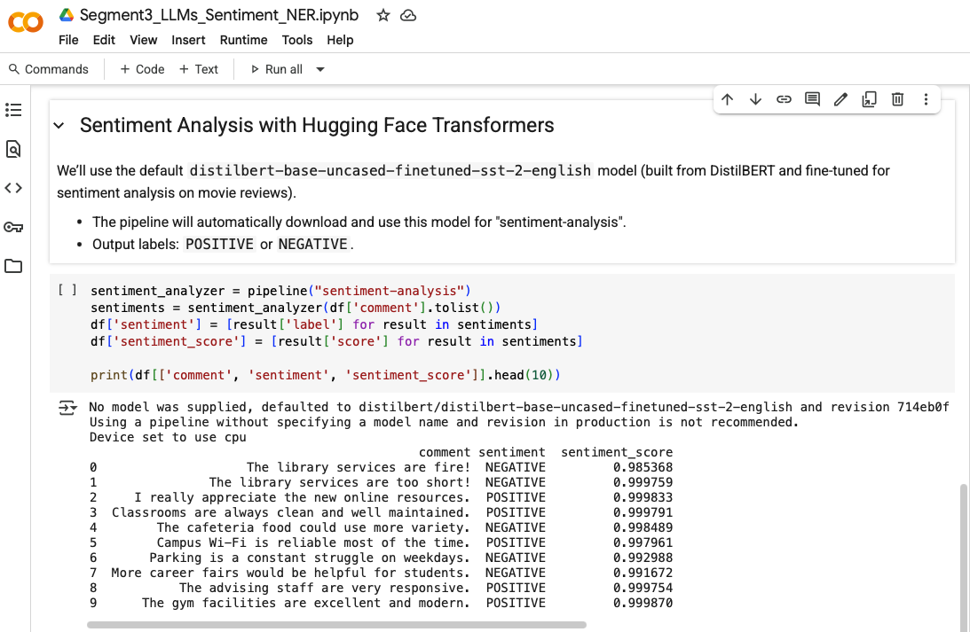
Thematic Analysis and Comment Coding
 | Activities | Academics | UGRD Costs | GRAD Costs | Dining | Parking
Promoters | 36% | 34% | 17% | 15% | 14% | 6%
Passives | 45% | 35% | 35% | 20% | 40% | 25%
Detractors | 19% | 31% | 48% | 65% | 46% | 70%
Notes:
AB

Slide 16
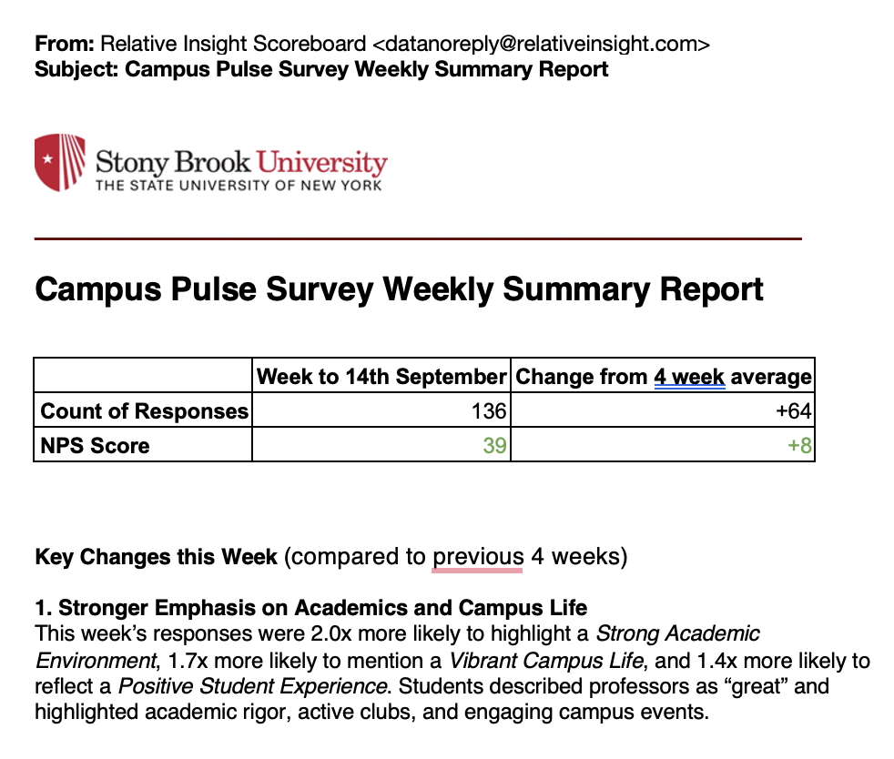
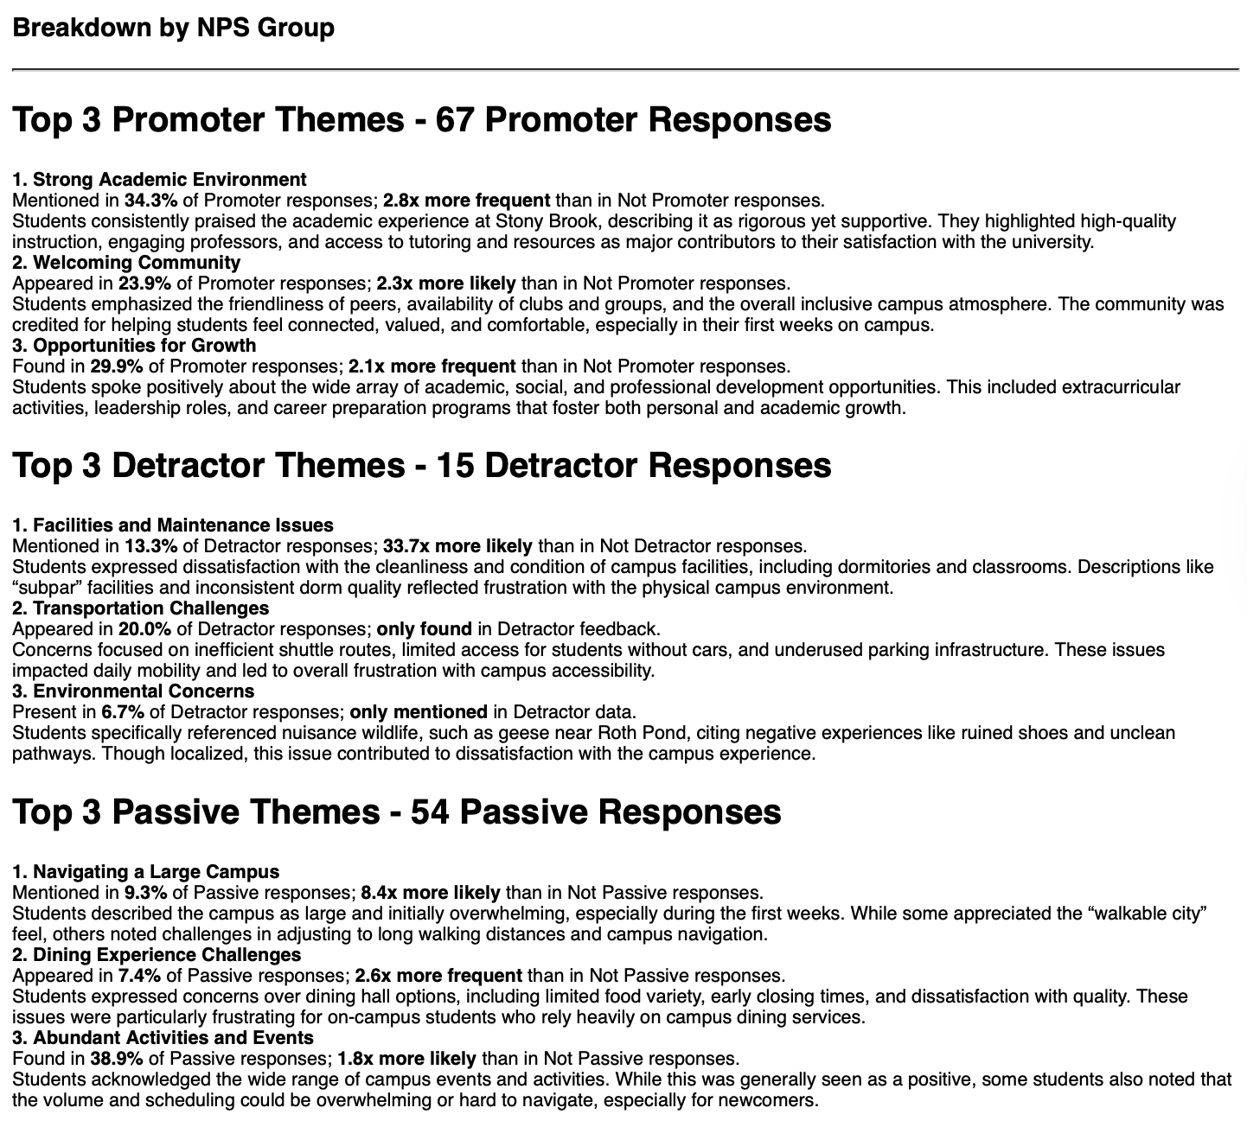
Weekly Summarization

Slide 17
Weekly Summarization – Key Changes
Shift from Welcome Experiences
  This week saw a 2x increase in mentions of an Inclusive and Diverse Community noting access to numerous clubs, supportive faculty, and welcoming spaces.
  This week’s feedback leaned toward sustained academic and personal development.
  The transition reflects students settling into campus life and focusing more on long-term resources and community engagement.

Slide 18
Themes by NPS (Promoters)
Welcoming Community
  Appeared in 24% of Promoter responses; 2.3x more likely than in Not Promoter responses.
  Students emphasized the friendliness of peers, the availability of clubs and groups, and the overall inclusive campus atmosphere.
  The community was credited for helping students feel connected, valued, and comfortable, especially in their first weeks on campus.

Slide 19
Themes by NPS (Detractors)
Transportation Challenges
  Appeared in 20% of Detractor responses; only found in Detractor feedback.
  Concerns focused on inefficient shuttle routes, limited access for students without cars, and underused parking infrastructure. These issues impacted daily mobility and led to overall frustration with campus accessibility.

Slide 20
Themes by NPS (Passives)
Abundant Activities and Events
  Found in 39% of Passive responses; 1.8x more likely than in Not Passive responses.
  Students acknowledged the wide range of campus events and activities. While this was generally seen as a positive, some students also noted that the volume and scheduling could be overwhelming or hard to navigate, especially for newcomers.

Slide 21
Relative Classification
it’s a good school academically, bad for commuters. Not commuter friendly at all.
the school is not very commuter friendly, they try to accommodate, but there’s a lot more that they could be doing for commuters.
parking options for commuters are unfair, tuition per semester is a bit pricey, and programs are too competitive and almost impossible to get into.
the parking situation is horrible and appalling especially for commuter students who also pay tuition.
Detractors are 7.9x more likely to mention Parking and Transportation issues than Promoters
…and…
Whereas Detractors who are Non-Residents are 14.4x more likely to mention Parking and Transportation issues than Residents

Slide 22
AI for Coding

Slide 23
Justification for Coding Records
Detailed statistical analysis
Trend analysis
Population analysis
Detailed quantitative analysis
Reliability
Audit trails
Ability to answer follow-up
Actionability
Supports evidence-based decision-making
Enables segmentation for targeted interventions
Offers a probability or confidence threshold

Slide 24
Prompt Construction
As a qualitative researcher, review the comment response in the specified cell that comes from an open-ended question related to a university student's rating of the university. Determine if the comment is related to parking based on an explicit and direct mention of the exact word 'parking' or 'park' within the text. If the comment is related to parking, return a 1 in Column C. If it is not related to parking, return a 0 in Column C. Do not return any other responses.
Assign a role
Provide context
Set evaluation criteria
Define output
Limit output

Slide 25
Prompt Variation – Conceptual Construct
Construct | Core statement in prompt
1. Tightly Bounded (Exact Word Match) | Determine if the comment is related to parking based on an explicit and direct mention of the exact word 'parking' or 'park' within the text.
2. Slightly Broader (Direct Mentions and Simple Forms) | Determine if the comment is related to parking based on direct mentions of 'parking,' 'parked,' 'parks,' or specific references to 'parking lots' or 'parking garages.'
3. Moderately Conceptual (Common Parking Issues) | Determine if the comment is related to parking based on discussions regarding the availability of spaces, the cost of permits or daily parking, enforcement of parking regulations, or the physical location and convenience of campus parking facilities.
4. More Conceptual (Logistics and Commuting Impact) | Determine if the comment is related to parking based on mention of challenges with parking, the time spent searching for a spot, the difficulty of commuting to campus by car, or the cost of parking.
5. Broadly Conceptual (Impact on Student Experience and Well-being): | Determine if the comment is related to parking based on how the challenges, frustrations, or lack of adequate provisions for parking for private vehicles affect the student's overall academic experience, stress levels, ability to arrive on time for classes, or participate in campus life and activities.

Slide 26
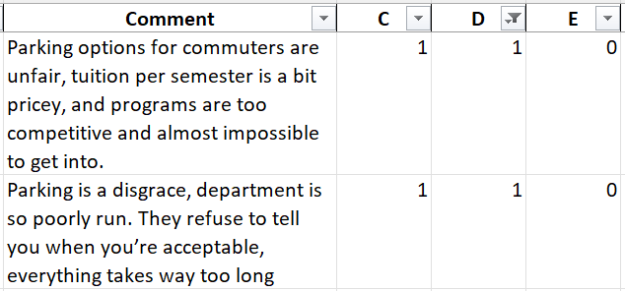
Prompt Variation – Single vs Multiple Instructions
For Column C, Determine if the comment is related to parking based on an explicit and direct mention of the exact word 'parking' or 'park' within the text. If the comment is related to Parking return a 1 in the column. If it is not related to Parking, return a 0 in the column. Do not return any other responses in this column.
For Column D, Determine if the comment is related to parking based on direct mentions of 'parking,' 'parked,' 'parks,' or specific references to 'parking lots' or 'parking garages.' If the comment is related to Parking return a 1 in the column. If it is not related to Parking, return a 0 in the column. Do not return any other responses in this column.
For Column E, Determine if the comment is related to parking based on discussions regarding the availability of spaces, the cost of permits or daily parking, enforcement of parking regulations, or the physical location and convenience of campus parking facilities. …

Slide 27
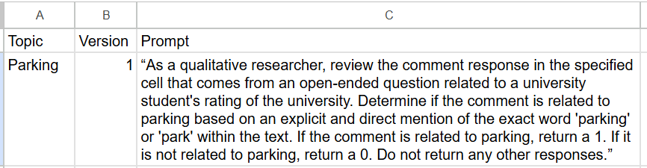
Prompt Variation – Spreadsheet Output

Slide 28


Model Variation – Same Prompt, Different LLMs
As a qualitative researcher, review the comment response in the specified cell that comes from an open-ended question related to a university student's rating of the university. Determine if the comment is related to parking based on an explicit and direct mention of the exact word 'parking' or 'park' within the text. If the comment is related to parking, return a 1. If it is not related to parking, return a 0. Do not return any other responses.”
345 positives out of 9,772 records
396 positives out of 9,772 records

Slide 29
Traditional Error Analysis-Parking
 | Prompt01 |  |  |  |  |  |  | Prompt04
Manual | No | Yes | Total |  |  |  | Manual | No | Yes | Total
No | 9,374 | 2 | 9,376 | -- | false positives |  | No | 8,581 | 795 | 9,376 | 201% | false positives
Yes | 53 | 343 | 396 | 87% | pct agreement |  | Yes | 1 | 395 | 396 | 100% | pct agreement
Total | 9,427 | 345 | 9,772 |  |  |  | Total | 8,582 | 1,190 | 9,772
 | Prompt02 |  |  |  |  |  |  | Prompt05
Manual | No | Yes | Total |  |  |  | Manual | No | Yes | Total
No | 9,375 | 1 | 9,376 | -- | false positives |  | No | 9,373 | 3 | 9,376 | -- | false positives
Yes | 19 | 377 | 396 | 95% | pct agreement |  | Yes | 2 | 394 | 396 | 99% | pct agreement
Total | 9,394 | 378 | 9,772 |  |  |  | Total | 9,375 | 397 | 9,772
 | Prompt03 |  |  |  |  |  |  | Prompt01-Gem
Manual | No | Yes | Total |  |  |  | Manual | No | Yes | Total
No | 9,375 | 1 | 9,376 | -- | false positives |  | No | 9,374 | 2 | 9,376 | -- | false positives
Yes | 19 | 377 | 396 | 95% | pct agreement |  | Yes | 2 | 394 | 396 | 99% | pct agreement
Total | 9,394 | 378 | 9,772 |  |  |  | Total | 9,376 | 396 | 9,772

Slide 30
Example Model Analysis: Parking

Slide 31
Example Model Analysis: Student Life

Slide 32
Catastrophic Prompt Failure
Limitations
Examples:
Prompt returns no records
Prompt returns 2x or more records than it should
When this happens, reject the prompt.
Numerous prompts failed on simple concepts. Catastrophic failure in 30-40% of attempts.

Slide 33
License Restrictions
Limitations
Examples:
AI tool license restricts file input and/or output
AI tool license restricts use in spreadsheet, ex. 200 cells at a time; daily limits.
AI tool license restricts agents to use only public URLs
We experienced limitations because of the licensing the University negotiated for tools in a protected environment.

Slide 34
Risk Assessment
Limitations
Are results used for understanding patterns or treating individuals?
What are the risks of false positives and false negatives
Accreditors and regulators require oversight of AI. Good professional practice demands monitoring to ensure reliable answers are provided

Slide 35
Final Thoughts
Coding surveys with AI changes cost-benefit of textual analysis
Know your data
Interact with your vendors and interrogate their output
There is value in AI; but investment of time and effort is required
With AI, don’t set it and forget it; human oversight required
AI development takes time

Slide 36
Supplementary Slides

Slide 37
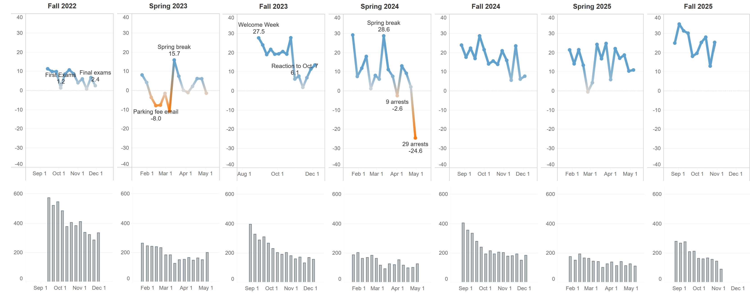
Trend of Net Promoter Score

Slide 38
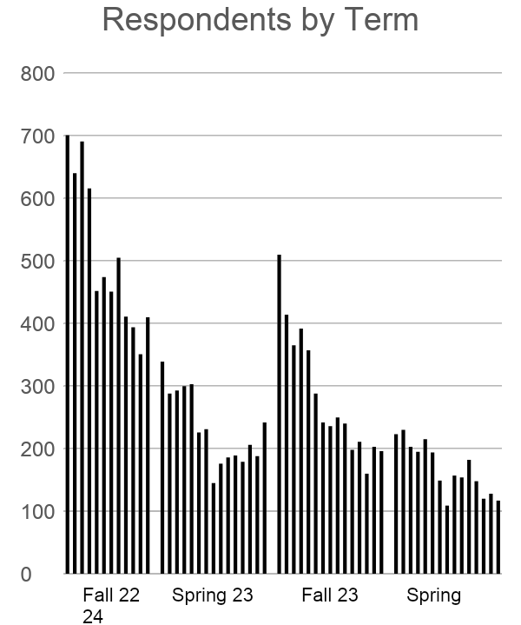
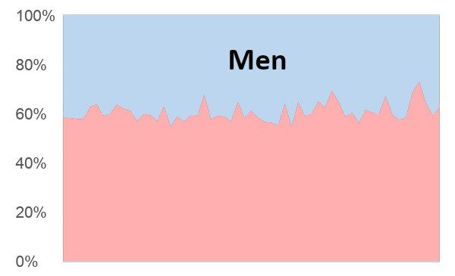
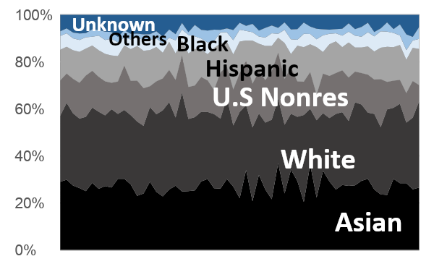
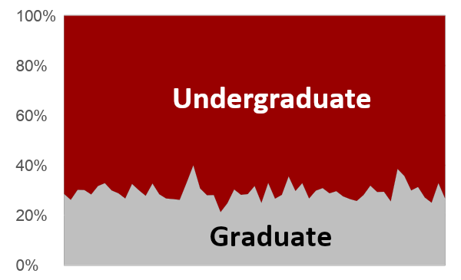
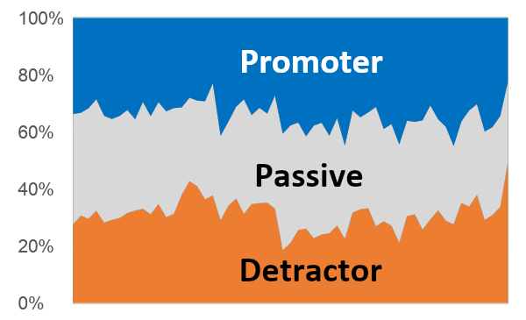
Even though response rates declined, the respondents remained representative
Women
Spring 24
Notes:
SK

Slide 39
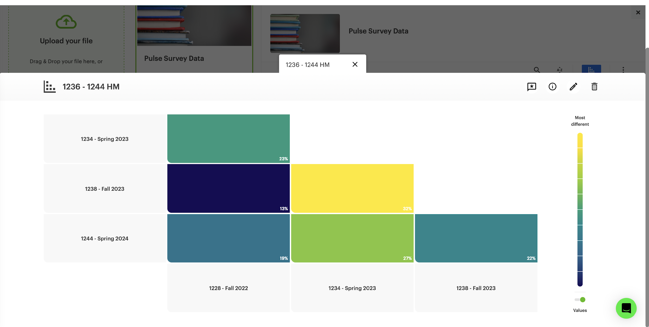
Overall Sentiment Analysis
Source: Relative Insight

Slide 40
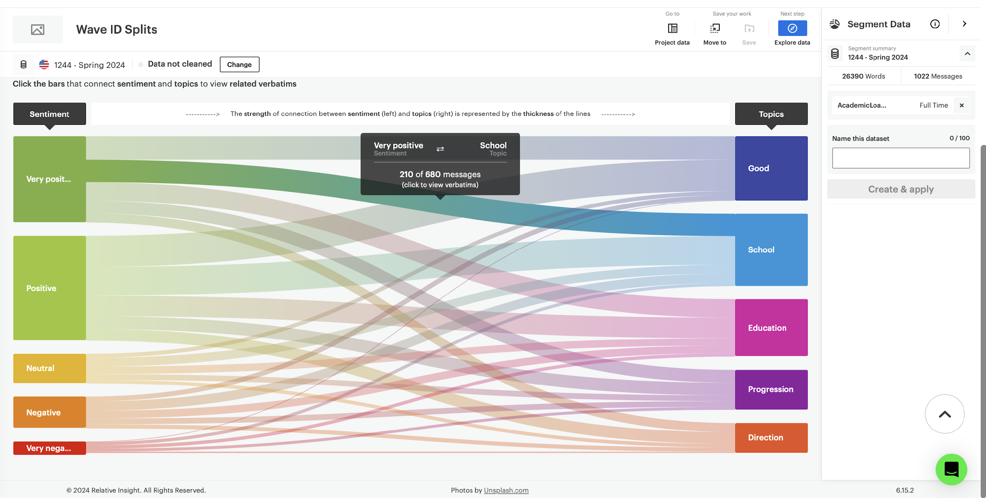
How Sentiment Maps to Topics
Source: Relative Insight

Slide 41
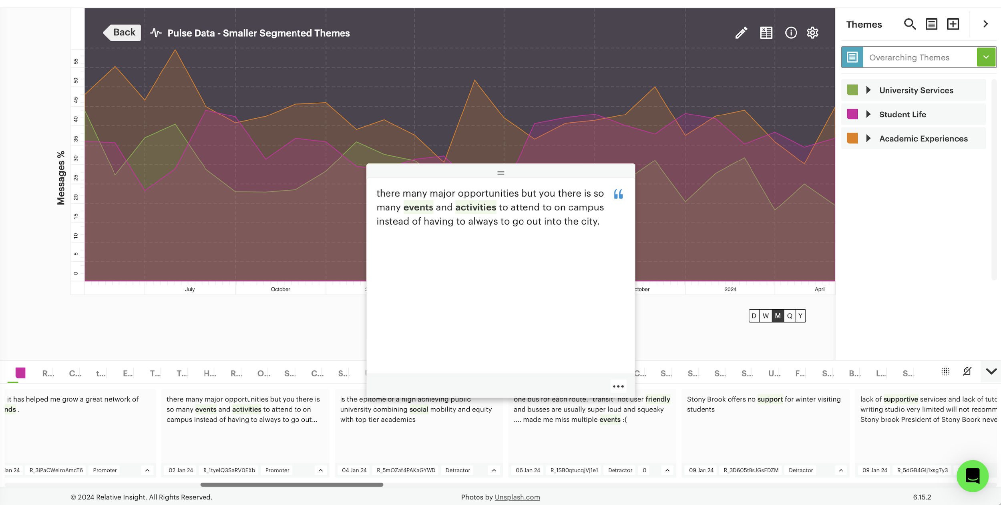
Trend of Themes
Source: Relative Insight

Slide 42
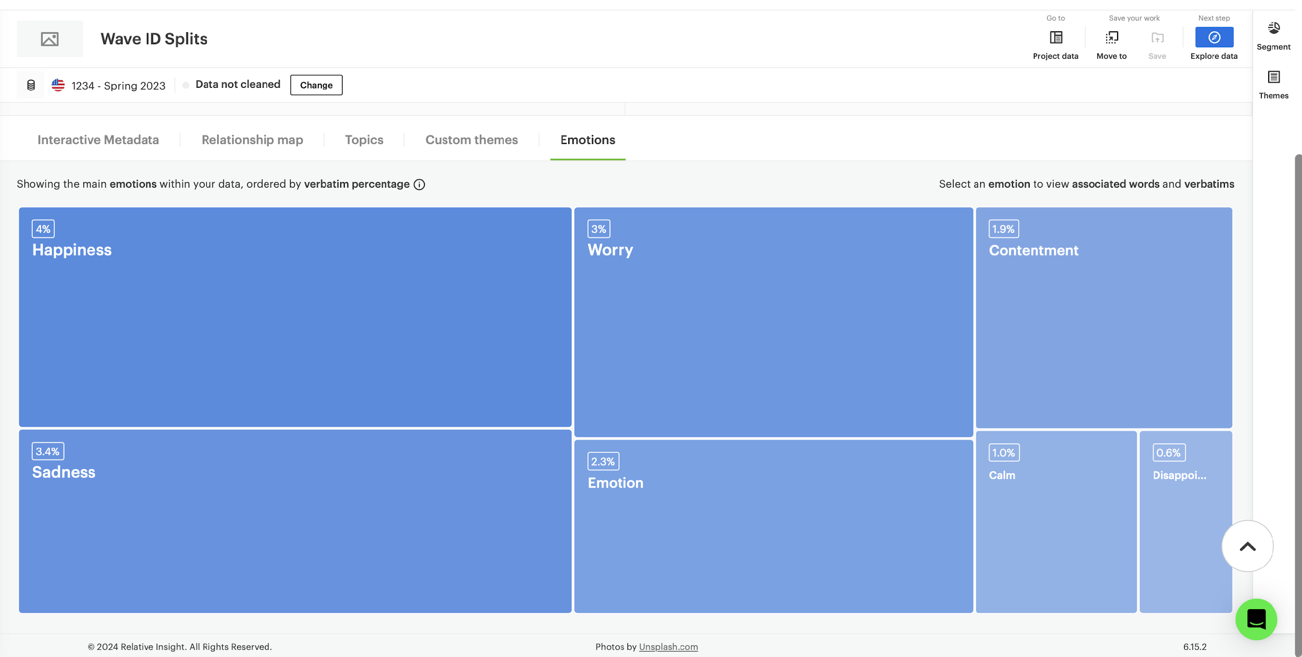
Distribution of Main Emotions
Source: Relative Insight

