Slide 1
Quick Insights, Big Impact: Leveraging Pulse Surveys and AI
Ahmed Belazi, Executive Director of Strategic Analytics & Technologies
Robert Miller, Director of Institutional Research, Planning, and Effectiveness
CIMA 2025
Notes:
Intro

Slide 2



Stony Brook University at a Glance
>26k Fall 2025 Enrollment | >10k Residents
68% 32% Undergrad Graduate | 2001 Joined AAU
Notes:
RM
Highlight overall enrollment, 10K residents, 70/30 ug grad split, AAU institution

Slide 3




Overview
Qualitative + Quantitative
Student outreach
Analysis & AI tools
Lessons learned
Confidential & Proprietary |
‹#›
Notes:
RM
Balancing focus on qualitative and quantitative
How we used AI for qualitative student responses
What worked, what required refinement

Slide 4
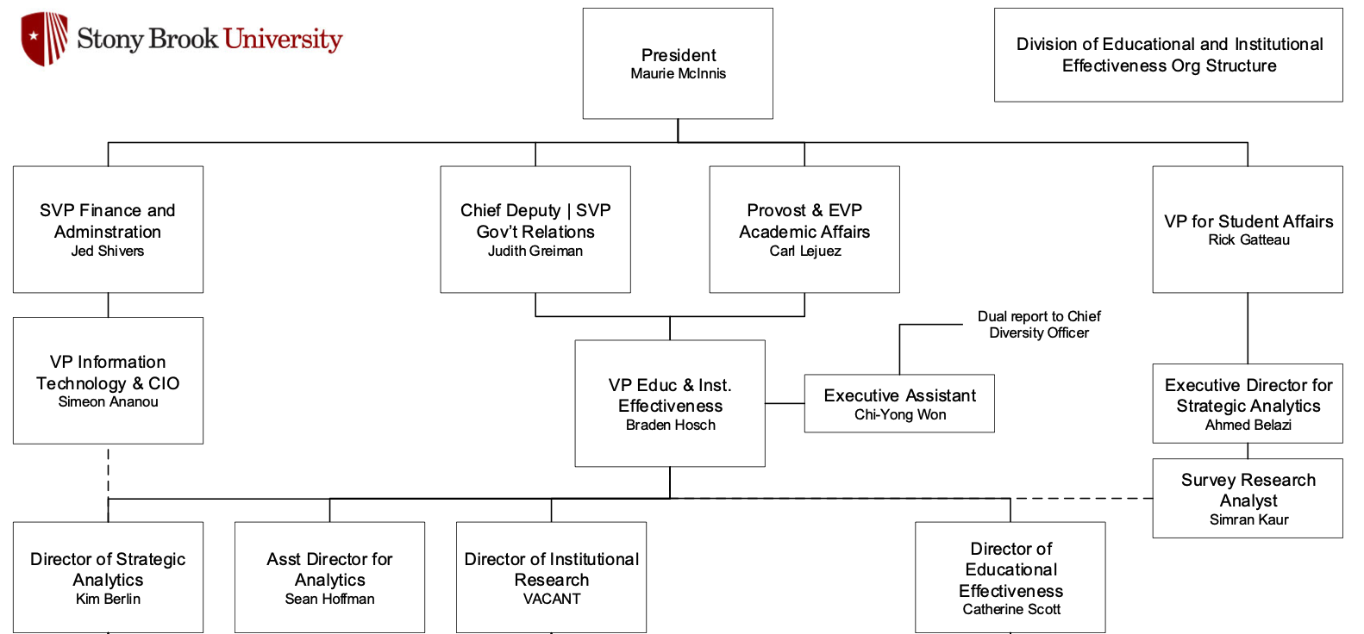
Organizational Partnership
Richard McCormick
Braden Hosch
Rob Miller
Notes:
RM
Intentitional partnership between IRPE and Office of Survey research
Highlight importance of coordination given the number of surveys (SUNY, internal constituents, etc.) and student response rates

Slide 5





Problems with Past Survey Activities
Cross- sectional survey research is too slow
Cycle time is too long
Lengthy instruments
Declining response rates
High burden for analysis
Confidential & Proprietary |
‹#›
Notes:
AB

Slide 6
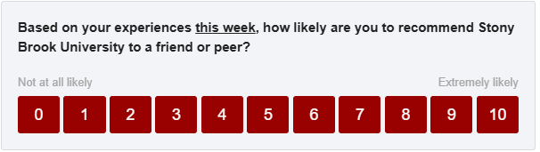
Email on Tuesday (+ reminder on Thursday)
Dear Ahmed,
We want your feedback! Using the Campus Pulse Survey, our goal is to listen and understand more about your current experiences at Stony Brook University. Your feedback will help us improve our services and your experience. Your participation is voluntary and the survey is only one question (with an option to share additional feedback as a comment).
You can participate by responding to the question below:
Or to respond via your web browser, you can click here or copy and paste the following URL into your browser:
https://stonybrookuniversity.co1.qualtrics.com/jfe/form/SV_2iy3WVHFwajp3im?Q_DL=QKNIpR5uiezXFpw_2iy3WVHFwajp3im_CGC_I0rwwd8SAedJiPE&Q_CHL=email
We know you have a lot going on so as a thank you for your participation, any student who participates will be entered into a monthly raffle for some awesome SBU swag pictured below!
Confidential & Proprietary |
‹#›
Notes:
SK

Slide 7
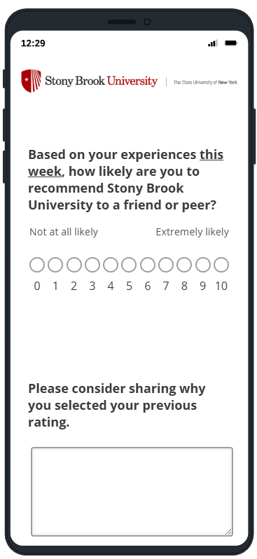
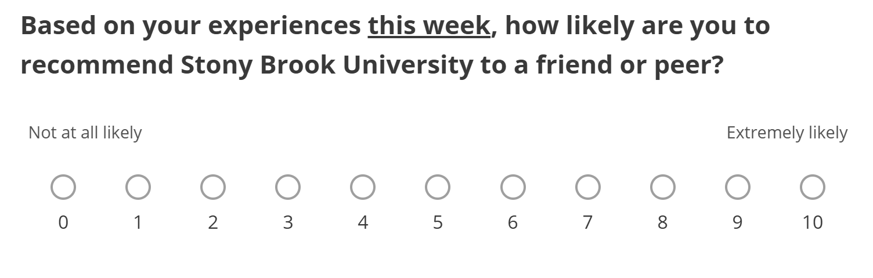
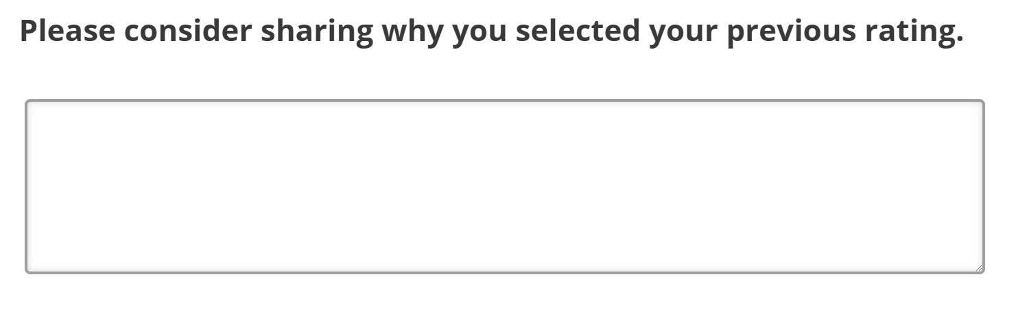
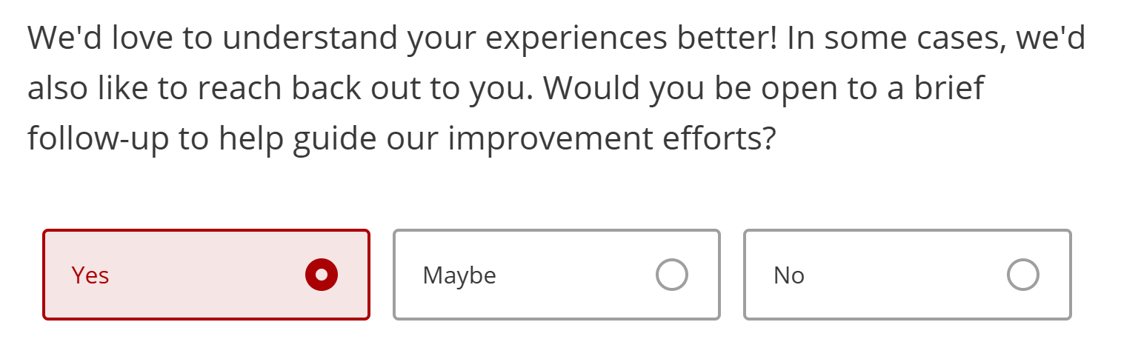
Instrument in Qualtrics
‹#›
Notes:
SK

Slide 8
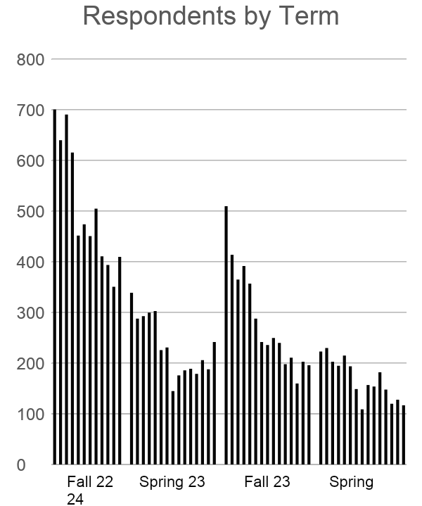
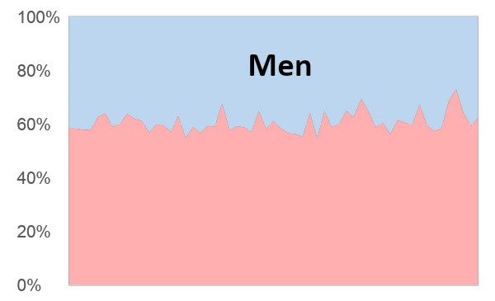
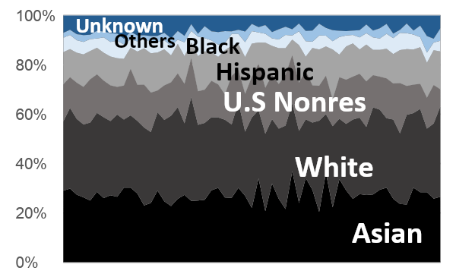
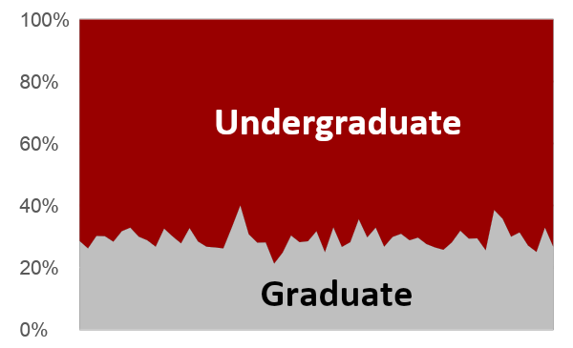
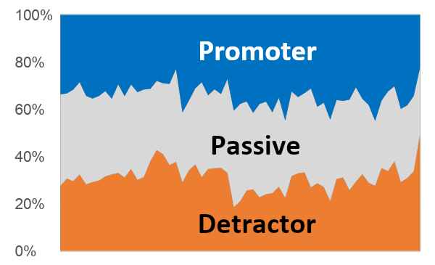
Even though response rates declined, the respondents remained representative
Women
Spring 24
Notes:
SK

Slide 9
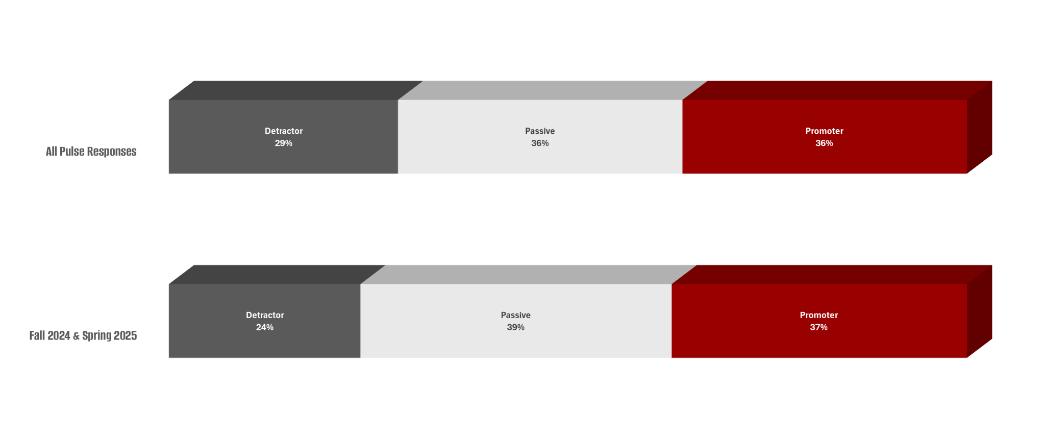
Summary Data
Notes:
SK

Slide 10
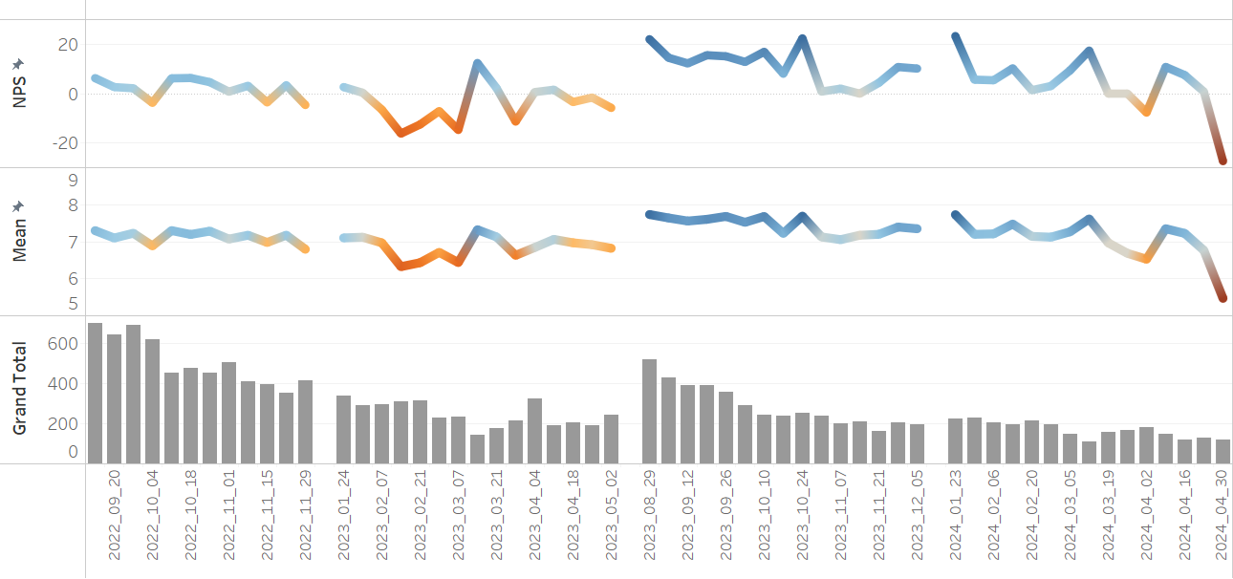
Fall 2022
Spring 2023
Fall 2023
Spring 2024
Monitoring
Fall 2022
Spring 2023
Fall 2023
Spring 2024
Spring Break
Fall Break
Spring Break
New
Welcome
Week /
Good News
Nine
Arrests
First
Exams
Final
Exams
Parking Fees
Announced
Reaction
To Oct. 7
Twenty-Nine
Arrests
Notes:
AB

Slide 11
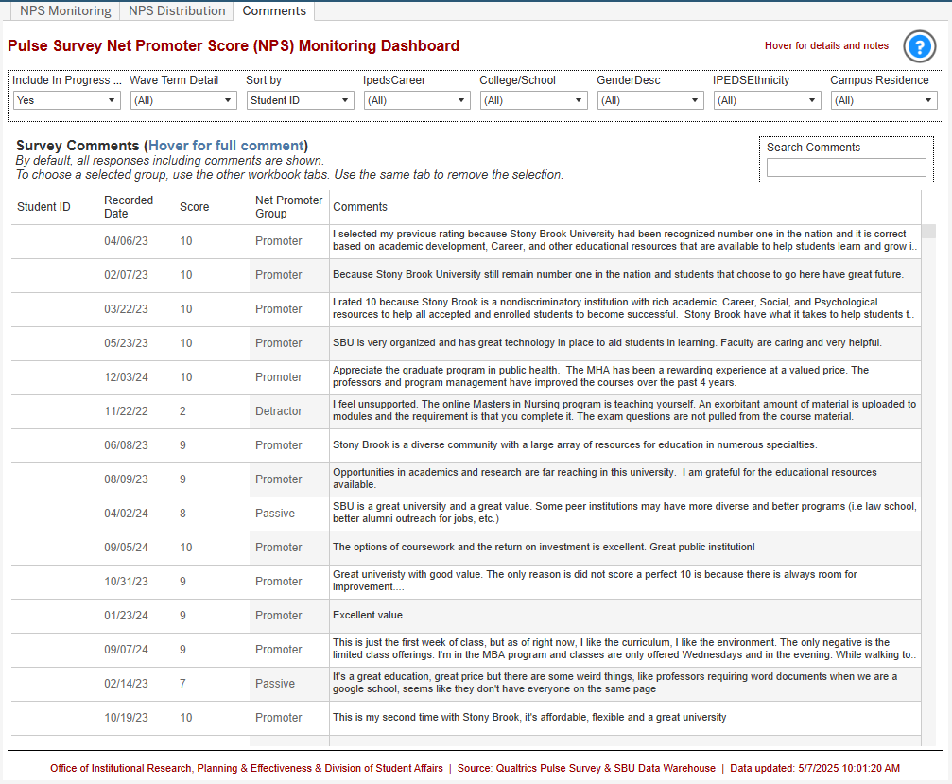
Monitoring
Notes:
AB

Slide 12


Follow-up
Health and Safety
Case Management
‹#›
Notes:
AB

Slide 13








QDA – Thematic Analysis and Comment Coding
NPS | Academics | Support | Professors | Program | Activities | Cost Cost Total UGRD GRAD |  |  | Dining | Parking
Promoters | 34% | 38% | 38% | 30% | 36% | 17% | 17% | 15% | 14% | 6%
Passives | 35% | 29% | 31% | 30% | 45% | 28% | 35% | 20% | 40% | 25%
Detractors NP Mean: | 31% | 33% | 31% | 41% | 19% | 25% | 48% | 65% | 46% | 70%
 | 4.6 | 3.8 | 4.1 | 4.4 | 5.0 | 3.2 | 4.5 | 2.8 | 3.7 | 2.3
Notes:
AB

Slide 14
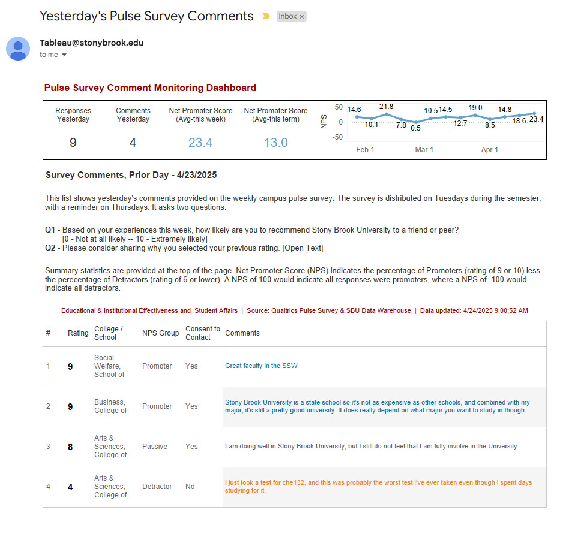
Monitoring
Notes:
AB

Slide 15
Current Stakeholders
Student Affairs
Public Relations
Institutional Effectiveness
Campus Security
Academic Affairs
Finance
Enrollment Management
Residence Life
Student Success
Athletics
Financial Aid
Student Support
Notes:
AB

Slide 16
Why AI?
Scalability and Speed
Discovery of Latent Patterns
Custom Taxonomy Adaptation
Interactive and Iterative Analysis
Consistency and Reduced Human Bias?
Notes:
AB

Slide 17
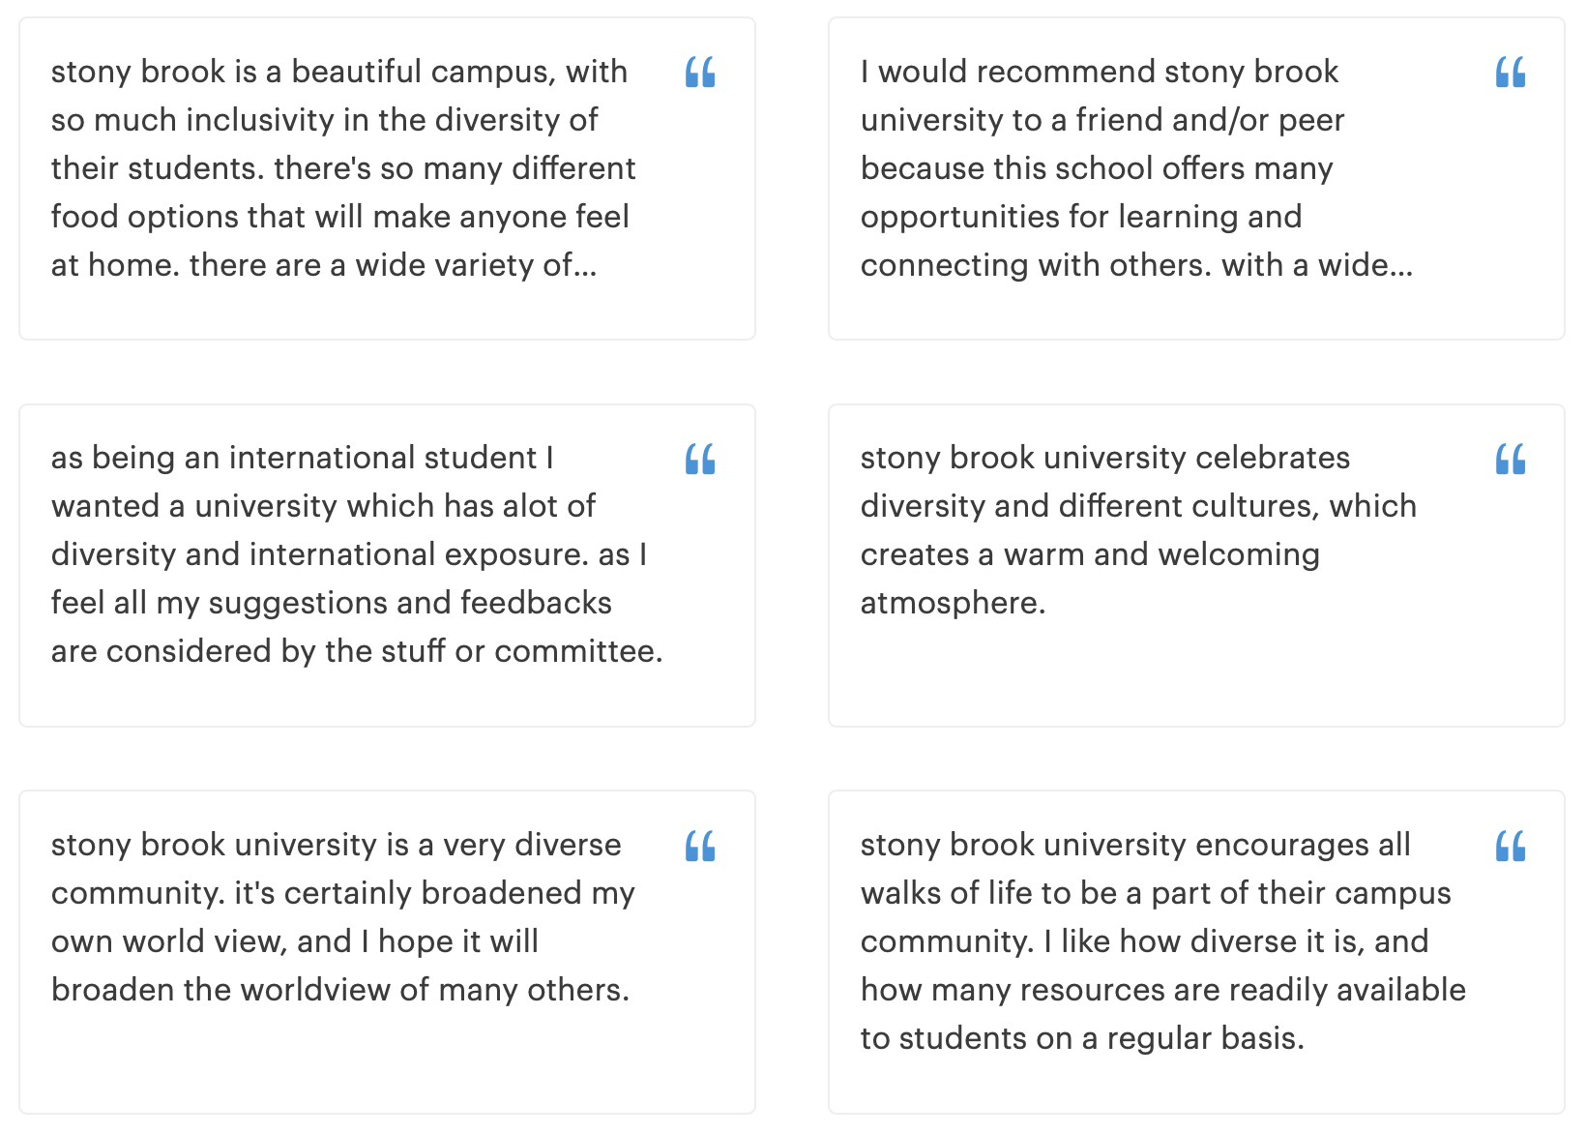
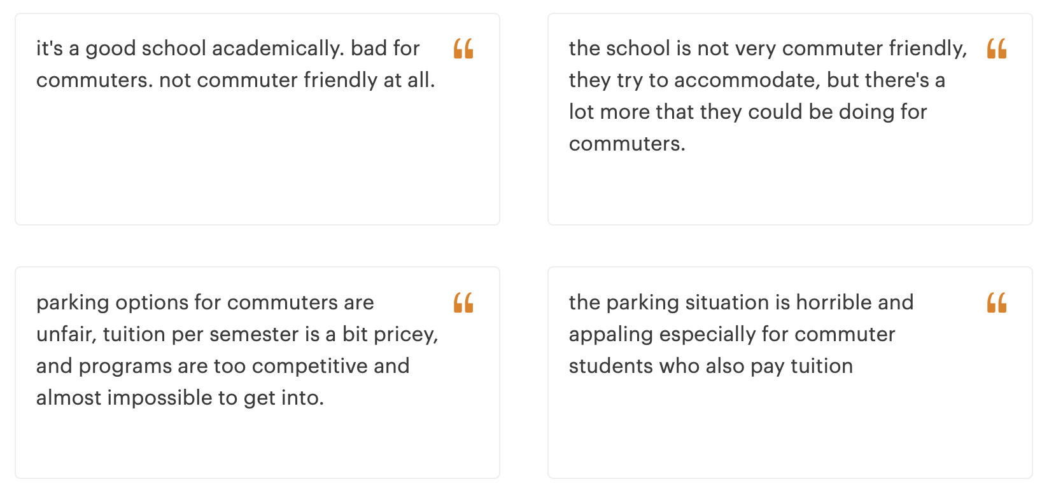
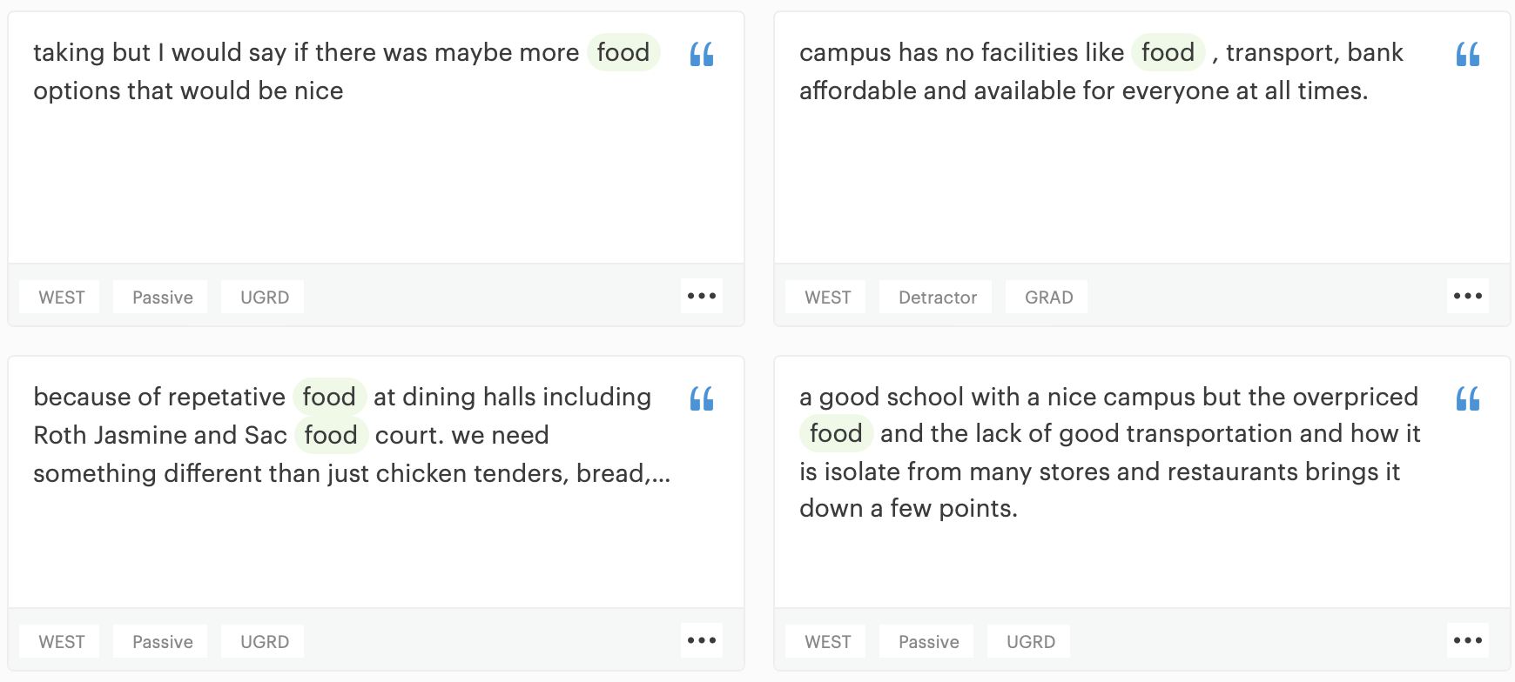
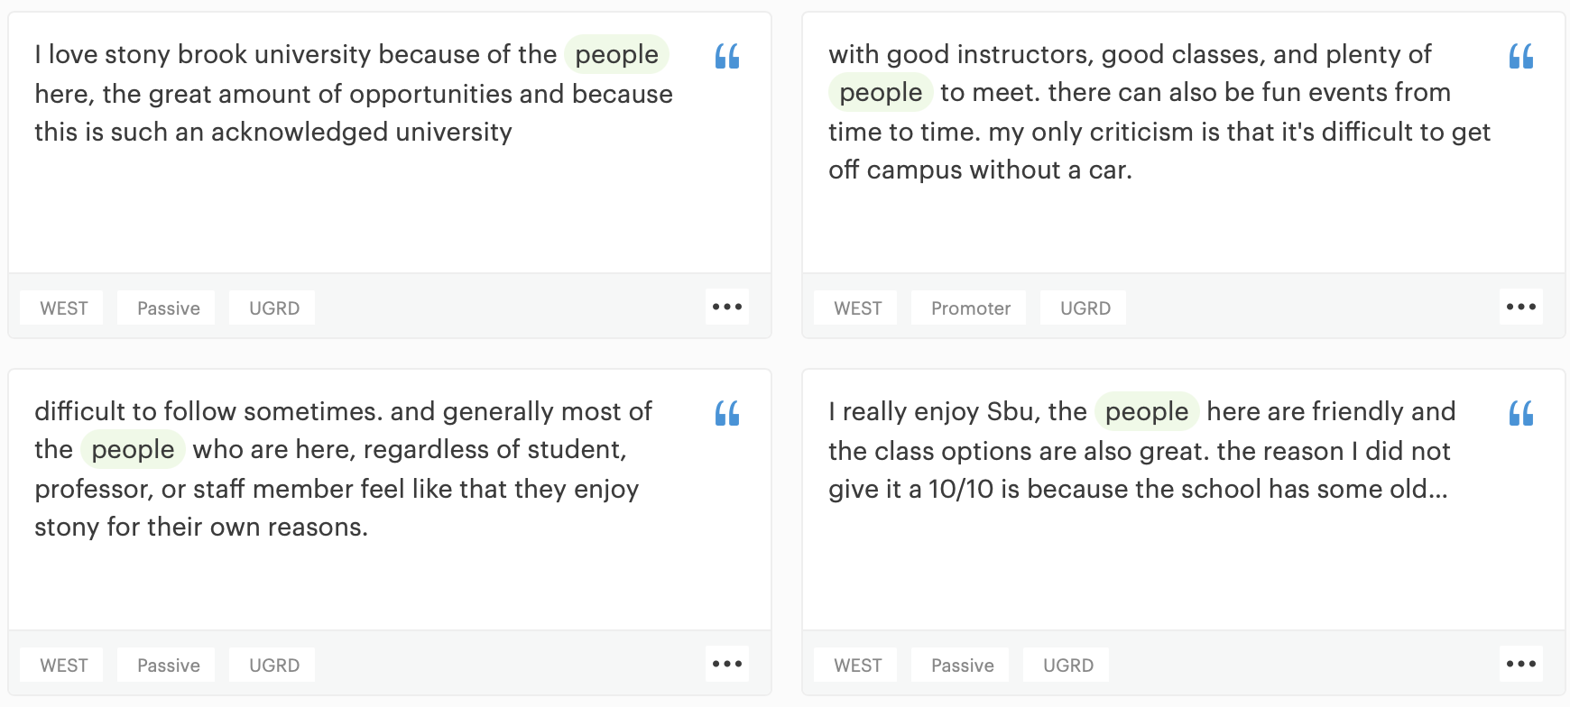
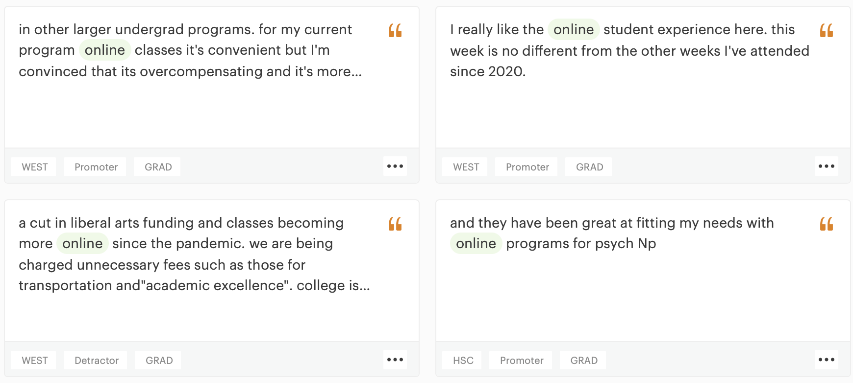
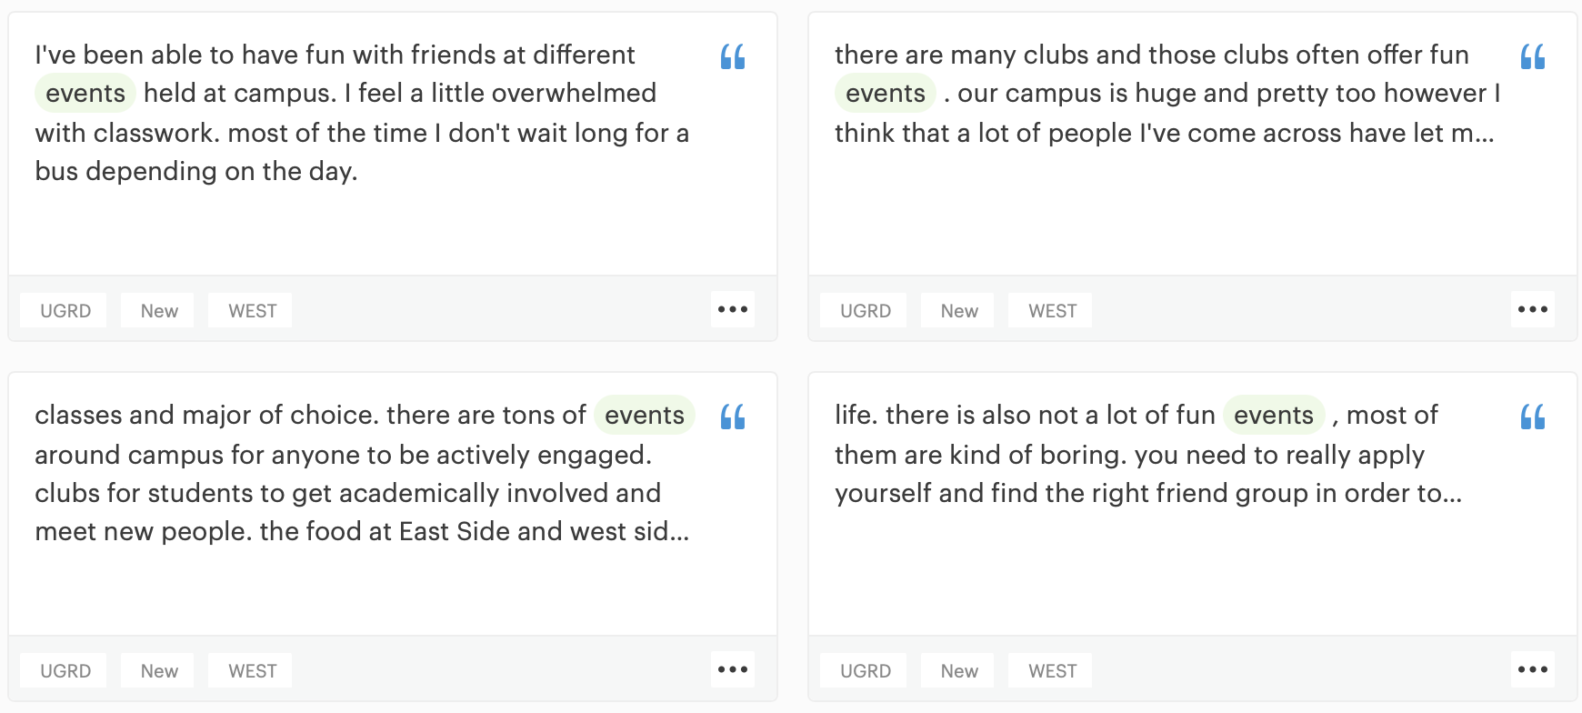
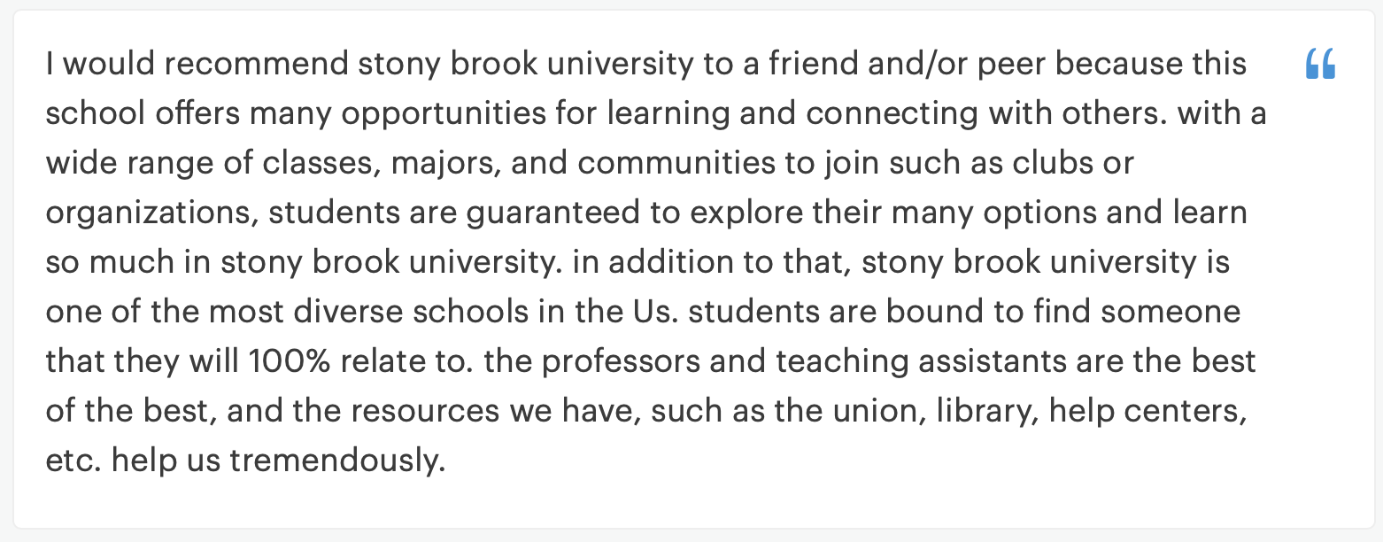
AI Tools - Relative Classification
Residents are 3x more likely to mention
Food
than Non-residents
Residents are 3x more likely to mention
Community
than Non-residents
Non-residents are 3x more likely to mention
Online Tech
than
Residents
Detractors are 7.9x more likely to mention Parking and Transportation issues than Promoters
Detractors who are Non-Residents are 14.4x more likely to mention Parking and Transportation issues than Residents
Promoters are 7.4x more likely to mention Diversity in relation to positive value than Detractors
Promoters are
4x more likely to mention
Events and Activities
than
Detractors
Results generated by Relative Insight Explore and Heartbeat (powered by ML)
Notes:
AB

Slide 18
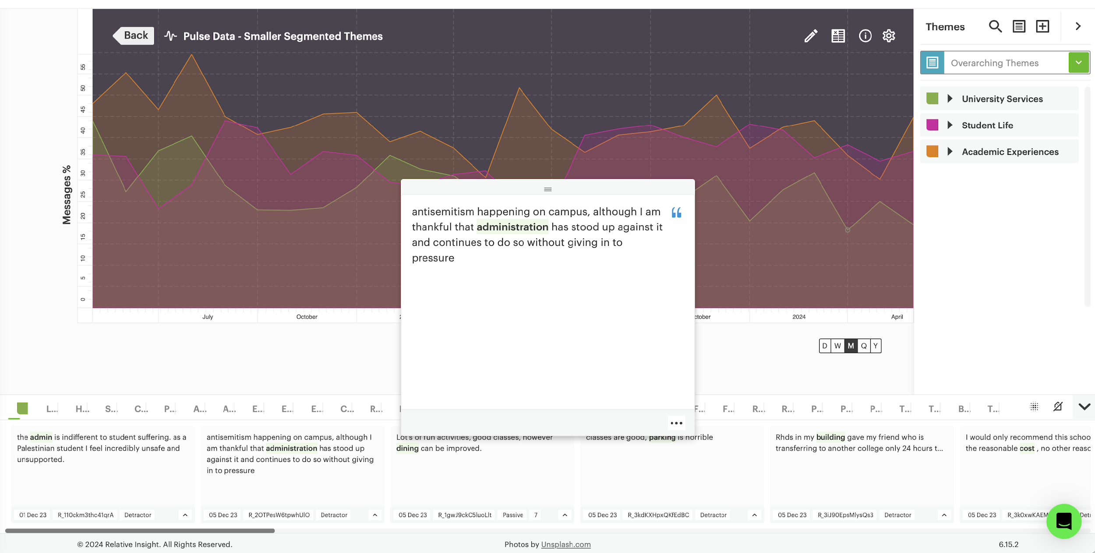
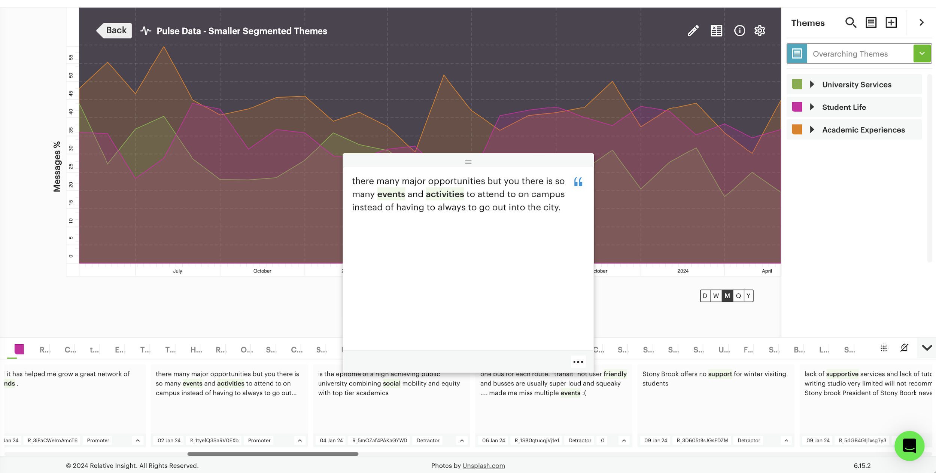
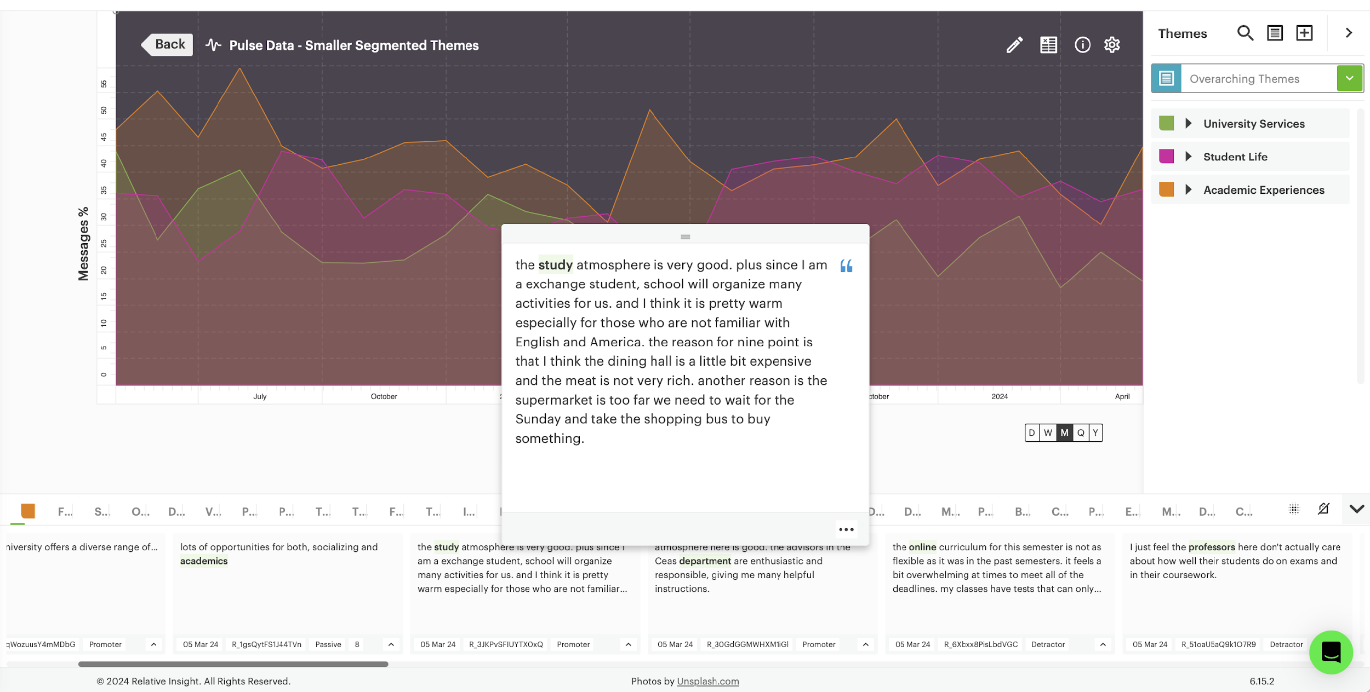
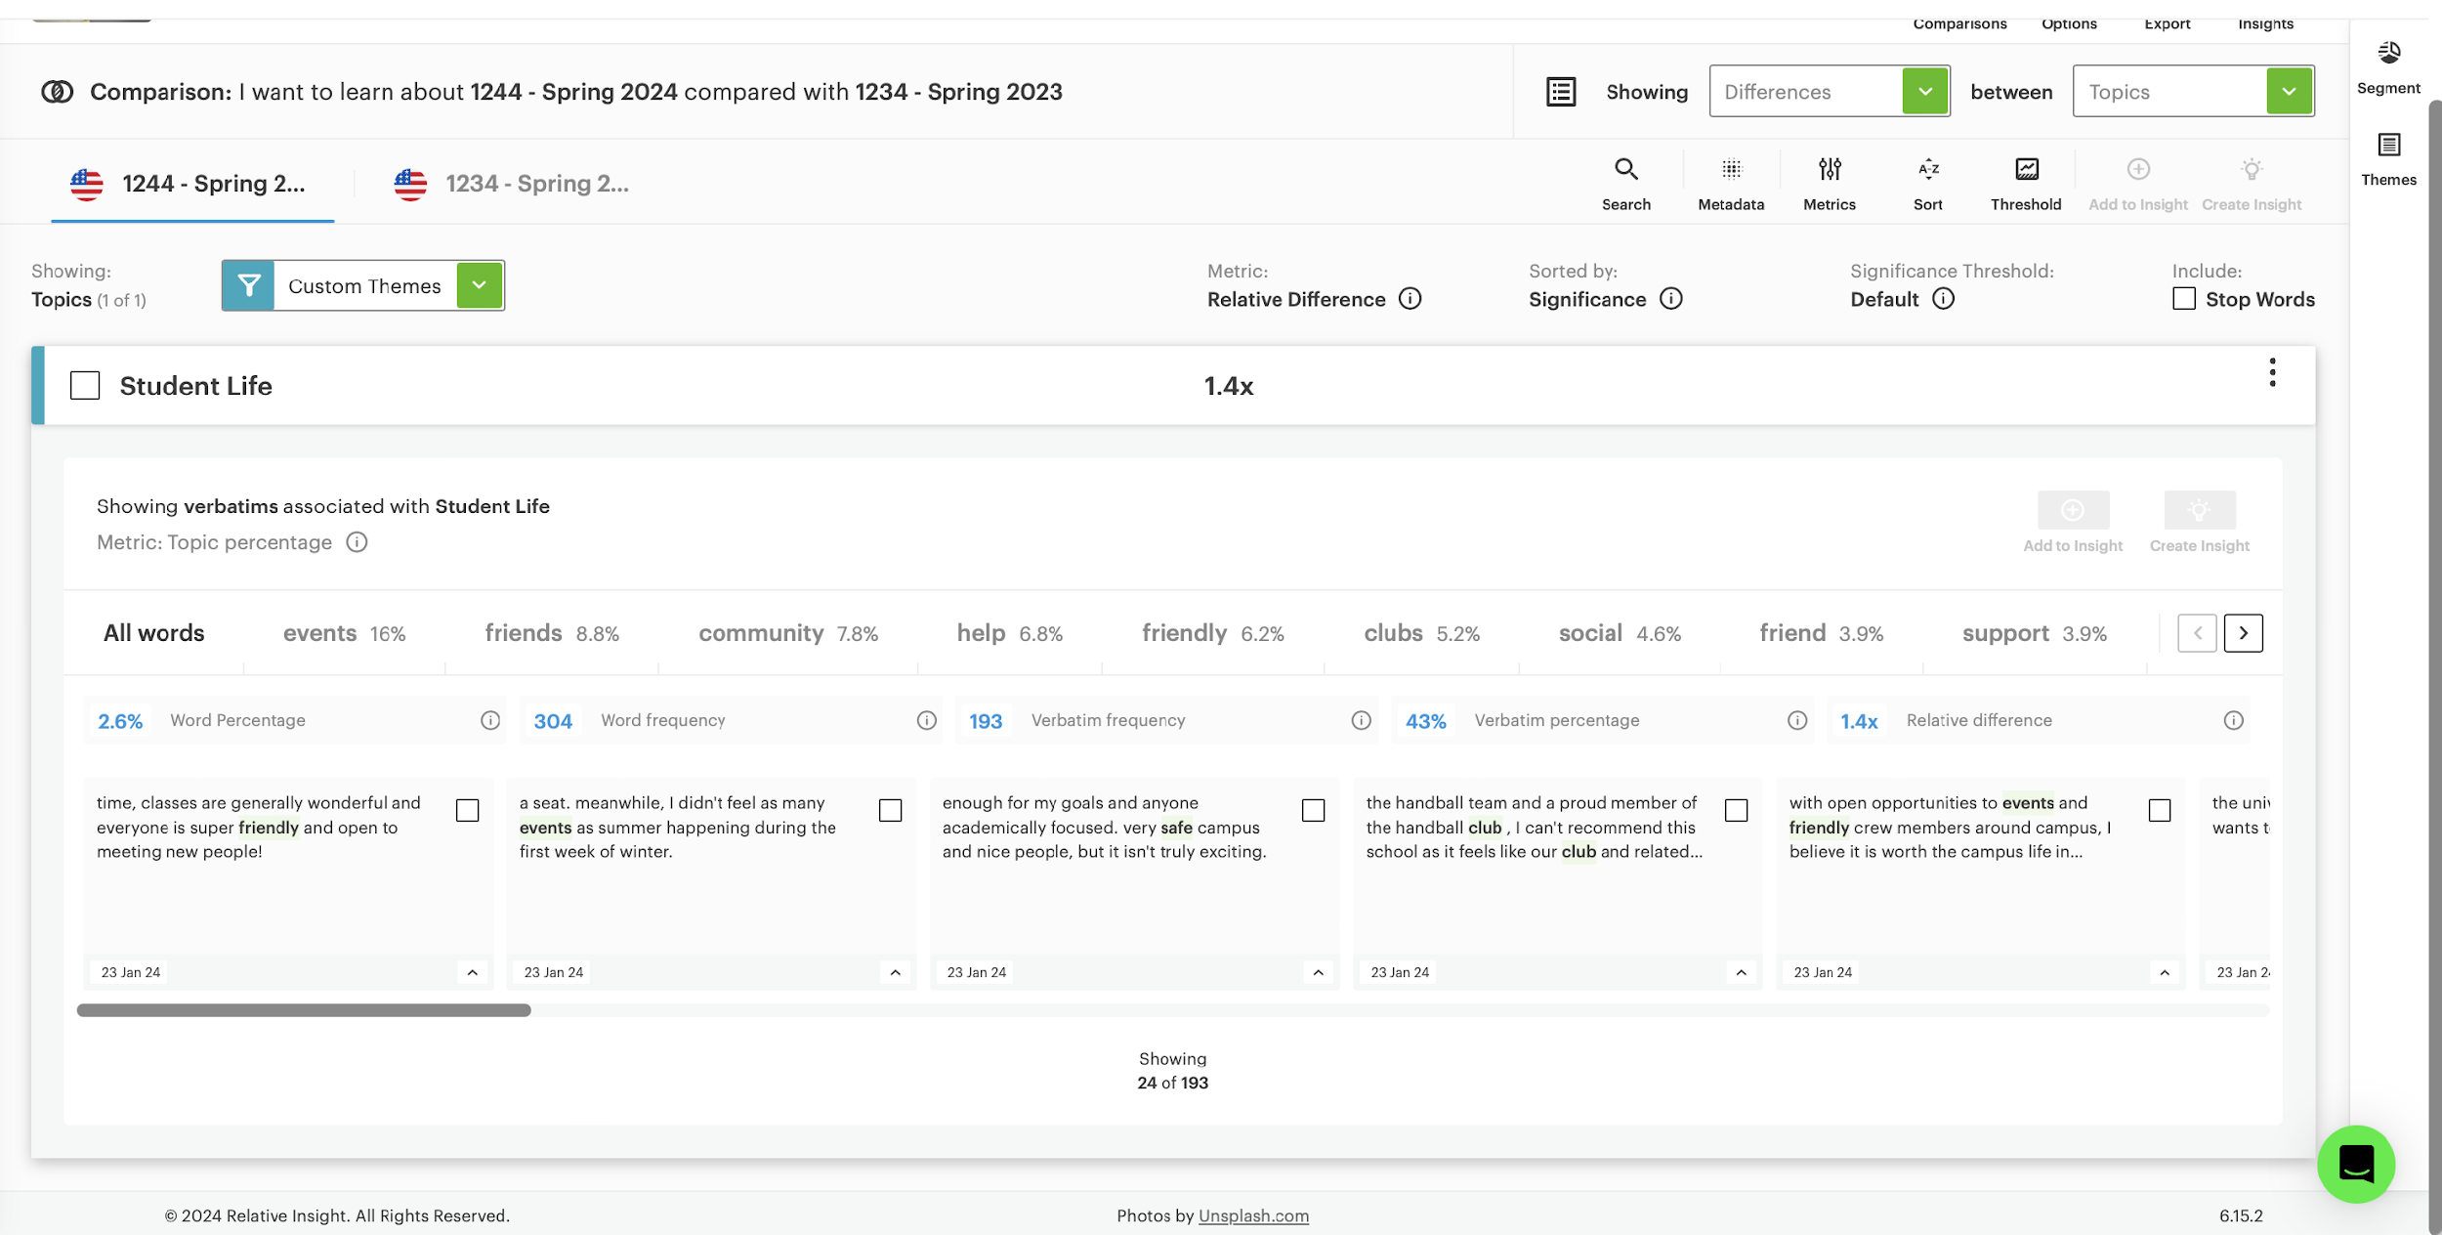
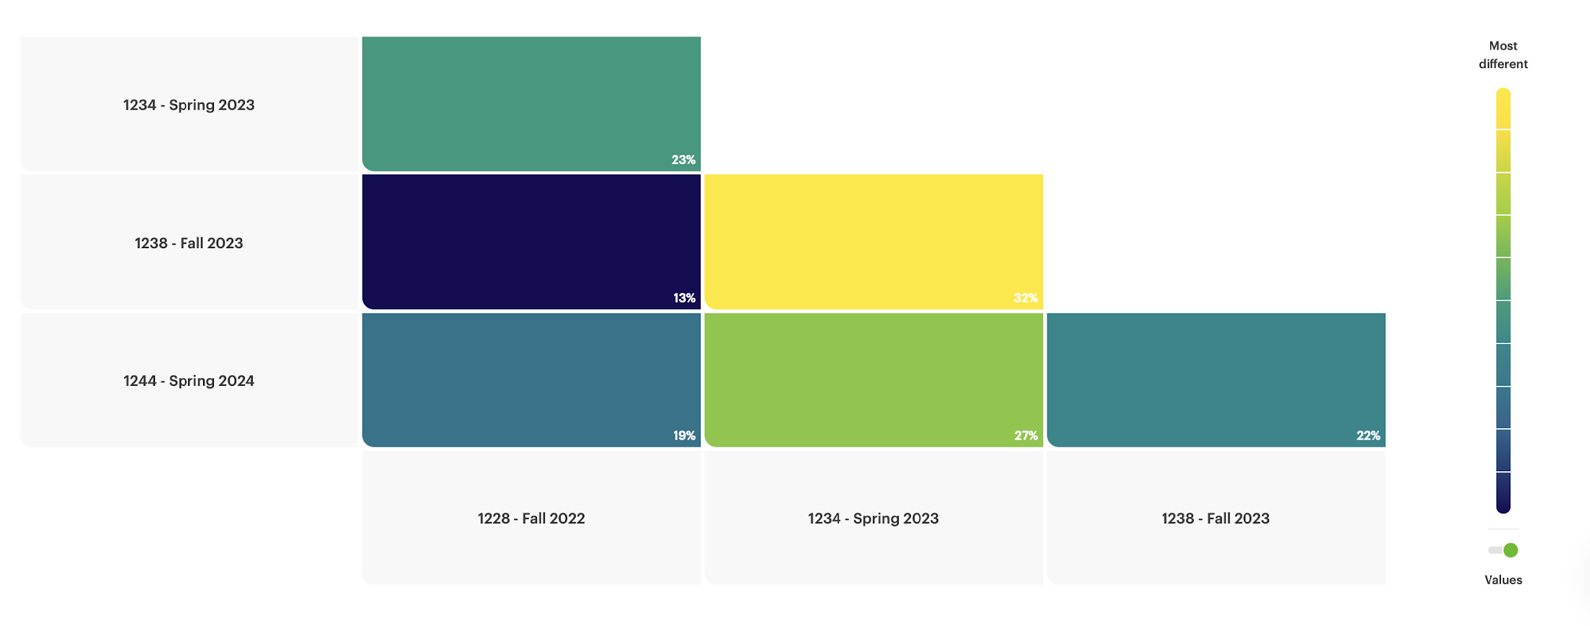
AI Tools - Coding Across Time
Results generated by Relative Insight Explore and Heartbeat (powered by ML)
Notes:
AB

Slide 19
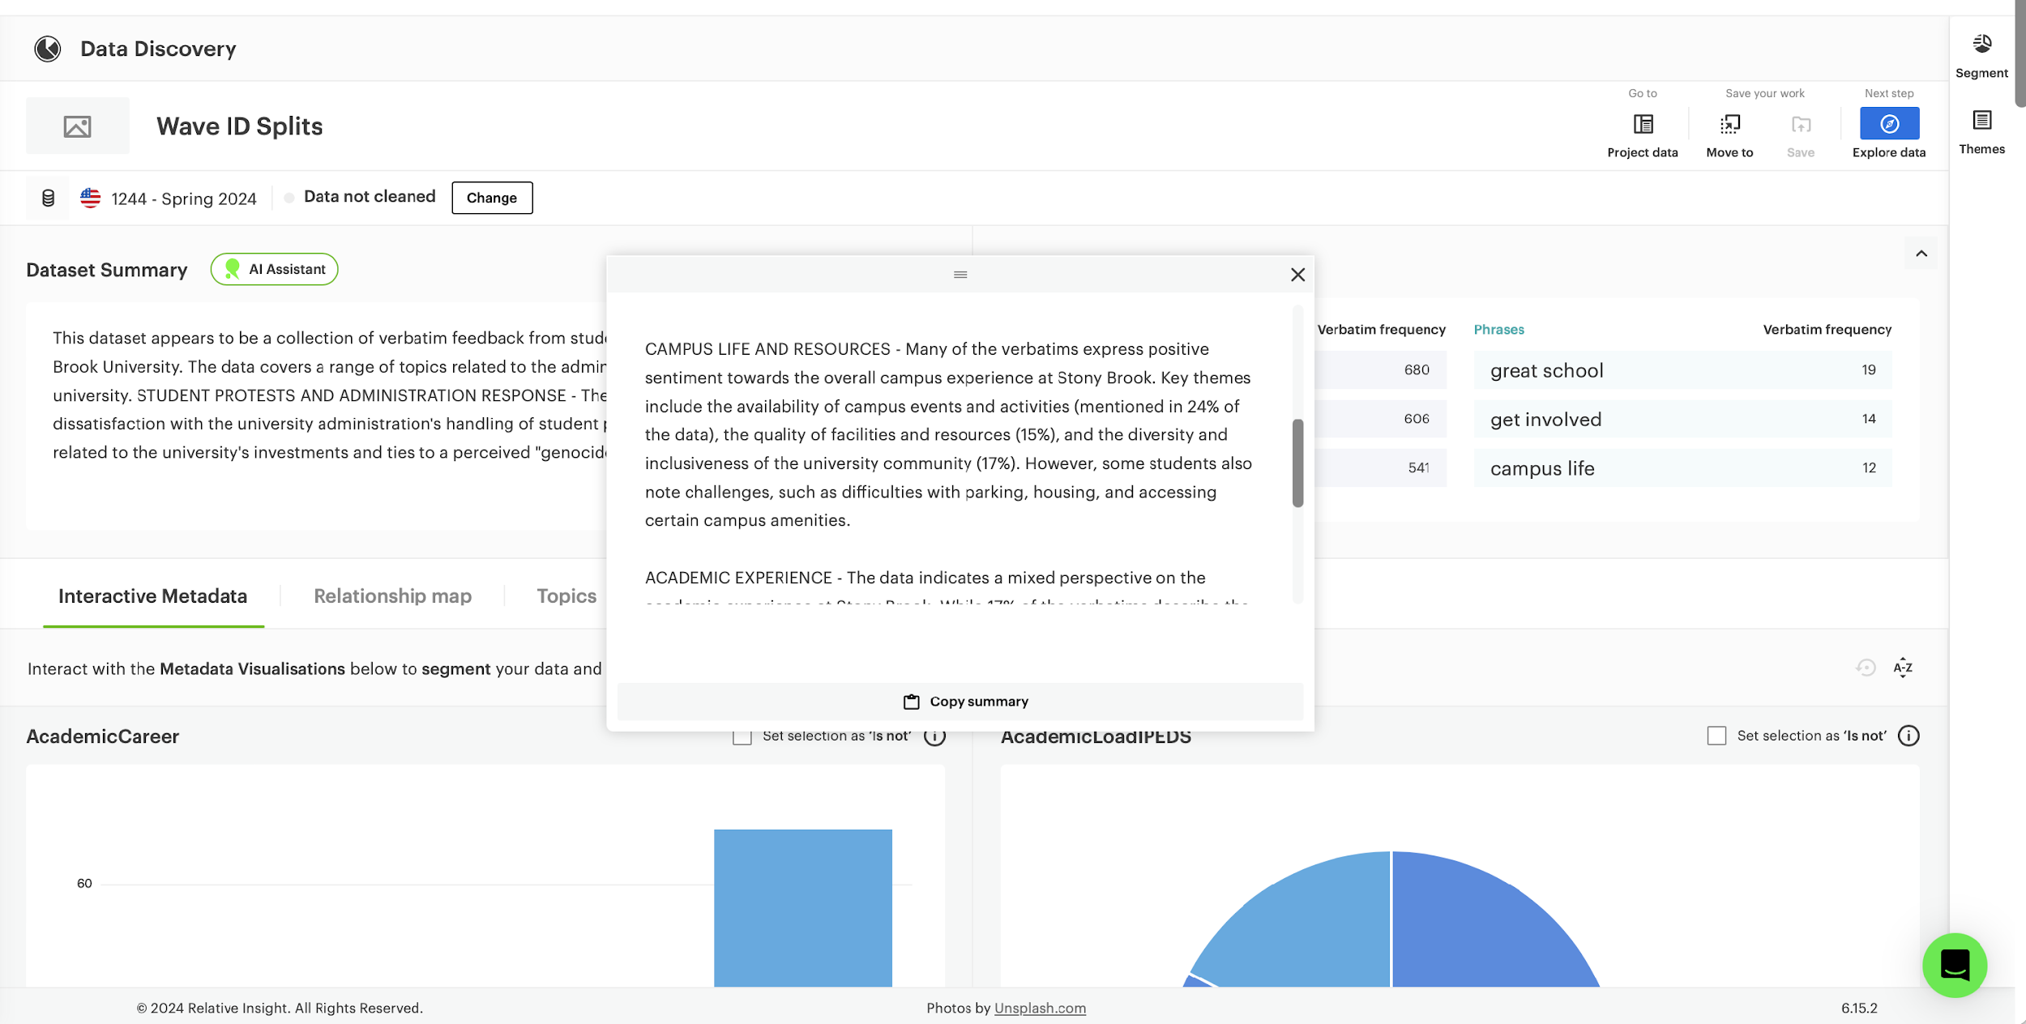
AI Tools - Abstractive Summarization
CAMPUS LIFE AND RESOURCES - Many of the verbatims express positive sentiment towards the overall campus experience at Stony Brook. Key themes include the availability of campus events and activities (mentioned in 24% of the data), the quality of facilities and resources (15%), and the diversity and inclusiveness of the university community (17%). However, some students also note challenges, such as difficulties with parking, housing, and accessing certain campus amenities.
ACADEMIC EXPERIENCE - The data indicates a mixed perspective on the academic experience at Stony Brook. While 17% of the verbatims describe the education and professors as "great," some students express concerns about the quality of instruction, lack of engagement from faculty, and difficulties with course registration and advising. There is also a sentiment that the academic workload can be demanding, especially towards the end of the semester.
In conclusion, this dataset provides a nuanced view of the student experience at Stony Brook University. While the campus is generally viewed positively in terms of its resources, community, and academic offerings, the data highlights significant concerns around the administration's handling of student activism and a perceived lack of responsiveness to student needs and concerns.
This dataset appears to be a collection of verbatim feedback from students about their experiences at Stony Brook University. The data covers a range of topics related to the administration and operations of the university.
STUDENT PROTESTS AND ADMINISTRATION RESPONSE - The data indicates significant student dissatisfaction with the [university administration]. Several verbatims describe instances of peaceful student demonstrations being met with excessive police force and unlawful arrests, with the administration allegedly siding with law enforcement over students. The data suggests a lack of responsiveness and transparency from administrators, with students feeling their voices are not being heard.
Results generated by Relative Insight Explore and Heartbeat (powered by ML)
Notes:
AB

Slide 20
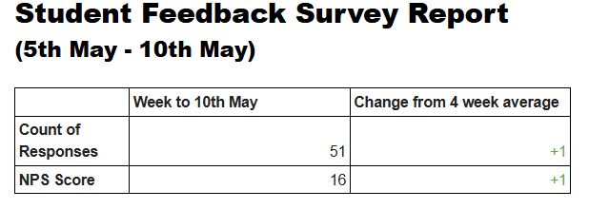
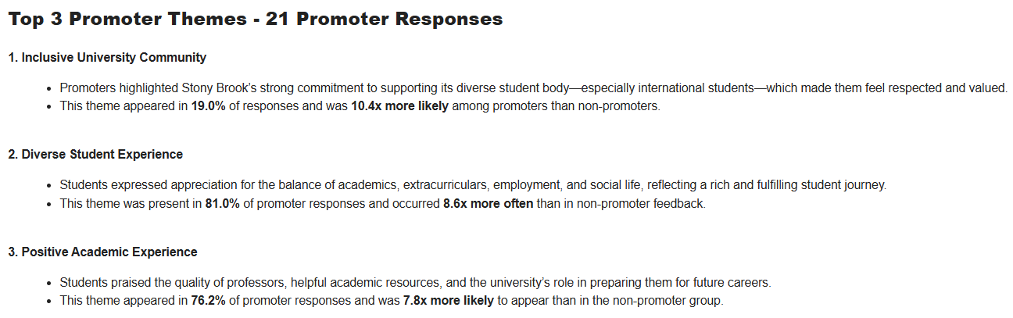
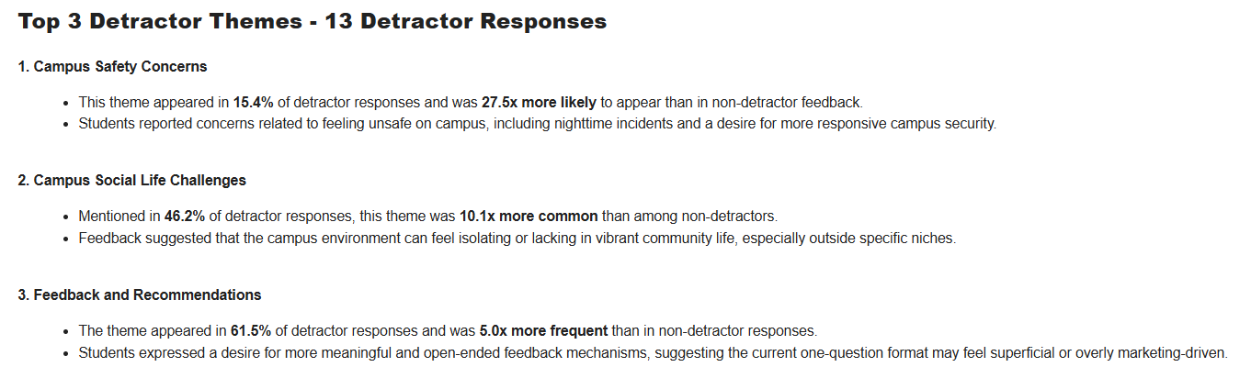
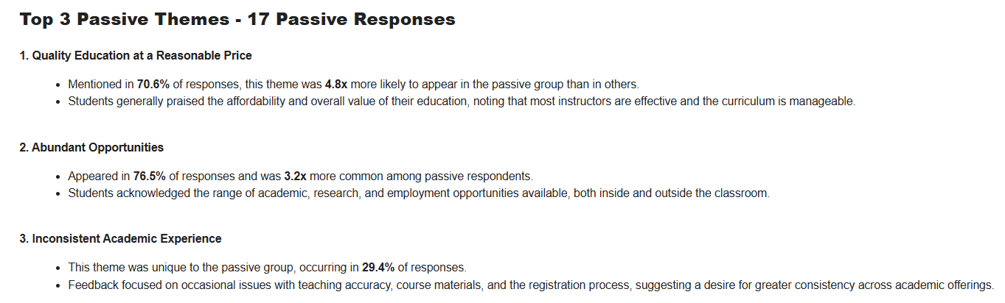
General Summary: Updated
Notes:
SK

Slide 21
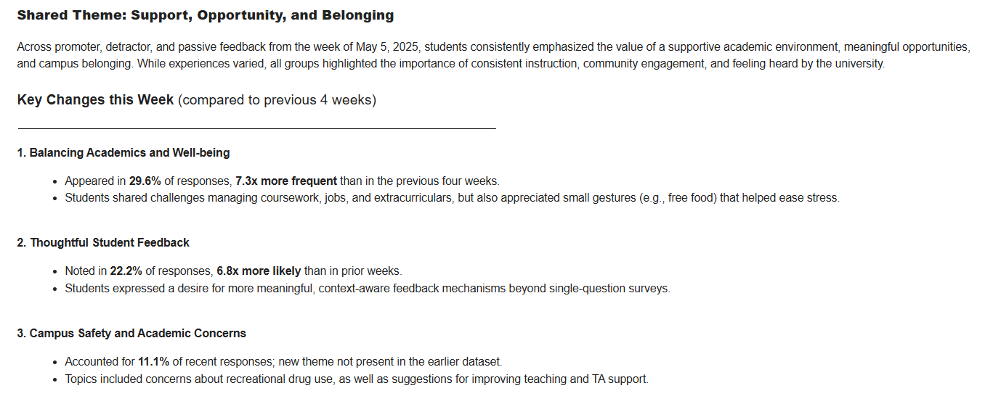
General Summary: Updated
Notes:
SK

Slide 22
AI Tools Comparison
Chat GPT
Gemini
A
B
Support natural language understanding and can assist with thematic analysis.
Capable of generally summarizing qualitative data, identifying patterns, and generating codebooks with prompts.
Good at interactive refinement: users can iteratively refine codes through dialogue.
Flexible qualitative analysis using conversation.
Integrates well with coding logic and pattern detection.
Thematic exploration
Contextual awareness in document threads.
Good for multi-document coding in Google Workspace.
Good at synthesizing across documents in GWorkspace.
Helpful for context-rich summaries.
Strength in Google ecosystem integration (e.g., Gemini can use Google Docs, NotebookLM is built for it), which facilitates annotated qualitative review.
A
-Initial open coding
-Drafting memos -Synthesizing themes
-Organizing codes
D
B
D
NotebookLM
C
Effective in guiding coding schemes and applying them to bulk text.
Can help generate macros, regex, or automation tools for coding at scale.
ChatGPT (via code interpreter) and Copilot (inside MS apps) both support semi-automated tagging.
Copilot
In-app document manipulation (e.g., tagging codes in Word or Excel), especially for enterprise teams.
Closed loop.
C
Anchoring qualitative insights to specific citations or sources, which is crucial for academic rigor.
More consistent sentiment coding
Strong on document structuring, tagging, and commenting.
Good for organizing qualitative datasets, especially within structured environments (e.g., Microsoft Word with Copilot, Google Docs with NotebookLM).
Notes:
SK

Slide 23
 | Pros | Cons
ChatGPT | Conversational refinement: “Does this quote fit the theme of resilience?” Flexible coding logic: Supports development of codebooks, categories, and rules for inclusion/exclusion. Bulk text analysis: Handles long interview transcripts, breaks them into themes, and suggests analytical memos. Custom workflows: “Organize these themes hierarchically.” | No document memory: Doesn't retain state between long uploads unless using advanced modes (e.g., Code Interpreter or file uploads). Limited document anchoring: Doesn’t automatically reference source files (like NotebookLM). Output may need manual verification: Especially when applying codes across large sets of text.
CoPilot | In-app tagging and automation: Works in Word and Excel to insert, tag, and highlight text segments with specific codes. Powerful in structured data: Can apply qualitative codes across surveys, interview matrices, etc., using formulas or macros. Integration with Teams/SharePoint: Great for collaborative coding in enterprise or institutional settings. Actionable summaries: Generates theme summaries alongside the original document. | Limited creativity: Copilot follows a more conservative logic, which is great for compliance but less helpful in open exploratory coding. Requires Microsoft ecosystem: Only works fully in 365 apps, limiting portability. Doesn’t infer nuance well: May struggle with interpreting subtle emotional or sociocultural cues.
Gemini | Google Docs integration: Can analyze directly inside your docs (especially Gemini for Workspace). Contextual memory: Keeps better in-document memory than ChatGPT, which helps with continuity across coding sessions. Semantic tagging: Strong at understanding implicit themes (e.g., detecting “power dynamics” even if not explicitly stated). Voice of the participant: Preserves narrative tone well during synthesis. | Limited cross-document synthesis: Unlike NotebookLM, it can struggle to consolidate findings across files. Prompt sensitivity: Requires well-structured prompts; unclear instructions can lead to generic or shallow output. Fewer bulk tools: Not as efficient for applying codes across massive datasets.
NotebookLM | Deep linking to sources: Every insight is anchored to the original document; perfect for ensuring traceability in research. Cross-document synthesis: Can analyze multiple qualitative data sources (e.g., focus group transcripts, memos) in tandem. Codebook development: You can upload a working codebook and use it as a reference lens for subsequent analysis. Memory-based learning: Learns from uploaded documents and maintains a running knowledge base. | Narrow interface: Less dynamic than a conversational tool; works best when the user is highly structured. Limited spontaneous interaction: Doesn’t allow for iterative back-and-forth questioning like ChatGPT. No live editing: Outputs need to be copied back into your original documents.
Notes:
SK

Slide 24
Using AI to Create a Strategic Summary
269 student comments related to parking, residence halls, and faculty
Prompts (Sample of prompts used)
  “As a qualitative researcher review the attached document and identify comments related to parking”
  “Review the excel file and create a table that shows each comment and identify comments related to parking (line item)”
  “Create a table listing every comment and highlighting if it is related to parking (line item)”
  “As a qualitative researcher I would like a summary of student comments in the attached file. Base the summary on frequency and strength of language.”
Notes:
RM
Interested in parking but was curious to see how the tool would address non parking comments
comments were previously coded by staff
Highlight importance of prompts
Attempted to create a general overview of responses
Asked tool to flag line item comments (unpack longer comments)

Slide 25
First Attempt at Using AI to Create a Strategic Summary
CoPilot
Notebook LM
Less robust summary of comments related to parking than Notebook LM. Provided simple lists when asked for more of a narrative.
Missed a significant number of comments when asked for line item identification.
Better job at flagging each individual comment.
Created a more nuanced and descriptive summary.
Segmented longer, multi focused comments and identified parking issues that were embedded in the comments.
Better at identifying student sentiment in terms of language.
Notes:
RM

Slide 26
Initial Thoughts of Using AI
Be cautious of aesthetically appealing outputs - they can be misleading in their perceived accuracy
The initial summary did not align with stakeholder expectations shaped by daily exposure to individual comments
The summary emphasized critical feedback, which may have overshadowed positive sentiment
  Strong language in negative comments had a disproportionate influence on the model’s tone and framing.
Notes:
RM

Slide 27
AI Tools: Key Considerations
Privacy & Confidentiality
Strip raw, identifiable data before using AI tools.
Understand how data is stored and used (e.g., CoPilot is closed-loop vs. public LLMs that may learn from your data).
Know if your data is used to train the model.
Notes:
RM - ALL PLAY
Never input raw, sensitive, or identifiable data into AI tools. Make sure to strip personal info first.
Understand how your AI platform stores and uses data
For example, CoPilot is closed-loop vs. public LLMs that may learn from your data.
Know whether your data is being used for training or model improvement.Check system policies.
ChatGPT free version learns from your questions and responses, but the paid version does not.

Slide 28
AI Tools: Key Considerations
Equity & Bias
AI may overlook underrepresented voices or reinforce dominant ones.
Stronger language may skew results toward negative responses.
Ask: Whose voices are being grouped or erased? What perspectives are missing?
Notes:
SK - ALL PLAY

Slide 29
AI Tools: Key Considerations
Interpretation Limitations
AI may miss tone, context, and cultural nuance.
Provides surface-level themes - human review is essential.
Avoid oversimplifying complex sentiments.
Notes:
SK - ALL PLAY

Slide 30
AI Tools: Key Considerations
Source Integrity & Prompting
Unclear prompts can lead AI to pull from unintended sources.
Be specific and consistent - track when & how you phrase prompts.
Results may vary with phrasing - replication is difficult.
Notes:
AB - ALL PLAY

Slide 31
AI Tools: Key Considerations
Human Expertise Leads - AI Facilitates
AI is a support tool, not a substitute for professional judgment.
Analysts guide stakeholders in understanding what they’re really trying to measure.
AI can find patterns, but analysts find meaning.
Notes:
ALL PLAY

Slide 32




Thank you!
Let’s stay connected!
Ahmed Belazi
Executive Director of Strategic Analytics & Technologies,
Division of Student Affairs
ahmed.w.belazi@stonybrook.edu
Robert Miller
Director of Institutional Research, Planning, and Effectiveness,
Division of Educational & Institutional Effectiveness
robert.l.miller@stonybrook.edu

