Slide 1
FINANCIAL AID 101 | Undergraduate Students | Spring 2021
Health Sciences Office of Student Services
Office of Financial Aid and Scholarship Services

Slide 2
WHAT WE WILL COVER
Applying for Financial Aid
  State/Federal
Dependency Status
Special Circumstances
Types of Federal Aid
Types of State Aid
SOLAR To-Do Items
How to Accept/Decline Financial Aid
Anticipated Aid
Things to Keep in Mind
Disbursement
Billing
Withdrawals
Upcoming Events

Slide 3
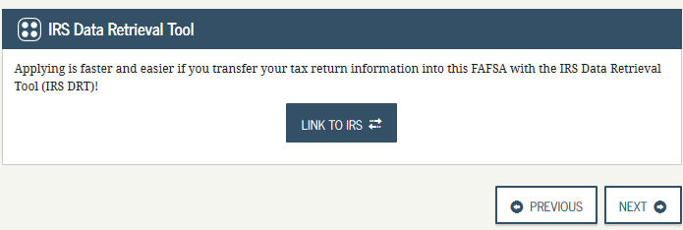
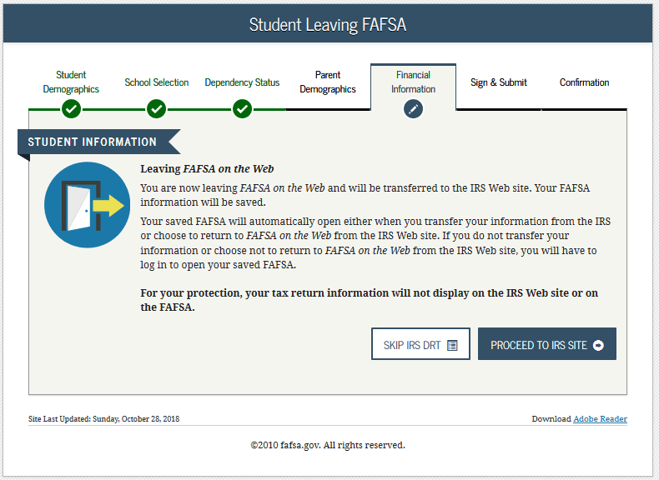
APPLYING FOR FINANCIAL AID
–FEDERAL AID–
To apply for federal aid, student’s must fill out the Free Application of Federal Student Aid (FAFSA) at fafsa.ed.gov
  Federal Loans
  PELL Grant
The FAFSA is available to fill out for the following year on October 1st
Always uses tax information from two years prior
  Ex. 2021-2022 FAFSA uses 2019 Tax Return
When filling out income portion of FAFSA, if given the option to use the Data Retrieval Tool, you should import all income information from IRS website
  Stony Brook school code on FAFSA: 002838

Slide 4
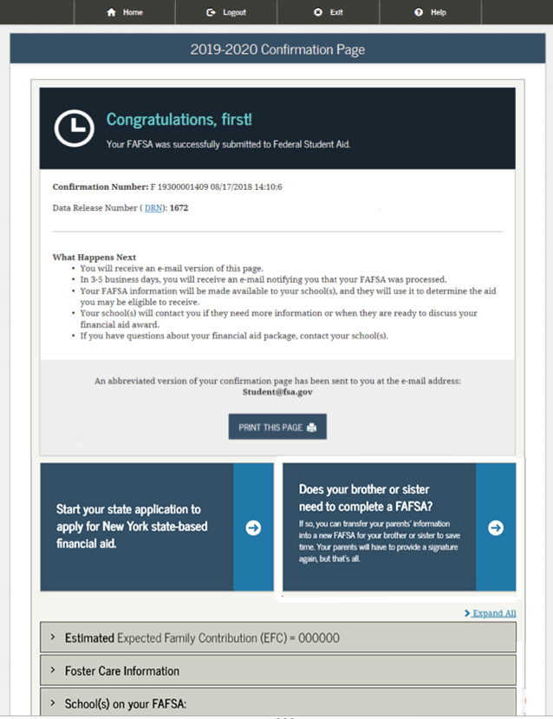
APPLYING FOR FINANCIAL AID
–STATE AID–
Applying for NYS aid requires a separate application from the FAFSA
Students can apply for NYS aid on HESC.NY.GOV
  Tuition Assistance Program (TAP)
  Excelsior
  Dream Act
NYS applications also use income information from 2 years prior
  NYS Tax Return (IT-201)
Can link data from FAFSA to HESC site on confirmation page when submitting FAFSA, otherwise you must wait 3 days for FAFSA to process before beginning a NYS aid application on HESC
Take note of EFC created from FAFSA
Stony Brook TAP code: 0875

Slide 5

INDEPENDENT VS. DEPENDENT
—FEDERAL AID—
—NYS AID—
Dependent: If student is under 24 and does not meet special circumstances, they must add parent’s income information
Independent: If student is 24 or older, they are considered independent and therefore do not have to include parent’s income
If student is over 22 but still lives with parents, they must include their parent’s income information on their application until they are 36
If you’re not sure whom to report as a parent, you can visit StudentAid.ed.gov/apply-for-aid/fafsa/filling-out/parent-info or call 800-4-FED-AID (800-433-3243).

Slide 6
SPECIAL CIRCUMSTANCES
—BEFORE FILING THE FAFSA—
—AFTER FILING THE FAFSA—
Students under 24 may be considered independent if they meet one or more of the following criteria:
    Unable to provide parental information
    Married
    Have dependents
    Ward of the court/Foster Care
    Veterans
    Homeless/at risk of being homeless
Once student submits the FAFSA after indicating there is a special circumstance, the school will contact them asking for additional information in order to determine their federal aid eligibility
If you have had changes in your financial situation after filing the FAFSA, you should contact your financial aid office about a ‘request for a re-evaluation’.
    Re-evaluation and appropriate supporting documentation will be reviewed by an advisor
  Examples of a change in financial circumstance include but are not limited to:
    Unemployment
    Disability
    Retirement
    Death
    Divorce/Separation
    Reduced Hours of work
If you’re not sure whom to report as a parent, you can visit StudentAid.ed.gov/apply-for-aid/fafsa/filling-out/parent-info or call 800-4-FED-AID (800-433-3243).

Slide 7
– TYPES OF FEDERAL AID –
GRANTS & SELF-HELP
TYPE | CAREER | ELIGIBILITY | TERMS | AMOUNT
Federal PELL Grant | Undergraduate | If EFC is under $5,500, student is eligible for PELL Students can receive PELL for 12 semesters Only available for students earning their first Bachelor’s degree | Grant that does not have to be repaid | PELL amounts can change annually. Current award amount for full year is $6,345
FSEOG | Undergraduate | Must demonstrate exceptional financial need PELL Grant recipients are given priority | Grant that does not have to be repaid | Award amount will vary depending upon the school
Federal Work-Study | Undergraduate/ Graduate NOTE: Undergraduate students given priority | Students earn money working part-time jobs on campus Work-study Award/Eligibility depends on: When you complete your FAFSA Level of financial need School’s funding level Must indicate you would like to be considered on FAFSA | Money is earned through a job and does not have to be repaid | Award amount will vary

Slide 8
– TYPES OF FEDERAL AID –
FEDERAL LOANS
TYPE | CAREER | ELIGIBILITY | TERMS | AMOUNT
Subsidized Loans | Undergraduate | Government pays interest while student is in school Must demonstrate financial need Must be enrolled in at least 6 credits Interest rates may vary each year Current interest rate = 2.75% | Loan that must be repaid with interest | Student may receive up to $5,500 depending on grade level and dependency status
Unsubsidized Loan | Undergraduate/ Graduate or professional students | Interest begins to accrue at the time of disbursement Interest rates may change every year and will differ for undergraduate/graduate unsubsidized loans Current interest rate = 2.75% | Loan that must be repaid with interest | Undergraduate: Up to $7,500 depending on grade level and dependency status Graduate: Up to $20,500
PLUS Loan | For parents of dependent undergraduate students Graduate or professional students | Borrower is responsible for interest during all periods; a student must be enrolled at least half-time; financial need is not required Interest rates for new Direct PLUS Loans can change every year. Current interest rate = 5.3% | Loan that must be repaid with interest Borrower must not have an adverse credit history. | Maximum amount is the cost of attendance minus any other financial aid received

Slide 9
TYPES OF STATE AID
TYPE | CAREER | ELIGIBILITY | TERMS | AMOUNT
TAP | Undergraduate | Must be a NYS resident and have resided in NYS for 12 continuous months Must be enrolled and attending as a full-time student of 12 or more degree applicable credits per semester Must meet income criteria All eligibility criteria can be found on HESC.NY.GOV | Students can receive TAP for 4 years or 48 points Full time semester is considered 6 points while a part-time semester is 3 NOTE: EOP students can receive TAP for five years | Award can be up to $5,165 per year
Aid for Part Time Study (APTS) | Undergraduate | Provides grant assistance for NYS residents who meet income criteria but are enrolled in less than 12 credits To apply for APTS, you can complete and submit the form to your financial aid office. | Students can receive TAP for 4 years or 48 points Full time semester is considered 6 points while a part-time semester is 3 | 1-3 credits = $800 per semester 4-11 credits = $1,000 per semester
Excelsior | Undergraduate | Must be a NYS resident and have resided in NYS for 12 continuous months prior to the beginning of the term Family adjust gross income cannot exceed $125,000 Must be enrolled and attending as a full-time student of 12 or more degree applicable credits per semester All eligibility criteria can be found on HESC.NY.GOV | Must sign a contract agreeing to reside in NYS for the length of the time the award was received and be employed in NYS Students can receive Excelsior for up to 4 years in an undergraduate program leading to a Bachelor’s degree | Fall/spring award only Max term award (Excelsior + Excelsior tuition credit combined) = $3235 (based on 2016/2017 full-time SUNY tuition rate) Combined award calculated by subtracting all grants and scholarships eligible to pay tuition for the term from $3235. If difference = $0, no $ awarded.
NYS Dream Act | Undergraduate | Gives undocumented students access to NYS administrated grants and scholarships—including TAP and Excelsior All eligibility criteria can be found on HESC.NY.GOV | Length of award eligibility will vary depending on grant/scholarship | TAP: Up to $5,165 per year Excelsior: Up to $5,500 per year
Additional NYS scholarships can be found on HESC.NY.GOV

Slide 10
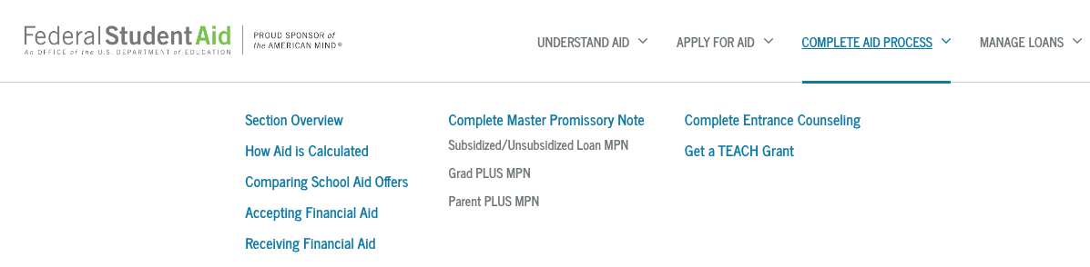
SOLAR TO-DO ITEMS
PAY ATTENTION TO SOLAR!
On SOLAR, students will see financial aid checklists or ‘to-do’ items when there is action for them to take
  If selected for verification, student will be asked to submit documentation in order to receive a financial aid package
  All documents should be uploaded through SOLAR
Examples may include: Tax returns, Verification forms, HS Diplomas, Proof of Citizenship
In order for loans to disburse, students will need to complete entrance counseling and master promissory note (MPN) on studentaid.gov

Slide 13
PLEASE NOTE: If you do not want to accept the full amount offered to you, once you press accept on the checkbox, you will then be able to delete the amount in the ‘Accepted’ box and re-enter the amount you would like. Then press submit.

Slide 14
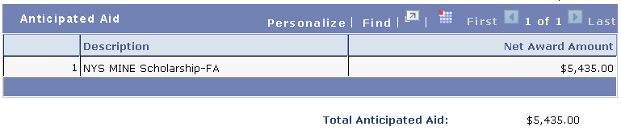

ACCEPTING AID
Once a financial aid award has been accepted, it immediately applies towards your bill as "anticipated aid”
  Anticipated Aid: Awards that you’ve accepted as part of your financial aid package and will apply to your bill to show how much you will need to pay after your anticipated aid is applied.
  Some awards will not show as anticipated aid either because they do not disburse to your student account or do not impact your balance owed
    Examples include:
      Award Estimates (TAP estimate)
      Book Stipends
      Federal Work Study
Grants and Scholarships are automatically accepted on your behalf as it is free money
If enrolled for Summer, loans may be offered. Be mindful of what you accept for summer as this can affect the amount of loans available for Fall and Spring.
EXAMPLE (Dependent Student in Junior Year): Offered $7,500 in federal loans for Summer and you accept $3,000, you will be offered $4,500 in federal loans for Fall/Spring as the annual limit for federal loans for a dependent student is $7,000.
Fall/Spring awards are always split evenly.
Prior to loans disbursing, students can modify amount accepted on SOLAR. After disbursement, please contact your Financial Aid office to make the change on your behalf

Slide 15

ACCEPTING AID
If your anticipated financial aid exceeds your charges, you will be issued a refund when your aid has been applied as a payment to your University Account
  Checks are mailed out every two weeks to home address
  We strongly encourage you to enroll in direct deposit on SOLAR to receive your refund quickest!
      SOLAR > Campus Financial Services > Enroll in Direct Deposit
Students who want to cover the exact cost of their bill should factor the origination fee into the amount accepted
EXAMPLE
Origination Fee = 1.059%
Bill = $4,500
Amount Accepted (4,500 + 1.059% ) = $4,548

Slide 16
THINGS TO KEEP IN MIND
In order to continue receiving federal aid, students must maintain Satisfactory Academic Progress (SAP)
  GPA: Minimum GPA = 2.0
  PACE: Must earn 67% of the credits you attempt
  Time Frame: Must complete program within 150% of the credits required to complete degree
    Ex. Bachelor of Science– Requires 120 credits. (120 *1.5 = 180) Student must complete program within 180 credits
When a student with federal loans graduates, or falls below 6 credits, they have 6 months before they must begin making payments on their loans. This is known as the grace period
Create account on loan servicer’s website to view payment options and loan amounts.
  Federal Government offers multiple payment plans
  Don’t know who your lender is or how much federal loans you have out?
Visit nslds.ed.gov and log in with your FSA ID and password.
Can access lender information, loan amounts, interest accrued, etc.

Slide 17

OTHER WAYS TO PAY FOR BILL
Apply for a private loan
    A list of frequently used private lenders and eligibility criteria can be found on https://www.stonybrook.edu/commcms/finaid/undergraduate/types_of_aid/private_loans
Enroll in Time Option Payment Plan (TOPP)**
    Pay one-time fee of $50 each semester that you enroll
      2 Plan Options:
      3 months
        Fall Deadline: September 15th
        Spring Deadline: February 15th
      4 months
        Fall Deadline: August 15th
        Spring Deadline: January 15th
3 Month Example
Balance = $3,000
1st Month = $1,000
2nd Month = $1,000
3rd Month = $1,000
4 Month Example
Balance = $3,000
1st Month = $750
2nd Month = $750
3rd Month = $750
4th Month = $750
** Only available for Fall/Spring
Visit https://www.stonybrook.edu/commcms/sfs/billing_payment/topp.php for more information

Slide 18

BILLING
Your University Student Account is maintained by Student Financial Services
All students will receive a SOLAR hold until they complete and submit the ‘Financial Responsibility statement'
Bills are typically due on the 15th of the month of the semester you are starting
Late fees are charged continuously for each subsequent month that there is an outstanding balance
Health Insurance billed for all full-time students. Students who have their own coverage are given two weeks to waive SBU’s Health Insurance on SOLAR
In state vs. Out of State Tuition: All residency questions should be directed to Student Accounts
Winter/Summer classes are billed at a per credit cost. For Fall/Spring, undergraduate students are considered “full time” at 12 credits
PLEASE NOTE:
      Certain programs have different fees and charges
      Health Sciences Students in modular sessions may have different disbursement dates
Please visit http://stonybrook.edu/sfs for specific billing information and due dates

Slide 19
DISBURSEMENT
All accepted financial aid will be reflected on the bill as “anticipated aid” until an award disburses
PELL, Federal Loans, and FSEOG will typically disburse 5 days prior to the start of the semester
Any aid that does not disburse prior to classes starting will be subject to confirmation of attendance from professors
TAP awards will not disburse until after the student is certified by the Registrar’s Office
  Certification does not begin until after Add/Drop for that semester
  For Health Science students in modular sessions, certification will not occur until the student is enrolled and attending 12 credits. This means that if a student is expecting a refund from their TAP award, it will not be issued until that point in the semester.
Refunds will be only be issued at the point when disbursed aid exceeds the cost of the bill

Slide 20
WITHDRAWALS
Withdrawing from classes may affect your bill and financial aid!!
Liability Period | Tuition Liability | Tuition Refund | Fees Refunded
Week 1 | 0% | 100% | 100%
Week 2 | 30% | 70% | 0%
Week 3 | 50% | 50% | 0%
Week 4 | 70% | 30% | 0%
Week 5 | 100% | 0% | 0%
If you withdraw from the University, your financial aid will be reviewed to calculate the percentage of aid that was earned based on the withdrawal date, which may result in money being owed to the university!!
HEALTH SCIENCES STUDENTS IN MODULAR SESSIONS: When a student withdraws, the percentage of financial aid earned for students enrolled in modular sessions is calculated differently than it is for students enrolled in traditional Fall/Spring terms. Be especially mindful if withdrawing from a modular session!!
** The information on this slide is subject to change. Please visit https://www.stonybrook.edu/commcms/sfs/withdrawals/index.php for up-to-date withdrawal information.

Slide 21
COVID-19
As per federal legislation, all federal loan payments and interest accrual has been suspended until September 30, 2021
All federal loans have had an “administrative forbearance” automatically applied to them
0% interest rate on federal loans until September 30, 2021
While payments are not required during this time period, borrowers can still make loan payments if they wish
Administrative forbearance will not affect progress towards Public Service Loan Forgiveness (PSLF)
PLEASE NOTE: If you are graduating early due to COVID-19, your grace period will begin on the day you graduate, therefore, you will enter repayment 6 months from that date.
If you have any questions regarding the suspension of loan payments or interest accrual, you should contact your federal loan servicer

Slide 22




UPCOMING EVENTS!
Stony Brook University offers multiple events throughout the year to keep students informed on responsible borrowing. Events include, but are not limited to:
  Loan Repayment Workshops
  Money Smart Seawolves
  Game of Life
  Financial Aid 101 Workshops
  … and more!
How will I find out which events are coming up?
  Visit stonybrook.edu/commcms/money
  Emails
  Flyers
  Social Media
@SBUFinancialAid
@SavvySeawolf
@Savvyseawolf
@SBU Financial Aid

Slide 23
THANK YOU!
Health Sciences Office of Student Services
Health Sciences Tower, Level 2, Room 271
Stony Brook, NY, 11794-8276
hsstudentservices@stonybrook.edu
www.stonybrook.edu/hsstudents
P: (631) 444-1866
F: (631) 444-6035
Office of Financial Aid & Scholarship Services
Administration Building, Room 180
Stony Brook, NY, 11794-0851
finaid@stonybrook.edu
www.stonybrook.edu/finaid
P: (631) 632-6840
F: (631) 632-9525
PLEASE PROVIDE YOUR FEEDBACK:
https://rb.gy/gbnrfu

