Slide 1
Graduate Students| General Financial Aid Information
Presented by the Health Sciences Office of Student Services

Slide 2
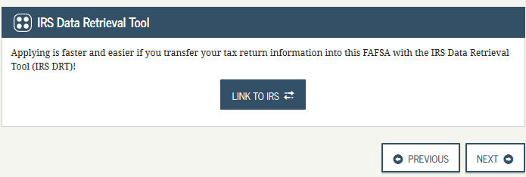
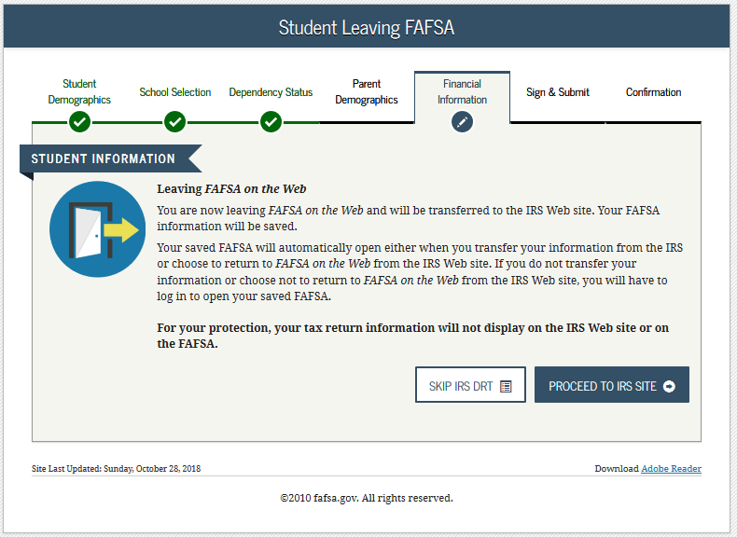
APPLYING FOR FINANCIAL AID
–FEDERAL AID–
To apply for federal aid, student’s must fill out the Free Application of Federal Student Aid (FAFSA) at fafsa.ed.gov
  Federal Loans Include:
    Unsubsidized Loan
    Graduate PLUS Loan
The FAFSA is available to fill out for the following year on October 1st
Always uses tax information from two years prior
  Ex. 2021-2022 FAFSA uses 2019 Tax Return
When filling out income portion of FAFSA, if given the option to use the Data Retrieval Tool, you should import all income information from IRS website
  Stony Brook school code on FAFSA: 002838

Slide 3
– TYPES OF FEDERAL AID –
FEDERAL LOANS
TYPE | ELIGIBILITY | TERMS | AMOUNT
Unsubsidized Loan | Must be enrolled in at least 6 credits Interest begins to accrue at the time of disbursement Interest rates may change every year and will differ for undergraduate/graduate unsubsidized loans Current interest rate = 4.3% | Loan that must be repaid with interest | Up to $20,500 per academic year
Graduate PLUS Loan | Must be enrolled in at least 6 credits Borrower is responsible for interest during all periods; a student must be enrolled at least half-time; financial need is not required Interest rates for new Direct PLUS Loans can change every year. Current interest rate = 5.3% | Loan that must be repaid with interest Borrower must not have an adverse credit history. | Maximum amount is the cost of attendance minus any other financial aid received

Slide 4
– HOW MUCH WILL I BE OFFERED IN FEDERAL LOANS? –
The amount of loans offered to graduate students is based on their Cost of Attendance
A Cost Of Attendance (COA) is an educational budget that is established for every student that includes expenses we believe you’ll have. Such expenses may include but are not limited to:
    Tuition/fees
    Housing (determined by housing selection chosen on the FAFSA)
    Food
    Transportation
    Personal Expenses
    Books
Your cost of attendance will always exceed the cost of your bill. If you choose to accept loans over the cost of your bill, the excess loan money will be issued to you as a refund after disbursement for you to use for living expenses you may have.
Two financial aid packages will be offered each year:
  Summer Package: Available in May
  Fall/Spring Package: Available in July
EXAMPLE
Summer COA = $12,000 Fall/Spring COA = $45,000
If, in the Summer, a student accepts $10,000 in the unsubsidized loan, that means that for Fall/Spring they will be offered the remaining $10,500 in the unsubsidized loan (Annual limit is $20,500) and the rest of the loans offered up to their cost of attendance will be offered in the Grad PLUS Loan (45,000 – 10,500) = $34,500.

Slide 5
— FEDERAL LOANS —
GRADUATE
 | Unsubsidized Loan | Grad PLUS Loan
Prior to 7/1/2021 | 4.3% | 5.3%
After 7/1/2021 | TBD | TBD
COVID-19
As per federal legislation passed on March 27, 2020, all federal loan payments and interest accrual has been suspended until September 30, 2021
All federal loans have had an “administrative forbearance” automatically applied to them
0% interest rate on federal loans until September 30, 2021
While payments are not required during this time period, borrowers can still make loan payments if they wish

Slide 6
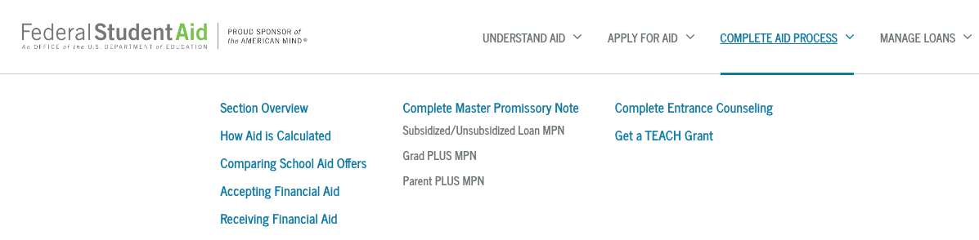
SOLAR TO-DO ITEMS
PAY ATTENTION TO SOLAR!
On SOLAR, students will see financial aid checklists or ‘to-do’ items when there is action for them to take
  If selected for verification, student will be asked to submit documentation in order to receive a financial aid package
  All documents should be uploaded through SOLAR
Examples may include: Tax returns, Verification forms, HS Diplomas, Proof of Citizenship
In order for loans to disburse, students will need to complete entrance counseling and master promissory note (MPN) on studentaid.gov

Slide 9
PLEASE NOTE: If you do not want to accept the full amount offered to you, once you press accept on the checkbox, you will then be able to delete the amount in the ‘Accepted’ box and re-enter the amount you would like. Then press submit.

Slide 10
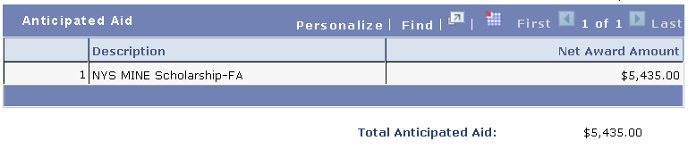

ACCEPTING AID
Once a financial aid award has been accepted, it immediately applies towards your bill as "anticipated aid”
  Anticipated Aid: Awards that you’ve accepted as part of your financial aid package and will apply to your bill to show how much you will need to pay after your anticipated aid is applied.
  Some awards will not show as anticipated aid either because they do not disburse to your student account or do not impact your balance owed
    Examples include:
      Book Stipends
      Federal Work Study
When enrolled in at least 6 credits in the Summer, loans will be offered if a valid FAFSA is on file. Be mindful of what you accept for summer as this will affect the amount of loans available for Fall and Spring.
EXAMPLE: If you are offered $12,500 for summer in the unsubsidized loan and you accept $8,000, you will be offered the remaining $12,500 for Fall/Spring in the unsubsidized loan as your annual limit is $20,500 per academic year.
PLEASE NOTE: Fall/Spring awards are always split evenly.
Prior to loans disbursing, students can modify amount accepted on SOLAR. After disbursement, please contact your Financial Aid office to make the change on your behalf

Slide 11

ACCEPTING AID
If your anticipated financial aid exceeds your charges, you will be issued a refund when your aid has been applied as a payment to your University Account
  Checks are mailed out every two weeks to home address
  We strongly encourage you to enroll in direct deposit on SOLAR to receive your refund quickest!
      SOLAR > Campus Financial Services > Enroll in Direct Deposit
Students who want to cover the exact cost of their bill should factor the origination fee into the amount accepted
  Origination fees change every October 1st
    Unsubsidized Loan— 1.059%
    Grad PLUS Loan – 4.236%
EXAMPLE
Origination Fee = 1.059%
Bill = $4,500
Amount Accepted (4,500 + 1.059% ) = $4,548

Slide 12
THINGS TO KEEP IN MIND
In order to continue receiving federal aid, students must maintain Satisfactory Academic Progress (SAP)
  GPA: Minimum GPA = 3.0
  PACE: Must earn 67% of the credits you attempt
  Time Frame: Must complete program within 150% of the credits required to complete degree
When a student with federal loans graduates, or falls below 6 credits, they have 6 months before they must begin making payments on their loans. This is known as the grace period
Create account on loan servicer’s website to view payment options and loan amounts.
  Federal Government offers multiple payment plans
  Don’t know who your lender is or how much federal loans you have out?
Visit www.studentaid.gov and log in with your FSA ID and password.
Can access lender information, loan amounts, interest accrued, etc.

Slide 13

OTHER WAYS TO PAY FOR BILL
Apply for a private loan
    A list of frequently used private lenders and eligibility criteria can be found on www.stonybrook.edu/commcms/finaid/undergraduate/types_of_aid/private_loans
Enroll in Time Option Payment Plan (TOPP)**
    Pay one-time fee of $50 each semester that you enroll
      2 Plan Options:
      3 months
        Fall Deadline: September 15th
        Spring Deadline: February 15th
      4 months
        Fall Deadline: August 15th
        Spring Deadline: January 15th
      Visit www.stonybrook.edu/commcms/sfs/billing_payment/topp.php for more information
Apply for scholarships
    To see what scholarships are available, please visit www.stonybrook.edu/commcms/hsstudents/financialaid/scholarships
3 Month Example
Balance = $3,000
1st Month = $1,000
2nd Month = $1,000
3rd Month = $1,000
4 Month Example
Balance = $3,000
1st Month = $750
2nd Month = $750
3rd Month = $750
4th Month = $750
** Only available for Fall/Spring

Slide 14

BILLING
Your University Student Account is maintained by Student Financial Services
All students will receive a SOLAR hold until they complete and submit the ‘Financial Responsibility statement'
Bills are typically due on the 15th of the month of the semester you are starting
Late fees are charged continuously for each subsequent month that there is an outstanding balance
Health Insurance billed for all full-time students. Students who have their own coverage are given two weeks to waive SBU’s Health Insurance on SOLAR
In state vs. Out of State Tuition: All residency questions should be directed to Student Accounts.
  Students who have lived in NYS for one year can submit a residency application to be considered for NYS tuition
Summer classes are billed at a per credit cost. Please visit https://www.stonybrook.edu/summer/tuition-and-aid for additional information on Summer tuition/fees
PLEASE NOTE:
Many of the health science programs have different fees and charges
Health Sciences Students in modular sessions may have different disbursement dates
Please visit stonybrook.edu/sfs for specific billing information and due dates

Slide 15
DISBURSEMENT
All accepted financial aid will be reflected on the bill as “anticipated aid” until an award disburses
Check SOLAR! To-do items can prevent disbursement
Federal loans will typically disburse 5 days prior to the start of the semester
Any aid that does not disburse prior to classes starting will be subject to confirmation of attendance from professors
Refunds will be only be issued at the point when disbursed aid exceeds the cost of the bill

Slide 16
WITHDRAWALS
Withdrawing from classes may affect your bill and financial aid!
Liability Period | Tuition Liability | Tuition Refund | Fees Refunded
Week 1 | 0% | 100% | 100%
Week 2 | 30% | 70% | 0%
Week 3 | 50% | 50% | 0%
Week 4 | 70% | 30% | 0%
Week 5 | 100% | 0% | 0%
If you withdraw from the University, your financial aid will be reviewed to calculate the percentage of aid that was earned based on the withdrawal date, which may result in money being owed to the university!
HEALTH SCIENCES STUDENTS IN MODULAR SESSIONS: When a student withdraws, the percentage of financial aid earned for students enrolled in modular sessions is calculated differently than it is for students enrolled in traditional Fall/Spring terms. Be especially mindful if withdrawing from a modular session!
** The information on this slide is subject to change. Please visit https://www.stonybrook.edu/commcms/sfs/withdrawals/index.php for up-to-date withdrawal information.

Slide 17
Additional Questions?
Feel free to contact us!
Health Sciences Office of Student Services
Health Sciences Tower Level 2|Room 271
Stony Brook, NY 11794-8276
P: (631) 444 - 2111 | F: (631) 444 - 6035
hsstudentservices@stonybrook.edu
www.stonybrook.edu/hsstudents

