Slide 1
Visualization of Student Migration Data Using Google Charts Sankey Diagrams
Sean V. Hoffman
Institutional Research Analyst
Office of Institutional Research, Planning & Effectiveness

Slide 2
Goals
Goals
  To learn the basics of Sankey diagrams
    To gain an understanding of how Sankey diagrams can be used in Institutional Research
    To be able to create a basic Sankey diagram in Google Charts, using Excel data
    To review an example of a Sankey diagram created to visualize student migration at Stony Brook

Slide 3
Agenda
Introduction to Sankey diagrams
Sankey Diagrams and Institutional Research
Building an Example Sankey
  Discuss the process behind collecting data and creating a basic Sankey diagram
  Look further into how a more complex diagram is created
Google Charts for Institutional Research
  Other charts available
  Dashboards in Google Charts

Slide 4
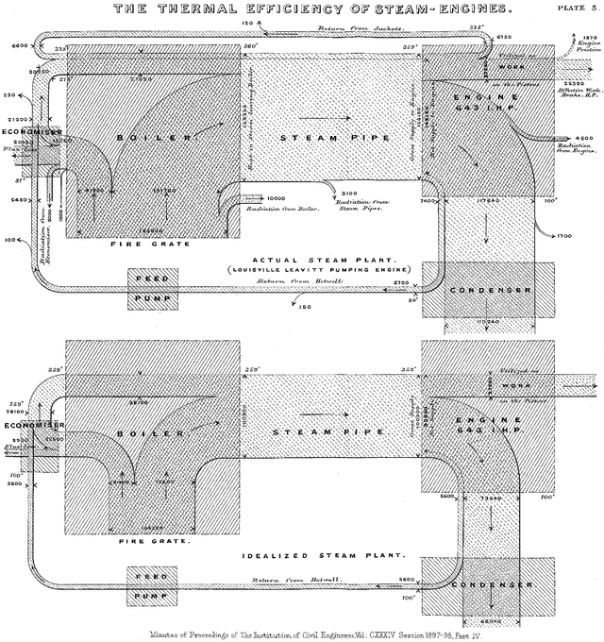
What is a Sankey Diagram?
Originally created to show efficiency of a steam engine by Captain Matthew Henry Phineas Riall Sankey in 1898 (Source: Wikipedia)
Flow diagram
Used to visualize flow of a system, transfer of items, movement of goods…
Thickness of line represents magnitude of flow

Slide 5
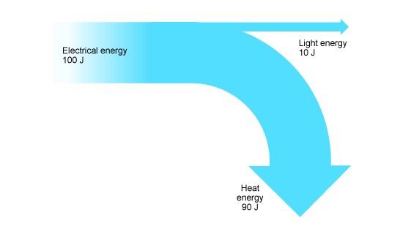
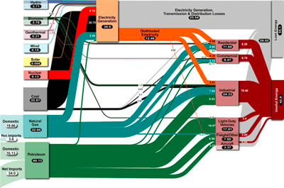
Examples of Sankey Diagrams
Simple Sankey Diagram of a Lightbulb
Multi Level Sankey Energy Diagram

Slide 6
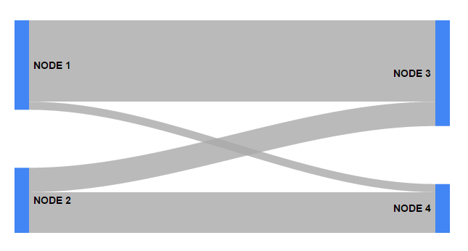
Basic Vocabulary
Nodes: Represent sources and destinations of flows
  Cities, Universities, Academic Departments, Accounts
Links: Links indicate that there exists flow between the nodes it connects
Weight: Also known as the thickness. The higher the weight of the link, the thicker it is

Slide 7
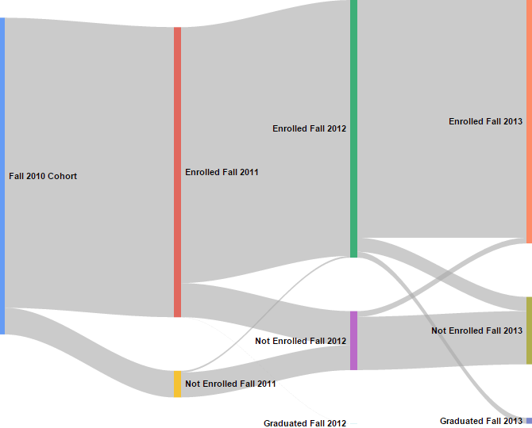
Sankey Diagrams for IR
Useful where there is movement
Student transitions
  Major changes, Time to degree, Transfer destinations
Transactional data
  Finance, Student Financial Aid, Research Expenditures, HR Data
Example: Tracking a cohort (Fall 2010 SBU FTFT to their 4th Fall)
Example 1

Slide 8
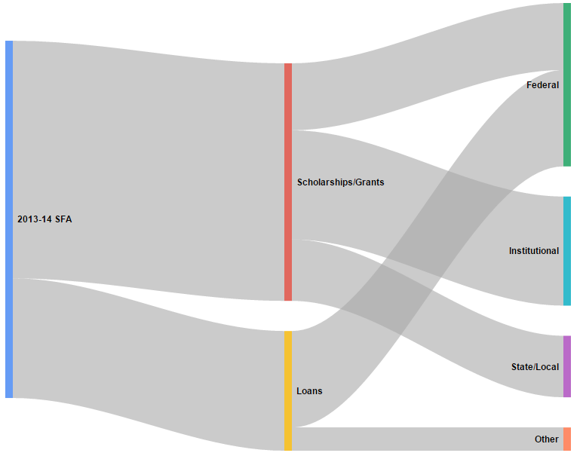
Sankey Example: IPEDS SFA
2013 – 14 IPEDS SFA Data from Stony Brook
Total financial aid
Scholarships/Grants vs Loans
Aid source
Example 2

Slide 9
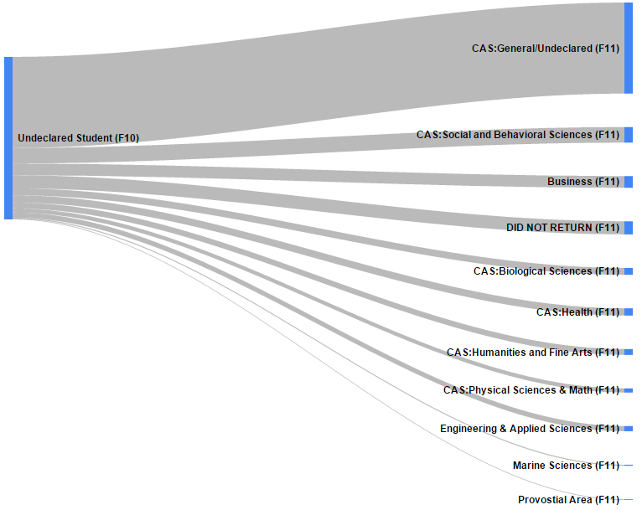
Major Changes At Stony Brook University
Closer look at Stony Brook University FTFT 2010 students
  Looking by Major groupings
Looking for retention/graduation interventions: undeclared?
For now, look at one year change (Fall to Fall)
Immediate observations
    Majority do not leave
  Questions about those not returning:
    In line with other majors?
Example 1.1

Slide 10
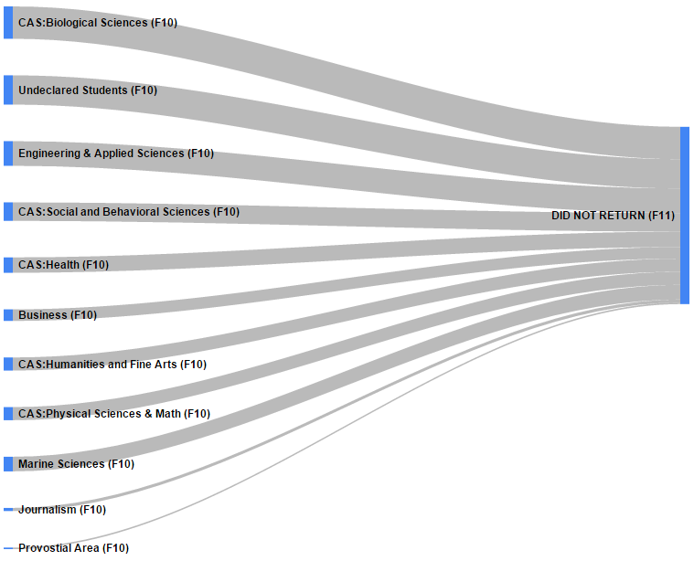
Major Changes At Stony Brook University
  To answer this question, let’s look at students who don’t return
  Observations
    Not out of line with other majors
  Benefits
    Not a list of numbers and percentages
    Easy to visualize
Example 1.2

Slide 11
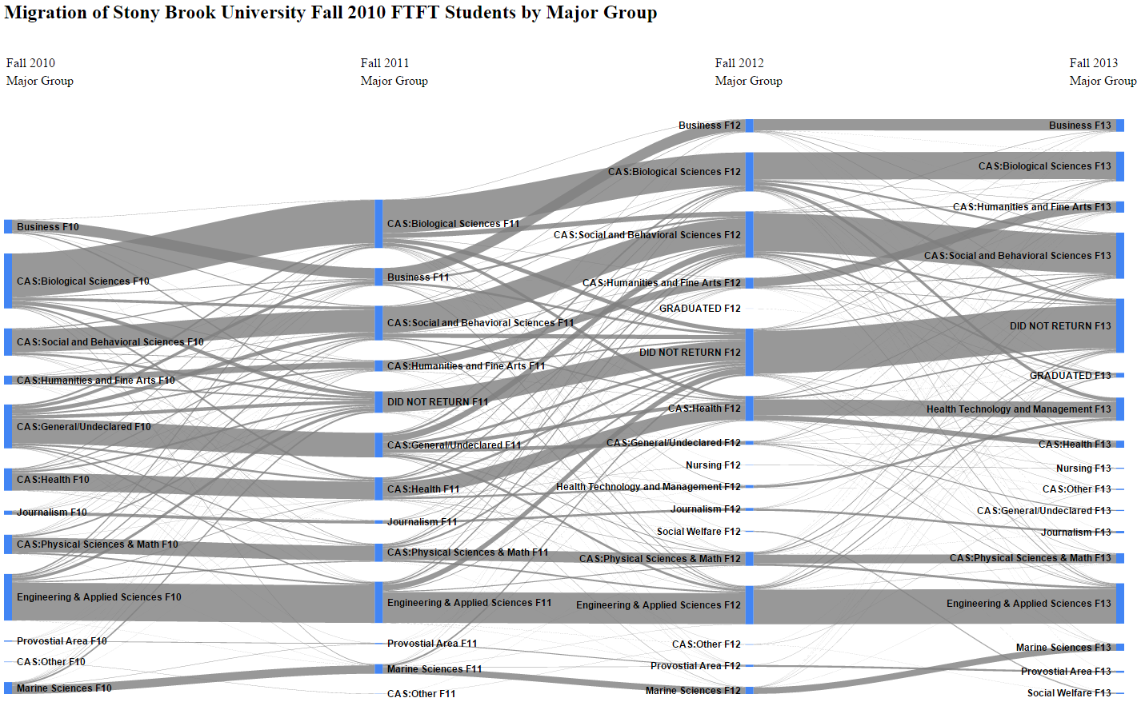
Major Migration at Stony Brook University
Add major groupings to initial cohort tracking example (Example 1)
Example 1.3

Slide 12
Major Migration Takeaways
What does this diagram show us? What does it show decision makers?
  Helps to show complexity to decision makers and those making requests
  Demonstrate trends in flow, or “currents”
  Highlight problem areas: high transfer out, high attrition,…
  Can also show successes
  Prompt further investigation into previously unnoticed subgroups or trends
SBU case specific examples
  SOMAS – High out, low in
  CEAS – AMS in, engineering out
  Undeclared students persist, do not leave at as significantly different rates as thought
  Major alone will not give us a target
What does the Sankey help to show

Slide 13
Creating Sankey Diagrams
Several options for creating Sankey diagrams (some others listed at end)
Sankey diagram included as part of Google Charts
  Clean, straightforward, and does not require a background in coding (I am not a programmer!)
  Replicable and easily editable to accommodate data changes or new project
  Can be combined to create dashboards with other Google Charts
https://developers.google.com/chart/interactive/docs/gallery/sankey
We will examine the code behind some simple Sankey diagrams
  Creating the diagram only involves changing one section of the code provided by Google
  Users can modify more if they like

Slide 14
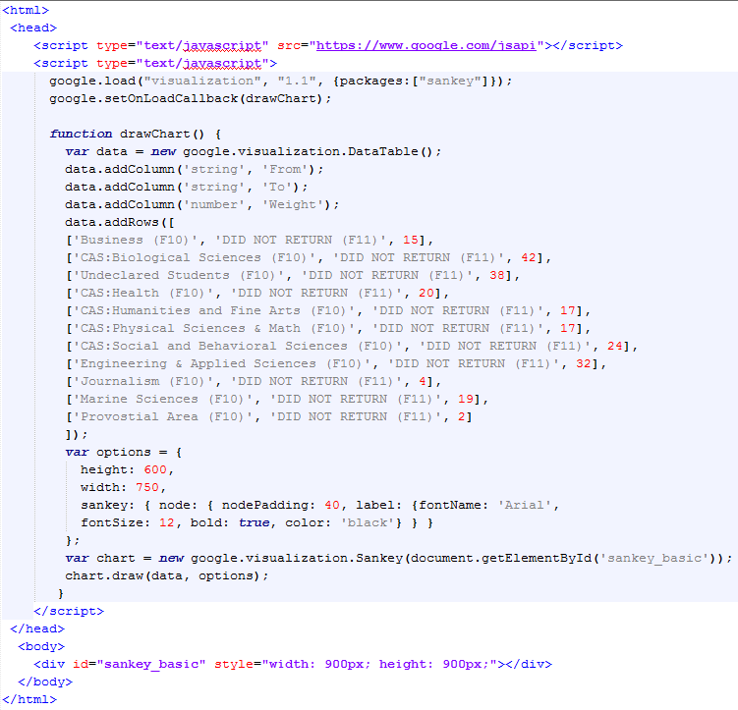
The Code For Example 1.2

Slide 15
Creating Your Own Sankey Diagram
This is the only section that needs to change: The links and weights
Some example code can be found on Google’s webpage

Slide 16
How to Create your Own Sankey Diagram
Basic Steps
  Define nodes, links, and weights
  Gather data (enrollments for this example)
  Create code for nodes and links using data
  Insert the code, replacing old nodes and links
  Run code in HTML editor, you’re done!
Going Further
  Edit Google chart options
  Edit HTML options (not covered in this presentation)
Let’s try it

Slide 17
Basic Steps: Define Nodes and Links
Build the Major Migration Sankey from Example 1.2
The following structure is used
  Nodes: Major groups by fall terms (Ex: Engineering Fall 2010)
  Links: Links represent movement between the two major groups they connect (the year of the movement is also specified by which nodes are connected – we limit to one year movements)
  Weights: Denotes the amount of students moving between the two program groups in the represented time frame
Not all definitions will be the same. Ensure you will be able to demonstrate what you are trying to show
  Initial attempts at this example led to adding a year component to the node labeling
  Initial cohort node – helps with start distribution

Slide 18
Basic Steps: Gather Data
Need enrollment data, stored in a spreadsheet
  Pulled from enrollment records
Create a panel that shows enrollment in one fall and then subsequent fall enrollment
  For SBU, data stored on major, school/college, graduation status, college/division (local grouping of majors to reduce number of links)
Summary sheet for total changes: will use to create code
  Pivot table

Slide 19
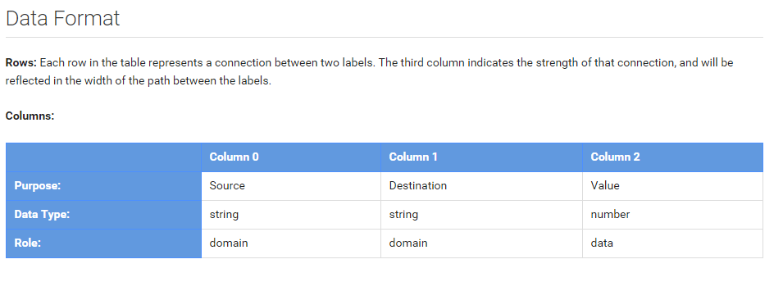
Basic Steps: Create Code
“Rows” create nodes, links, and their relationship
Columns inside each row are:
  Source – Where does the flow start?
  Destination – Where does the flow go?
  Value – How much flow?
Row code format: [‘Source’, ‘Destination’, Value],
  [ ‘Source’ , ‘Destination’ , Value ] , Note: ORDER MATTERS
Use a concatenate formula in your spreadsheet to create rows in this format
Must start and end with open bracket: [
Include single quotes around node names: ‘ ’
Separate source, destination and value with commas. Also, separate EACH row entry with a comma (except for the final entry): ,

Slide 20
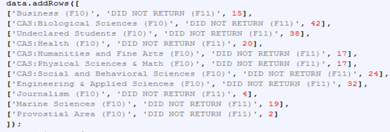
Basic Steps: Insert Code
Leave
This sample is from example 1.2. You can use any previous Sankey code to start.
Replace
Leave
Copy basic example code from Google Sankey page or code from a previous diagram you created
Place in editor (Notepad, Notepad++, HTML online editor, JSFiddle…)
Leave the first and last lines
  data.addRow([
  ]);
Remove links in between these lines, and add your links
  Make sure last link does NOT end with a comma, the code will not work

Slide 21
Basic Steps: Run Code
Notepad
  Save as .htm, open file with internet browser
Notepad++
  Save file, use run option to run in a browser
HTML editor
  http://htmledit.squarefree.com/ - updates in real time
JS Fiddle
  https://jsfiddle.net/ - need some HTML experience, since Javascript and HTML is separated by this editor

Slide 22
Going Further: Options
Options are entered with the following format
  Example: var options = {node: {label: {bold: true, font: ‘Arial’} …} …}
Available option categories
  Sankey (Node, Link, and Iterations subcategories – Node and Link are shown on next page)
  Height
  Width
  forcelFrame
  Tooltips (can be used to change hover effect)
Declare the options variable
Open the node options
Open label category within node options
Make label font bold
Set label font to Arial
Close the node and label sections

Slide 23
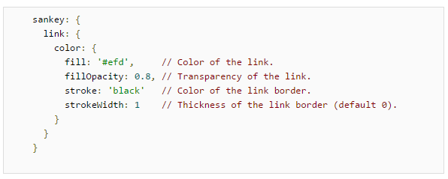
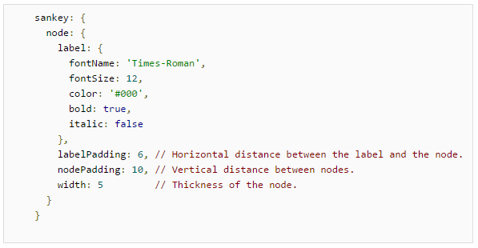
Going Further: Options
Sankey
  Link
    Color
      Fill
      FillOpacity
      Stroke
      StrokeWidth
Sankey
  Node
    Label
      FontName
      FontSize
      Color
      Bold
      Italic
    LabelPadding
    NodePadding
    Width

Slide 24
Going Even Further
Multi level Sankey Diagrams are coded in the same manner
  Keep adding links
  Logical flow (Example, F10 to F11, F11 to F12,…)
  Add in order for organization, Google will add them in best fit
SBU migration has hundreds of links
  Still created in the same manner
  Pivot tables and concatenate in Excel
Options will be key for Visualization
  Use node padding and sizing, label padding and sizing
  Change chart size

Slide 25
Other Charts Available from Google Charts
Traditional Graphs | Diagrams
Area Charts (Traditional and Stepped) | Bubble Charts
Bar Charts | Box and Whisker Plots (Candlestick Charts)
Column Charts | Calendar Charts
Combo Charts | Gauge Charts
Histograms | Geographic Charts
Intervals | Organizational Charts
Line Charts | Tables
Pie Charts | Timelines
Scatter Charts | Tree Map Charts
Time Series (Annotated) | Word Trees
Trend lines | **User created community charts are also available**

Slide 26
Dashboards
Dashboards allow combination of charts and controls
Controls act as filters
  Category (Pick from available), String (Search), ChartRange, DateRange, NumberRange
  Customizable filter options (Examples: starting states, allow one choice only…)
Can use same data source across multiple charts and filters, or multiple data sources
Can control one or many charts with filter; can use multiple filters per chart

Slide 27
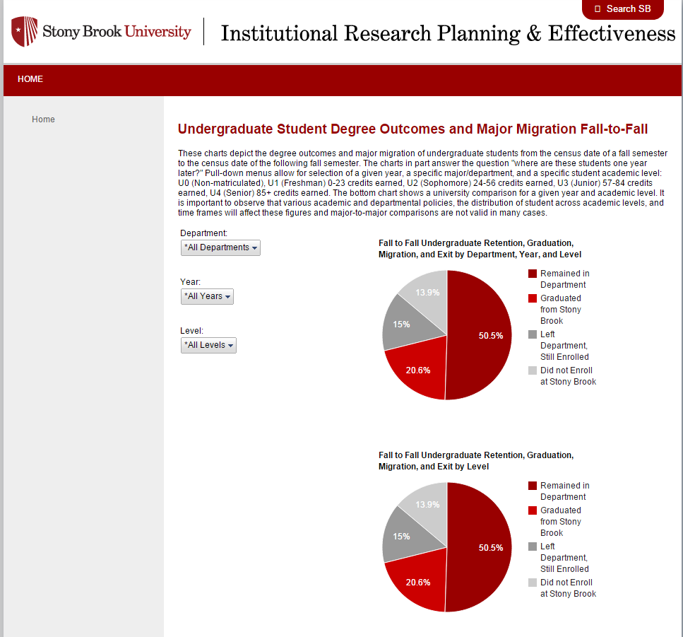
Dashboard Example

Slide 28

Dashboard Example Continued
Department Category Filter set to Applied Math
Year Category Filter set 2013-14
Second pie chart set to only change with “Level” Category Filter

Slide 29
Other Sources For Creating Sankey Diagrams
Connecting to Data
Google charts allows connection to your database with php and a .json file
https://developers.google.com/chart/interactive/docs/php_example
Other Resources for Creating Sankey Diagrams
D3.js
  Javascript Visualization library
  Powerful, with more options than Google Charts
  More complex
  http://d3js.org/
Tableau
  Requires manipulation
  Not flexible, very complicated

Slide 30
Thank you!
Examples will be posted on our Webpage within the next week
  http://www.stonybrook.edu/commcms/irpe/dashboards/viz.html
Contact information
  sean.hoffman@stonybrook.edu

