Slide 1

The Unbearable Lightness of Executive Transition:
Supporting the Vision of a New Chief Executive
Braden J. Hosch, Vice President of Educational & Institutional Effectiveness

Slide 2
Overview
Introduction and Context
Trends in Presidential Tenure: What the Data Show Us
Case Study: Presidential Transition at Stony Brook
Key Insights and Actionable Takeaways for HR Professionals

Slide 3
Introduction

Slide 4

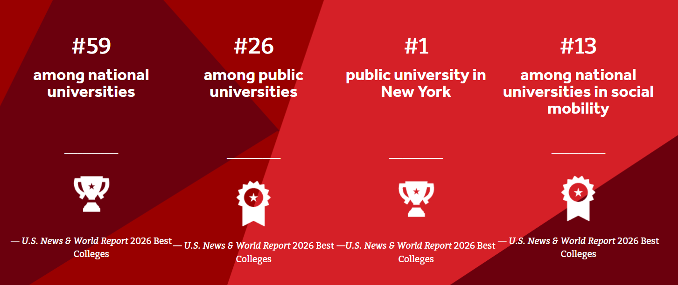
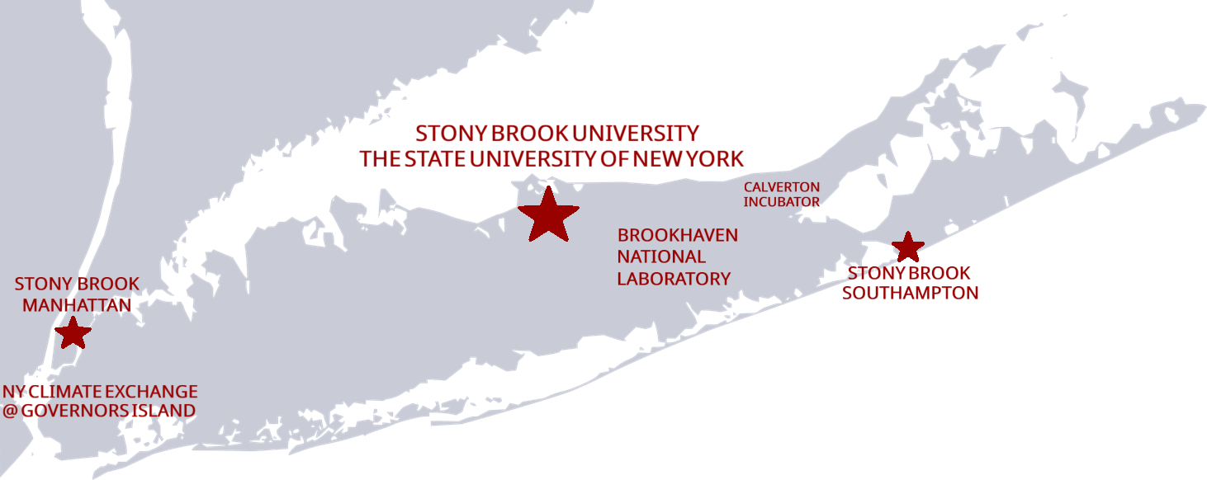
27,200 Fall 2025 Headcount Enrollment | 52% of Undergraduates Live on Campus
68% 32% Undergrad Graduate | 1 out of 3 First Generation
41% 39% 22% Asian White Underrep Minority | 40%+ Pell Grant Recipients Fall 2025
67% 76% 4-year 6-year grad rate grad rate | $4.58 B $340 M FY25 Operating FY25 Research Budget Expenditures
17,000+ 3,100 Employees Faculty including hospital | AAU Member Since 2001
$93,894 Median earnings (bachelor’s deg) 10 years after graduation | 1 of just 21 R1 Universities to be designated an Opportunity University 2025 Carnegie Classifications

Slide 5
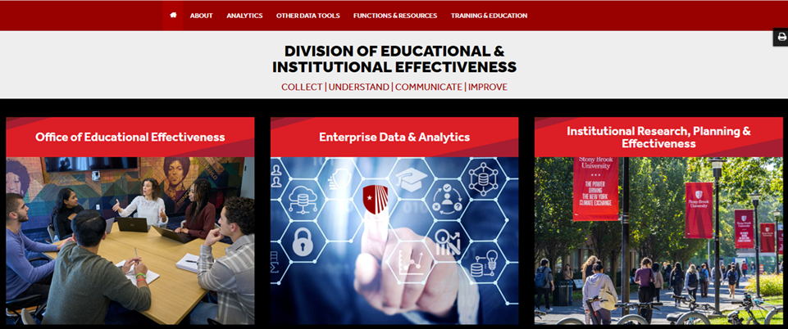
Mission: To enable the University to improve through the collection, analysis and use of data
https://www.stonybrook.edu/effectiveness/

Slide 6
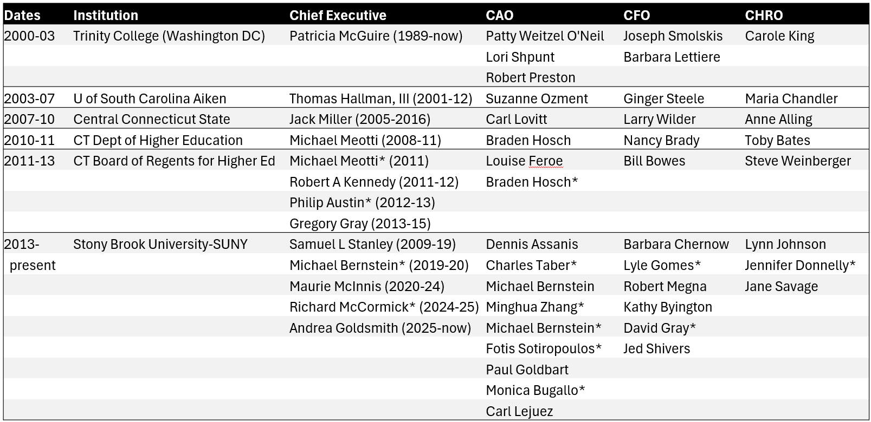
Executives Leading Institutions I Worked At
* interim

Slide 7
Presidents are Spending Less Time In Role

Slide 8
Decrease in Average Tenure of College Presidents
Source: The American College President (2023). American Council on Education.

Slide 9
Chief Executives of SUNY & AAU Institutions
Percent of CEOs in First Year
(includes interim/temporary CEOs)
Source: IPEDS Data Center; institutional websites for 2025; various web sources/bios for presidents starting prior to 1990.

Slide 10
SUNY Chief Executives - Years In Role
(includes interim/temporary CEOs)
Serving 19+ Years
Charles Meder | Finger Lakes Community College | (1972-1991)
Marvin Feldman | Fashion Institute of Technology | (1972-1991)
Earl Mac Arthur | SUNY College of Technology at Canton | (1972-1992)
James Hall | Empire State University | (1971-1997)
Alden Haffner | SUNY College of Optometry | (1971-2004)
Joseph Hankin | SUNY Westchester Community College | (1971-2013)
Serving 19+ Years
Joyce F. Brown | Fashion Institute of Technology | (1998-present)
Erik J. Bitterbaum | SUNY Cortland | (2003-present)
Randall VanWagoner | Mohawk Valley Community College | (2007-present)
Source: IPEDS Data Center; institutional websites for 2025; various web sources/bios for presidents starting prior to 1990.

Slide 11
AAU Chief Executives - Years In Role
(includes interim/temporary CEOs)
Serving 19+ Years
William Danforth | Washington University in St Louis | (1971-1994)
Derek Bok | Harvard University | (1971-1990)
John Silber | Boston University | (1971-2003)
Charles Young | University of California-Los Angeles | (1968-1996)
Wesley W Posvar | University of Pittsburgh | (1967-1990)
Serving 19+ Years
Michael M. Crow | Arizona State University | (2002-present)
Source: IPEDS Data Center; institutional websites for 2025; various web sources/bios for presidents starting prior to 1990.

Slide 12
Stony Brook’s Presidential Transition

Slide 13
Hard Powers of the Presidency
Presidential Power
Allocate money
Hire and fire people
Start/stop policies and programs
Presidents have three basic powers

Slide 14

Soft powers of the Presidency
Presidential Power
Audiences include:
Students
Faculty
Staff
Donors
Trustees
Elected Officials
Community members
Presidential soft power is persuasive and motivational.
Presidents set aspirations an inspire stakeholders.

Slide 15

Presidential Power is Dynamic
Presidential Power
Presidential effectiveness changes over time
One goal of transition is to boost effectiveness as high as possible by the start date

Slide 16
Timing is Everything
Jan 13
Interim Chief of Staff Appointed
July 17
Permanent Chief of Staff Hired
March 6
Incoming President Visits Campus
Jan 20
President Trump Inaugurated
Aug 1
President’s “Start Date”
May 8
NY State Budget Passed
Feb 19
New President Announced

Slide 17
Transition Principles
Stony Brook First
Accomplish Institutional Goals
Make Everyone Look Like Rock Stars
Additional considerations
Outgoing president
Orient and educate incoming president
Crisis management

Slide 18
Challenges
Spring 2025
Senior Leadership
Provost publicly named as finalist at higher ranked institution
Changes in federal administration
Cancellation of research grants
Changes to immigration policy and enforcement
Various additional uncertainties
Campus climate
Tension about Middle East
Tension about federal landscape
Six interim cabinet members (President, Chief of Staff, Advancement, Marketing & Communications, Chief Campus Counsel, Human Resources)
Actions taken against high-profile universities
Ensure the incoming President starts with a fully functioning University.

Slide 19
Presidential Transition Curriculum
Materials
Meetings
Urgent vs Educational

Slide 20
Presidential Transition Curriculum
Briefing Book
Initial briefing by area - Mission - Functions - SWOT Analysis - Urgent issues Organization chart Issue briefings
Sections
Advancement Athletics Diversity Inst. Effectiveness Enterprise Risk Mgt Finance & Admin. Campus Counsel Human Resources Information Technology Marketing & Communication Provost/Academic Affairs Research & Innovation Stony Brook Medicine Strategic Initiatives Student Affairs University Hospital
HR Briefing Outline
Background & Context Assessment Findings HR Transformation Milestones HR Now Transformation HR Business Partner Model Talent Acquisition Compensation Training & Development Employee Engagement Enhanced Labor Relations Org Chart Strategic Plan Additional briefings on Unions Employee Engagement Survey

Slide 21
2025 Stony Brook president Transition Meetings

Slide 22
University Transition Meetings Detail
Searches/Recruitment
Cabinet position interviews
Director/researcher recruitment
Executive Office
Operational details (office/house)
Cabinet functions
Finance
Budget for 2025/26
Financial Overview
New Budget model
President (outgoing)
Notes from outgoing CEO
Most meetings were educational in nature but as many as 10% included a larger financial decision and or personnel issue.

Slide 23
Takeaways for
Human Resources

Slide 24
Research The President’s Prior Institution
“How does this president think?”
“What does this president value?”
“What annoys this president?”
“How does this president measure success?”
“How did you help this president succeed?”
Questions to ask your counterpart
HR services provided
HR org chart & FTE
HR website

Slide 25
Understand and Communicate Uniqueness of SUNY
Large & Diverse
Finances
Unions
Notes:
Large & Diverse
Competing interests across sectors
Trustee attention spread across 64 campuses
Public & private
Local councils
Finances
Tuition
Institutional allocations
Pooled offset
Related entities
Budgets approved and communicated
Unions
Permanent appointment for staff
Confluence between HR/LR/GR

Slide 26

Lists You should Have
Things to shut down
Things to buy
Things you want to do
Emergency backups for senior leaders
What keeps you up at night

Slide 27
Briefings You should Provide
Unions
President’s role in tenure/permanent appointment
High-level numbers as talking points
Employee morale, sentiment, and salient issues

Slide 28
Final Thoughts

Slide 29
Recap
The Time Presidents Spend in Role Is Decreasing
Context Matters (Background, Runway, Environment)
Balance Education and Urgent Issues
Research and Prepare

Slide 30
Implications
Similar principles apply for the transition of all new leaders, if not all new employees
Similar principles apply when employees change roles
Transition out of the organization should have similar levels of deliberate planning

