Slide 1
Repayment Rates: What IR Professionals Need to Know and Why It Matters
Braden Hosch, Assistant Vice President, Office of Institutional Research, Planning & Effectiveness, Stony Brook University
Rachel Dykstra Boon, Assistant Vice President for Student Success, Ivy Tech Community College
Amanda Janice, Research Analyst, Institute for Higher Education Policy
Association for Institutional Research 2016 Conference
June 1, 2016

Slide 2

Presentation Overview
Policy background of repayment rates
IHEP’s report Making Sense of Student Loan Outcomes
Ivy Tech Community College
Stony Brook University

Slide 3
Why repayment rates?
Increased policy attention:
  Gainful Employment
  Higher Education Affordability Act of 2014
  Student Protection and Success Act of 2015
  Other accountability proposals
  College Scorecard
Public attention to student debt
CDR critiques

Slide 4
What is a repayment rate?
  Borrowers or Dollars In Repayment
  Borrowers or Dollars Entering Repayment
  “In repayment” typically defined as reducing loan principal by at least $1.
  RR =

Slide 5
Project Background
Primer on repayment rates
Institutional data analysis
Expert convening
Compiled recommendations: “Making Sense of Student Loan Outcomes”
“Primer on Repayment Rates” available at: http://www.ihep.org/research/publications/primer-repayment-rates
“Making Sense of Student Loan Outcomes” available at: http://www.ihep.org/sites/default/files/uploads/docs/pubs/making_sense_of_student_loan_outcomes_paper.pdf

Slide 6
Making Sense of Student Loan Outcomes
Report makes 11 recommendations in four categories:
  Principles for using repayment rates
  Calculating repayment rates
  Setting high and attainable performance standards for repayment rates
  Recommendations for the Department of Education to make repayment data more usable

Slide 7
Making Sense of Student Loan Outcomes
Three principles for using repayment rates:
  Repayment rates are a measure of student and taxpayer protection, not a measure of academic quality.
  Policymakers and institutions should disaggregate repayment rates.
  Offices within institutions should collaborate with each other to use repayment rate data to better serve their students.

Slide 8
Making Sense of Student Loan Outcomes
Three recommendations for setting high and attainable performance standards:
  Successful repayment is more than a $1 reduction in principal.
  Policymakers should use repayment rates to supplement, but not replace, CDRs as an accountability measure.
  Policymakers should hold servicers accountable for repayment rate performance.

Slide 9
Making Sense of Student Loan Outcomes

Slide 10
Making Sense of Student Loan Outcomes
Recommendation for ED
  The Office of Federal Student Aid should improve student loan reports available to the public and to institutions.
    Need for complete student-level data.
    Diminishes the ability of the institution to use and disaggregate these data to make meaningful campus change.

Slide 11
Moving Forward
Continued policy attention:
  Negotiated Rulemaking for Higher Education 2015-16
  Risk-sharing
  Higher Education Act Reauthorization
Additional research

Slide 12
Stony Brook University
Braden J. Hosch
Asst. Vice President, Institutional
Research, Planning & Effectiveness

Slide 13
Overview
Institutional Profile
Findings and Analysis
Potential Institutional Uses
Implications
Notes:
Current targets remain under discussion as fall 2015 numbers are finalized, 2014-15 fiscal results come in, and SUNY white paper proposals are returned.

Slide 14
Institutional Profile
Graduate
Students: 25,272 | Institution: Carnegie: Doctoral, Highest Research Activity Public AAU
Undergraduate Profile 1253 avg. SAT | Program Profile 6,712 Completions 2014-15
Employees: 14,349, including hospital 2,617 faculty | Finance: 2.5 billion USD annual budget 220 million USD research exp.
Fall headcount
Undergraduate
33% Pell
Recipients

Slide 15
Repayment Rates
Considerations
Entering repayment FY11 and FY 12
Undergraduates only
Exclusion of FY15 deferments
Federal loans, excluding Perkins, Parent PLUS, TEACH
Loans paid through consolidation ≠ repayment
    Added complexity because of graduate/other borrowing
Profile
Borrowers (N) | 5,251
Completed degrees | 72%
Women | 50%
UR minorities
Pell grant recipients

Slide 16
Post-Graduation Debt Metrics
Cohort Default Rate | Repayment Rates
Average Debt $20,408 $23,592 Federal loans All loans Common Data Set-Undergraduate Completers | Average Federal Borrowing (excludes deferments & consolidations) $10,346 $16,433 Non-Completers Completers RR Study

Slide 17
Degree Completion Associated with Higher Repayment Rates

Slide 18
Borrower Based Repayment Rate by Gender
Bar thickness represents
number of borrowers

Slide 19
Borrower Based Repayment Rate by Race/Ethnicity
Bar thickness represents
number of borrowers

Slide 20
Higher Repayment Rates Associated with Higher Paying Fields of Study
Bar thickness represents
number of borrowers

Slide 21
Gaps in Repayment Rates Among Pell Grant Recipients Observed Among Non-Completers
Bar thickness represents
number of borrowers

Slide 22
FT Freshman entrants Exhibited Higher Repayment Rates
Bar thickness represents
number of borrowers

Slide 23
Potential Institutional Uses
Current practice
Future practice
Default prevention
Debt reduction
General financial literacy efforts
Efforts targeted to selected populations
Financial literacy in Financial Aid silo
Partnerships (academic / career advising, etc.)

Slide 24
Implications
Factors Related to Repayment
Demographics
Field of study (earnings potential)
Institutional Considerations
Prefer higher rates (federal w/o consolidation adjustment)
Management of rates based on components of rates could have harmful side effects
Policy considerations
Better measure of progress in debt retirement
Not an institutional effectiveness metric
Degree completion
Socioeconomics
Personal approach to money management (?)
Harmful side effects of managing rates

Slide 25
Caveats for Working with the Data
Usefulness dependent on proper accounting of consolidated loans
Consolidated loans inclusive of all institutions attended
Never the same two days in a row
Lots of lingo and codes
  (Seriously, you will need to bring donuts for the Financial Aid staff!)

Slide 26

Ivy Tech Community College of Indiana
Rachel Dykstra Boon
Assistant Vice President for Student Success
May 2016

Slide 27
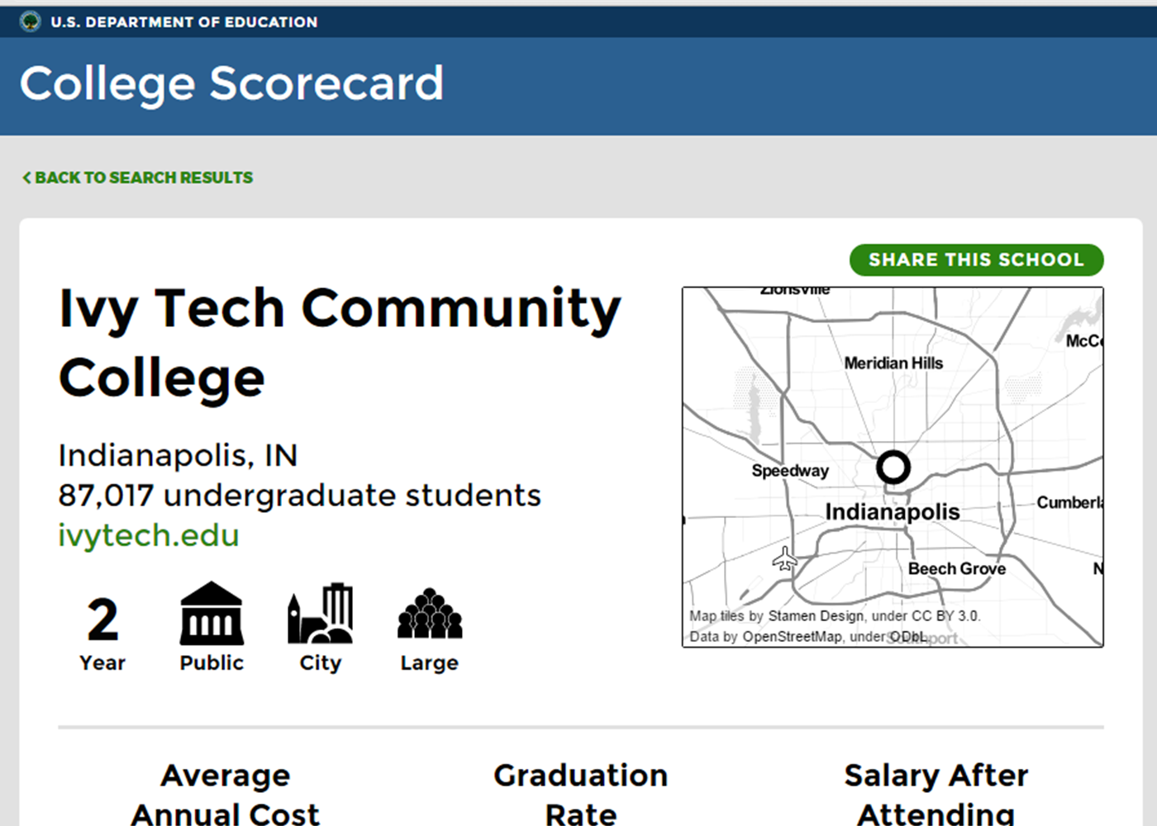

Slide 28
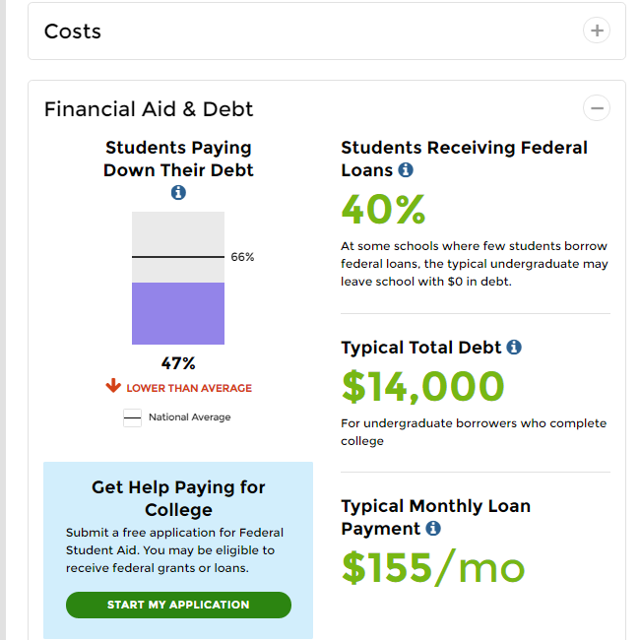
14 ppt gap with published College Scorecard data

Slide 29
Borrower-based Repayment Comparisons
Credential Completers
Income-Driven Repayment Plan
12 ppt higher than non-completers
18 ppt lower than non-IDR Plans

Slide 30
*Showing only those servicing more than 1000 borrowers

Slide 32

Decisions to Make in Using Repayment Rates
College Scorecard or own analysis of NSLDS records?
Both

Slide 33

Decisions to Make in Using Repayment Rates
Who should be on the cross-functional team assessing and acting on the repayment rate information?
Institutional Research, Financial Aid, President, Provost, and Student Affairs

Slide 34

Decisions to Make in Using Repayment Rates
Which disaggregations are meaningful? Which are operationally useful?
Varies by institution

Slide 35
Caveats for Working with the Data
Usefulness dependent on proper accounting of consolidated loans
Consolidated loans inclusive of all institutions attended
Never the same two days in a row
Lots of lingo and codes
  (Seriously, you will need to bring donuts for the Financial Aid staff!)

Slide 36
Thank you!
Braden Hosch
Rachel Dykstra Boon
Amanda Janice: ajanice@ihep.org

