Slide 1
Beyond Data Governance to Data Strategy
Braden J. Hosch, Ph.D.
Asst. Vice President for Institutional Research, Planning & Effectiveness
Stony Brook University
AIR Annual Forum, Washington, DC, May 31

Slide 2
Overview
Background
What is a data strategy and why do we need one?
Components of Stony Brook’s data strategy
Implementation (as process, not project!)

Slide 3
Institutional Profile
Students: 25,734 | Institution: Doctoral, Highest Research Activity Public AAU Founded 1957
Undergraduate Profile 1254 avg. SAT | Program Profile 6,754 Completions 2015-16
Employees: 14,732 including hospital 2,695 faculty (FT & PT) | Finance: 2.5 billion USD annual budget 230 million USD research exp.
Graduate
Fall headcount
Undergraduate
Pell
Recipients

Slide 4
What is a data strategy?
Intentional action & prioritization plan to:
Harness and integrate data
Create and disseminate information/intelligence
Advance University mission

Slide 5
Why do we need a data strategy?
Support objectives to:
Proliferation of data assets
Increasing organizational size and complexity
Advances in analytical tools
Promote operational effectiveness, excellence & efficiency
Retain and grow revenue
Reduce risk
Drive innovation

Slide 6








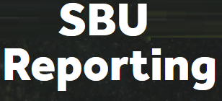











Selected Stony Brook data assets
Assessment Data
Help Desk Tickets
Card Swipes
Surveys

Slide 7
Stony Brook’s mission
The university has a five-part mission to provide and carry-out:
Highest quality comprehensive education
Highest quality research and intellectual endeavors
Leadership for economic growth, technology, and culture
State-of-the-art innovative health care, with service to region and traditionally underserved populations
Diversity and positioning Stony Brook in global community

Slide 8









Elements of Stony Brook’s data strategy
 | Data acquisition
 | Data governance
 | Data quality
 | Data access
 | Data usage & literacy
 | Data extraction & reporting
 | Data analytics

Slide 9
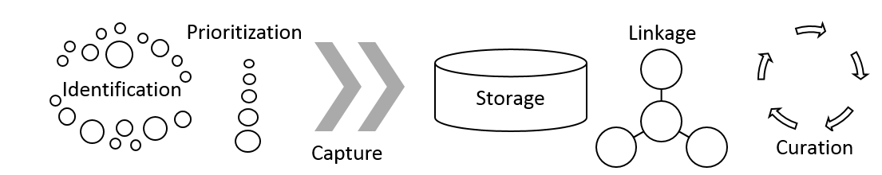
Data acquisition
Data acquisition involves identification, prioritization, capture, storage, linkage, and curation of data assets most valuable to the enterprise

Slide 10


Data acquisition
Identification & prioritization
Establish and maintain an inventory of data assets and assess acquisition maturity
Establish a process to prioritize integration into data infrastructure

Slide 11

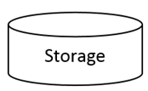
Data Acquisition
Capture & storage
For each data asset identify current and optimal capture procedures
For each data asset identify current and optimal storage areas

Slide 12
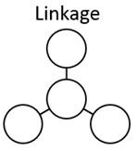

Data Acquisition
Linkage & curation
For each data asset identify current and optimal procedures to link to other data sources
For each data asset identify how data will be updated and maintained to preserve value

Slide 13
Data governance
Data governance formalizes behavior around how data are defined, produced, used, stored, and destroyed to enable and enhance organizational effectiveness.
PeopleSoft and the Data Warehouse are governed by the University Data Governance Council
Establish expectations for all other data assets to have formal data governance

Slide 14
Data governance
Requirements
Stony Brook
Data Governance Framework*
Designated decision-making body
Formal data dictionaries and descriptions of architecture
Individuals designated to provide stewardship
May opt to be governed through the Stony Brook Data Governance Council
Data Governance Council
Finance
Student
Human Resources
Data Stewards
Data Stewards
Data Stewards
SteerCo
*Applies to PeopleSoft and the Data
Warehouse (as of 9/26/16)

Slide 15
Data Quality
Data quality is the state of completeness, validity, consistency, timeliness and accuracy that makes data appropriate for a specific use.
The Data Governance Council is charged with improving data quality for PeopleSoft and the Data Warehouse. A roadmap to achieve this has been developed
For each data asset, develop and execute a plan to maintain and improve data quality; automate when justified by ROI.

Slide 16



Data access
Data access ensures authorized individuals can obtain and use data when and where they are needed and protects privacy and sensitive information by preventing unauthorized use.
Accessibility | Authorization | Security

Slide 17
Data usage and literacy
Data usage and literacy entail people regularly obtaining data; understanding them; and using them to improve operational effectiveness .
Establish for all data assets:
Usage metrics
Effectiveness metrics
Training inventory
Data User Responsibilities
1. Recognize data complexities; understand data meanings and limitations
2. Cite sources; assume broad audiences
3. Respect privacy
4. Secure data and reports
5. Report data quality issues

Slide 18
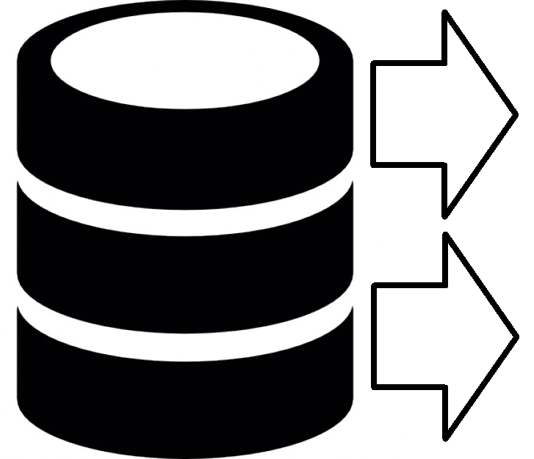

Data extraction and reporting
Data extraction and reporting represent the ways that data are queried and retrieved from storage and then delivered to users through regularized and ad hoc reporting to support day-to-day operations.
Extraction | Reporting

Slide 19
Data extraction and reporting
Methods for querying and extracting data from storage should be identified, including user types associated with each extraction method
Reports should be linked to operational objectives
Report inventories should be maintained in an accessible area.
Reports should be automated depending on ROI
Reports should include effectiveness metrics
Extraction
Reporting

Slide 20
Data analytics
Analytics deliver dynamic and visual analysis of data, internal & external benchmarking, exploratory and causal analysis, and predictive/forecasting capacity.
Requirements
Maturity in data acquisition, governance, quality, access, usage, & extraction
Tools capable of performing analyses and communicating effectively
Speed and ease of use

Slide 21
Data asset strategy document compiled for each data asset
Data Asset Strategy Doc
e.g. IPEDS
Description & use
Data acquisition
Priority (High, medium, low)
Data governance plan
Data quality protocols
Data access plan
Accessibility
Authorization
Security
Data usage and literacy
Data extraction/reporting
Data analytics
 | Current | Plan | Date
Capture
Storage
Linkage
Curation

Slide 22
Example – Description and Use, Priority
National Student Clearinghouse
Third-party repository of enrollments and some completions of post-secondary enrollments in participating higher education institutions in the United States. Data are used for monitoring subsequent enrollment of applicants, students leaving Stony Brook without degrees, and degree completers. Major types of data include:
Institution of enrollment
Institution characteristics
Dates of enrollment
Student level and enrollment intensity
Award completion
Field of award (later records)
Priority Level: Medium

Slide 23
Example – Data Acquisition
National Student Clearinghouse
 | Current | Plan | Date
Capture | Special query required. Applicants uploaded and maintained by Enrollment Management; students transferring out and graduates queried and maintained by IRPE; Student ID reattached following query | Continue query protocol; standardize query dates | 2017
Storage | Store on Enrollment Management file share, IRPE file share | Store in data warehouse SQL server | 2017
Linkage | StudentID in Excel files – linkages are custom queries in IRPE | Housed in Data Warehouse with StudentID | 2017
Curation | Applicant data maintained by Enrollment Management; other data cleaned through Access database to establish primary enrollment in fall term for grads and fall & spring terms for students transferring out | Write query into Data Warehouse; store analysis tables there | 2017 and ongoing

Slide 24
Example – Data Governance, Quality
National Student Clearinghouse
Data governance plan
Once integrated into data warehouse, data would be under purview of Data Governance Council. Data Stewards: [Name removed], Enrollment Management (admitted undergraduates not enrolled), [Name removed], IRPE (all other data).
Data quality protocols
Raw data from the NSC are stored; annual updates are performed for students / graduates from 10 years prior through current year. Historical data are not overwritten even when updates appear in the NSC.
SQL in Access database uses a set of decision rules to identify a primary enrollment institution for fall and spring terms; IDs are unduplicated. Stony Brook enrollments are reattached from enrollment database regardless of NSC return file.

Slide 25
Example – Data Access Plan
National Student Clearinghouse
Accessibility – Student Tracker access limited to 2 enrollment management staff, and 3 IRPE staff. Return files accessible to two EM staff, and all IRPE staff. Future storage plan will extend access to 5 additional BI staff. Future access plan will extend analytics access to Academics Access Users and Executive Dashboard Users
Authorization – AVP of Enrollment management or AVP of IRPE required. Future authorization to access reports is TBD.
Security – Password authentication to NSC; password authentication to one of two university file shares. Note: Institution name is a restricted data element and may not be shared outside of Stony Brook. Future security will leverage Data Warehouse security protocols.

Slide 26
Example – Data Usage and Literacy
National Student Clearinghouse
Data Usage and Literacy
Dictionaries: import NSC data dictionary for raw files, construct dictionary for cleaned files to explain eliminated records; integrate definitions with Tableau Server.
Documentation: Construct 1-page of friendly documentation to accompany all reports discussing how data are collected, appropriate uses, and limitation.
Video: This asset is not high priority for video training

Slide 27
Example – Extraction/Reporting
National Student Clearinghouse
Extraction/Reporting
Current reporting is ad hoc.
Future reporting will provide regularized metrics for enrollment at other institutions and completion at other institutions for non-enrolled admitted undergraduates, transfer out undergraduates, completers at all levels.
Unit record reports if developed would be delivered via SBU Reporting.

Slide 28
Example – Analytics
National Student Clearinghouse
Analytics
No analytics are in place.
Development of Tableau reports for Academics Users is primary deliverable.
High level metrics may be developed for Executive Dashboard Users if requested.

Slide 29
Issues To Tackle
Research data
Prioritization process
Resource allocation, with special attention to:
  Storage
  Security
  User literacy

Slide 30
Wrap-Up and Discussion
Creating and implementing a data strategy is a process, not an IT project → establish sustainable systems
If it isn’t written down and shared, then it’s not a strategy, it’s a secret
This is just one approach. How are you considering a data strategy at your institution?

