Slide 1
Advancing Social Mobility and Academic Excellence
Braden J. Hosch, PhD.
Asst. Vice President for Institutional Research, Planning & Effectiveness

Slide 2
Overview
Institutional Profile
Mobility Report Cards (Chetty, et al.)
Why is Stony Brook so successful?
Profile | Graduation rate improvement
Takeaways
Method | Rankings | Geography | Parents’ income
Value proposition | Programs | Geography

Slide 3
Stony Brook University
Institutional Profile

Slide 4
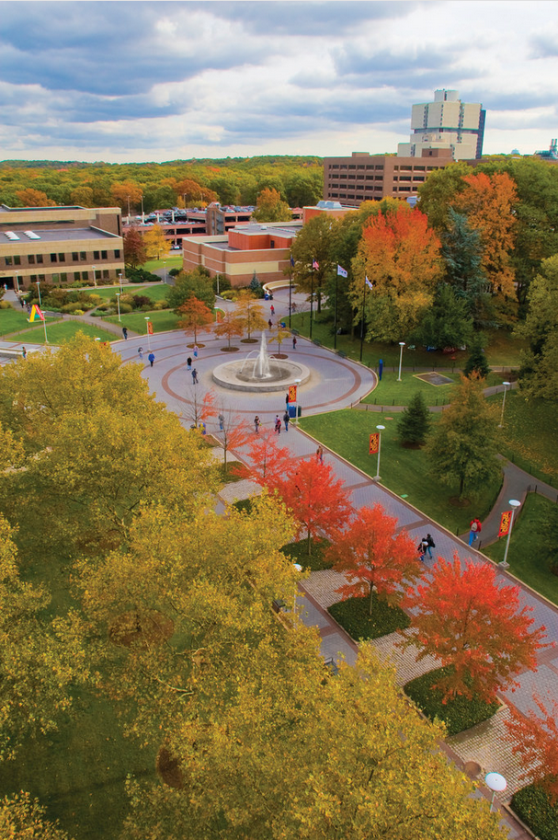
Stony Brook University Profile
26,256
Fall 2018 headcount
enrollment
1323
Avg SAT 2018
Incoming Freshmen
93.5
Avg HS GPA 2018 Incoming Freshmen
67% 33%
Undergrad Graduate
36% 17%
White URM
1/3
Receive Pell Grants
14,907
Fall 2018 employees including hospital
2,738
Faculty
full-time & part-time
#80
U.S. News & World Report Rank 2019
2.8 Billion
USD Annual Budget
1957
Founded
2001
Joined AAU

Slide 5
Freshman graduation rates increased fifteen percentage points in the last five years
15
Percentage point increase
in 4-yr grad rate over 5 years
Top 3%
of colleges or universities for improvement over a 5-year period

Slide 6

Economic benefit to students
1,300 additional students graduated on time
$88 million
economic benefit to students
$16 million saved in tuition & fees
$72 million in additional earning capacity

Slide 7
Equity gaps in graduation rates are largely closed

Slide 8
Mobility Report Cards:
The Role of Colleges in Intergenerational Mobility
Raj Chetty, Stanford University
John N. Friedman, Brown University
Emmanuel Saez, UC-Berkeley
Nicholas Turner, US Treasury
Danny Yagan, UC-Berkeley
January 2017, Stanford Center on Poverty & Equality

Slide 9
Mobility Report Card Research Approach
Research question
What role do colleges play in intergenerational income mobility?
Primary Sample
11 million children born 1980-82 claimed as dependents by tax filers in the U.S.
Data source
Focus on change in percentile ranks
De-identified data from 1996-2014 income tax returns
What proportion of students from bottom fifth of parental income distribution reach the top fifth of graduate income distribution?
Attendance data reported by institutions to IRS on Form 1098-T

Slide 10
Mobility Report Major Findings
Differences by Sector
Elite institutions provided low-income students with most access to top 1%
Comprehensives and community colleges provided most access to top 20%
[Stony Brook is an exception]
“Overplacement” Not a Concern
Low-income students exhibited similar outcomes to peers at selective institutions
Solutions to mobility may reside in comprehensive sector
Because Cal State and CUNY exhibit high mobility rates look there for answers
[I will complicate this in a moment]
Access declining at high mobility institutions
When they got in
When they graduated
Calls for some reconsideration of aid policies, state support
New America follow-up

Slide 11
Stony Brook’s calculated mobility rate
Access
16.5%
of students came from the lowest quintile of family income
(under $25,000)
Success
54.5%
of these students reached the top quintile of graduate income in their 30s (over $58,000)
Mobility Rate
8.4%
Stony Brook ranked #3 among all institutions and #1 among highly selective institutions
X
=
Median income of all Stony Brook graduates in their 30s: $64,700
Source: Chetty, et al. online data table 3, amounts are 2015 dollars, adjusted by CPI-U. Graduate income is a non-zero median.

Slide 12
Stony Brook ranked #3 on social mobility rate; #1 among highly selective universities
Rank | Name | Mobility Rate = | Access X | Success Rate
1 | Cal State, LA | 9.9% | 33.1% | 29.9%
2 | Pace Univ. | 8.4% | 15.2% | 55.6%
3 | Stony Brook U. | 8.4% | 16.5% | 51.2%
4 | Technical Career Insts. | 8.0% | 40.3% | 19.8%
5 | U of Texas – Pan American | 7.6% | 38.7% | 19.8%
6 | CUNY System | 7.2% | 28.7% | 25.2%
7 | Glendale Comm. Coll. | 7.1% | 32.4% | 21.9%
8 | South Texas College | 6.9% | 52.4% | 13.2%
9 | Cal State, Poly.-Pomona | 6.8% | 14.9% | 45.8%
10 | U of Texas – El Paso | 6.8% | 28.0% | 24.4%
Access: share of children at a college with parents in the bottom quintile of the income distribution
Success rate: share of children with parents in the bottom quintile of the income distribution that reach the top quintile of the income distribution
Many institutions rolled up into systems
Source: Published Table III (Table IV in later versions)

Slide 13
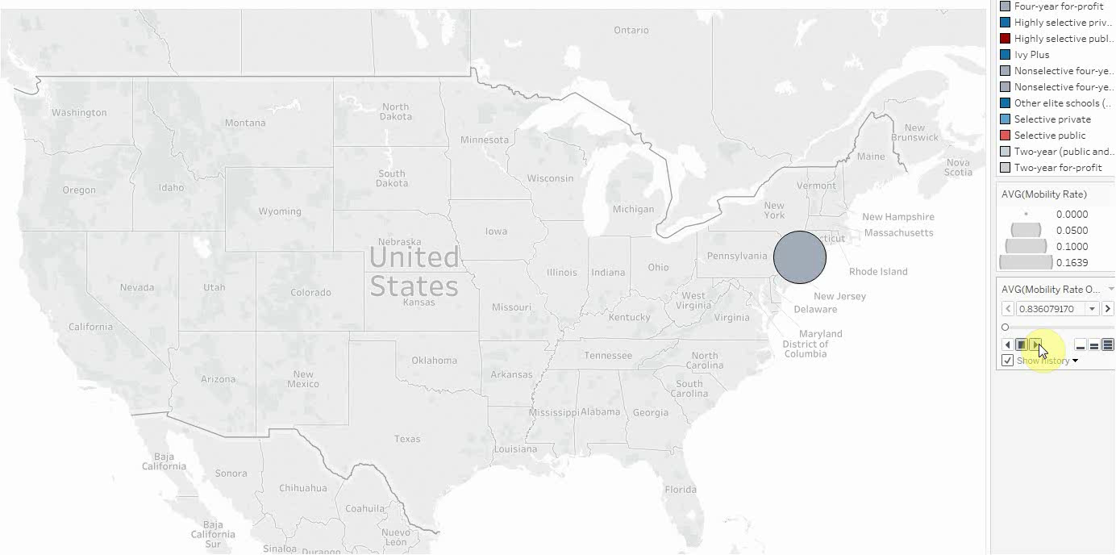
Association between geographic location and mobility rate
Source: Chetty, et al. (2017) Web data table 3

Slide 14
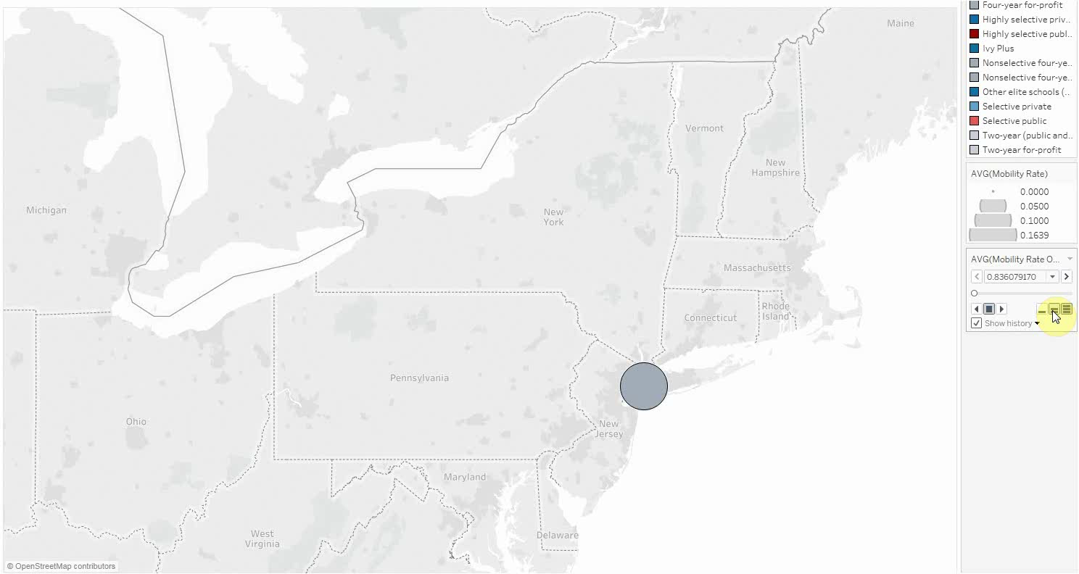
Consolidation of public systems masks some of the data
Source: Chetty, et al. (2017) Web data table 3

Slide 15
Change in access at Stony Brook requires context
Birth cohort
College mid-point
Source: Chetty, et al. (2017) Web data table 3; Stony Brook Institutional Research; submissions to IPEDS

Slide 16
Stony Brook remained among the most accessible highly selective institutions
Name | Birth cohort year
 | 1980 |  | 1991
 | parent income ($) | rank (out of 157) | parent income ($) | rank (out of 157)
University Of California, San Diego | 112,300 | 43 | 82,000 | 1
Stony Brook | 75,100 | 1 | 88,300 | 2
University Of Texas At Dallas | 96,700 | 11 | 89,800 | 3
Kettering University | 107,400 | 28 | 92,700 | 4
Milwaukee School Of Engineering | 88,100 | 5 | 93,600 | 5
University Of Wisconsin System | 95,100 | 8 | 95,700 | 6
Loyola University New Orleans | 113,100 | 46 | 96,300 | 7
University Of California, Irvine | 86,200 | 3 | 98,500 | 8
Illinois Institute Of Technology | 84,900 | 2 | 99,100 | 9
Gustavus Adolphus College | 112,600 | 44 | 101,800 | 10
Source: Chetty, et al. online data table 3, amounts are 2015 dollars, adjusted by CPI-U; selectivity tiers include highly selective, Ivy +, and other elite institutions, excludes institutions with data missing in either year.

Slide 17
Parent median income by student birth cohort, Public AAU
Buffalo
Source: Chetty, et al. (2017) Web data table 3

Slide 18
Why is Stony Brook so successful with social mobility?
Value Proposition
Programs
Geography

Slide 19
Stony Brook’s Value Proposition
2018-19 Undergraduate Tuition & Fees – Public Research Universities in Northeast
Source: Institutional web sites; consistent with IPEDS Data Center

Slide 20
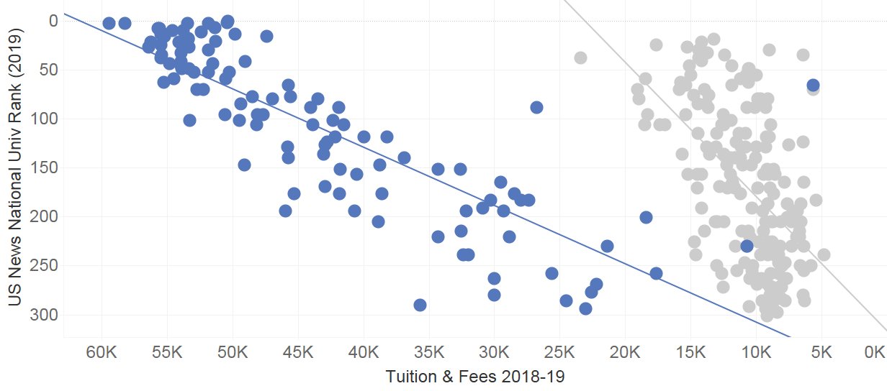
Value Proposition – US News Rank vs. Tuition & Fees
Stony Brook
$9,625
#80
Source: US News and World Report, IPEDS Data Center

Slide 21
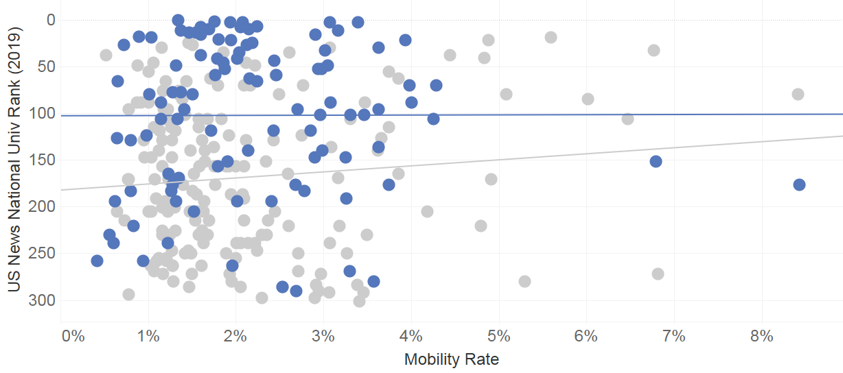
US News Rank vs. Mobility Rate
UC-Berkeley
UCLA
UC-San Diego
UC-Irvine
Stony Brook
UC-Riverside
Binghamton
NJIT
U of Houston
St. John’s U (NY)
Pace U (NY)
Cal State Fullerton
TX A&M
Kingsville
UT-El Paso
Source: US News and World Report; Chetty, et al. (2017) Web data table 3

Slide 22
Stony Brook’s Programs
STEM & Health Focus
Two-thirds of graduates complete a STEM or Health Degree
Educational Opportunity Program
Summer program w/ no cell phone
Other Support Programs
Collegiate Science and Technology Entry Program (CSTEP)
Financial Aid
Personalized financial aid check-ups
Student Success Initiatives
Louis Stokes Alliance for Minority Participation (SUNY LSAMP)
40% receiving NY Tuition Assistance Program grants
Microgrants to seniors with unexpected financial need
Analytics and predicted support need
Cohort program for low income, preparation gaps
STEM & Health grad rates exceed avg. grad rates
Small advising groups
Intensive mentoring academic support
Detailed schedule planning
S-STEM ASSETS
Long standing cross-functional academic success team
Reduction in classes w/ high DFW rates
Campus housing first generation program
Class availability
Policy reform
Notes:
EOP Initiatives That Foster Academic Success
One-on-One Academic, Personal, Career, & Financial Aid Counseling/Advising: Students are assigned an EOP advisor from the moment they come to campus and that advisor gets to know them very well and guide them in these areas. This includes four mandatory meetings per semester with their assigned EOP advisor, detailed 4-year academic plans and EOP sections of freshmen 101 classes which foster a sense of community and involvement.
EOP Summer Academy: Mandatory 5 week academically intensive preparation program for incoming freshmen. Intended to level the playing field for academically/financially underrepresented students. Once given the tools and support during the summer academy success is close to 100% completion and continuation into fall semester. It’s a very structured program with restricted cell phone use and a curfew.
Tutoring Program: Academic support is a key component to EOP success. Offering, and in some cases mandating, tutorial services for areas that students need support in aids directly in retention and graduation rates.
Mentoring Programs: Offering guidance and support through peer interaction is crucial to help develop in the areas of academics and personal growth.
EOP funding consists of a $450 book stipend per semester and a small grant to offset the cost of attending college. Even with all funding there is an increasing gap in the cost of attendance versus the amount of financial aid they receive. This year the average gap was over $1400.

Slide 23
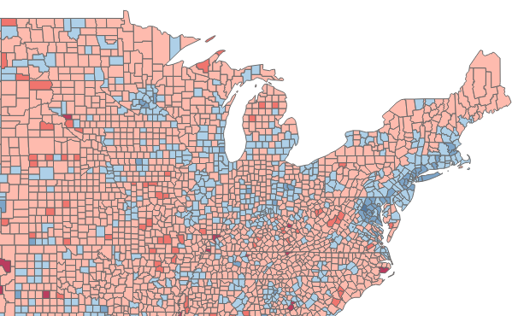
Stony Brook’s Location
Access to dense HS populations with quality schools | Access to hot labor market
16 public high schools in US News Top 100 located in NYC / Long Island 13% of Stony Brook’s entering freshmen come from these 16 schools 57% of these students received Pell grants | Median earnings bachelor’s recipients, age 25+
NYC/Long Island
$63-75k median
U.S. = $52,519
Source: Stony Brook Institutional Research; US Census ACS 2017, 5-year estimates

Slide 24
Stony Brook attracts Pell recipients with academic backgrounds comparable to non-Pell recipients
Distribution of Entering First-Time Freshmen by HS GPA
Data sources: NCES Beginning Postsecondary Student Survey 2012/14, Stony Brook IR Office (fall 2014 cohort)

Slide 25
Stony Brook attracts Pell recipients with academic backgrounds comparable to non-Pell recipients
Six-year bachelor’s completion rates of first-time undergraduates by HS GPA
Data sources: NCES Beginning Postsecondary Student Survey 2004/09, Stony Brook IR Office (fall 2014 cohort)

Slide 26
Takeaways
High quality academic and support programs are a foundational requirement for student success
Recruit low income students with sufficient if not equitable preparation
Target:
- high grades
- quality high schools
Improve access to high paying labor markets
Be prepared to address new data about higher ed effectiveness

