Slide 2
Creating Tableau Dashboards with IPEDS Data: How To, Tips, and Tricks
2016 Association for Institutional Research Annual Forum
Sean V. Hoffman, Institutional Research Analyst
Office of Institutional Research, Planning & Effectiveness
Stony Brook University

Slide 3
Goals
Goals
    To learn what data are available in the IPEDS data center, and how to retrieve them.
    To be able to use these data to create a basic benchmarking dashboard with Tableau.
    To review some advanced techniques for creating more useful and informative visualizations in Tableau.
    To gain an understanding of how these dashboards can be used to aid in institutional research and planning.

Slide 4
Agenda
Agenda
Tableau basics
The IPEDS Data Center
Building a dashboard – Admissions Data
    Basic – Filters and calculated fields
    Intermediate – Parameters and more calculated fields
Advanced techniques
    Comparison charts
    Chart switching on a dashboard
    Dashboard actions
Uses for Institutional Research
Questions

Slide 5
Tableau BASICS
Tableau Desktop
  Create, manage, edit, and update workbooks locally. Can be deployed to a server (campus, public or online).
  Personal vs Professional – Need professional for DB connections
Tableau Server
  View and edit published workbooks in a secure environment
Tableau Online
Tableau Public
  Free, but not secure
Tableau Reader
  View and interact with dashboards
Backwards compatibility issues

Slide 6
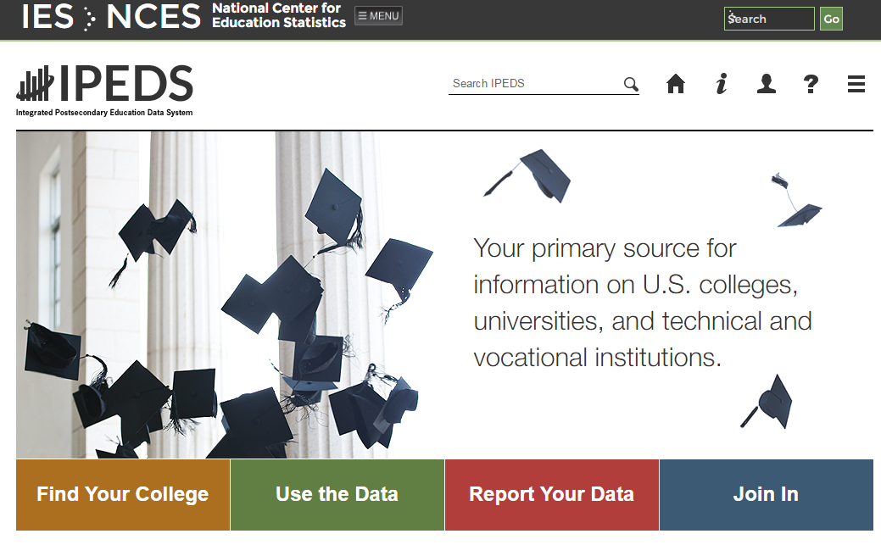
IPEDS Data Center: What’s Available
    Find Your College
    -College navigator
    -College scorecard
    Use the Data
    -IPEDS Data Center
    -Customizable, downloadable data
    Report Your Data
    -Log in to complete surveys
    -Collection Level Data Center (Most recent data available)
    Join In
    -Training
    -Resources
    All data reported to IPEDS is available, as well as copies of the actual surveys submitted

Slide 7
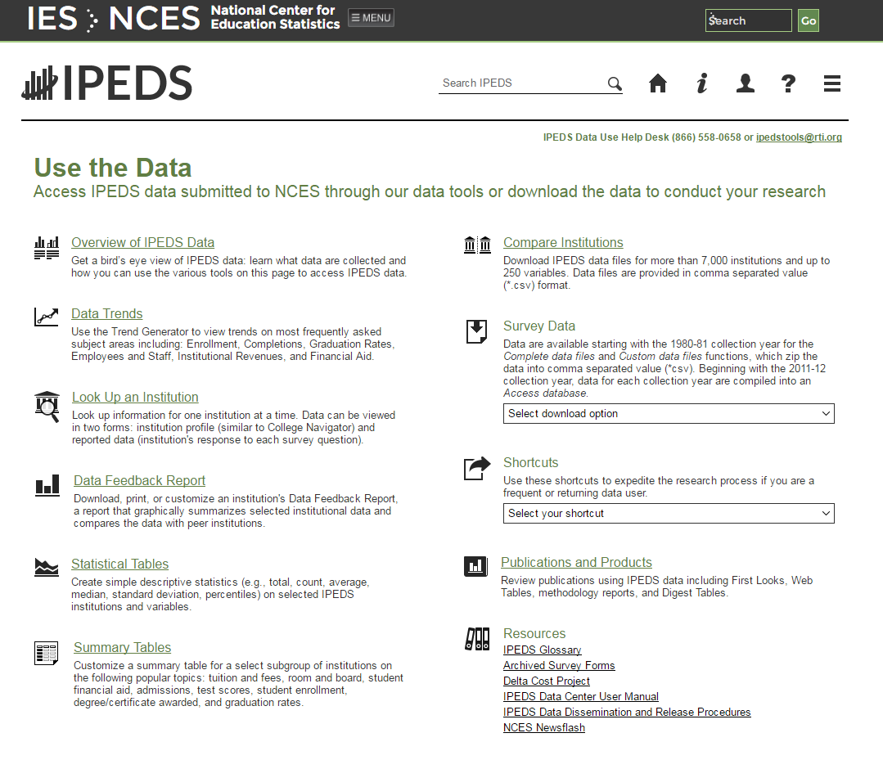
IPEDS Data Center: What’s Available
    For this exercise we will use “Compare Institutions”

Slide 8
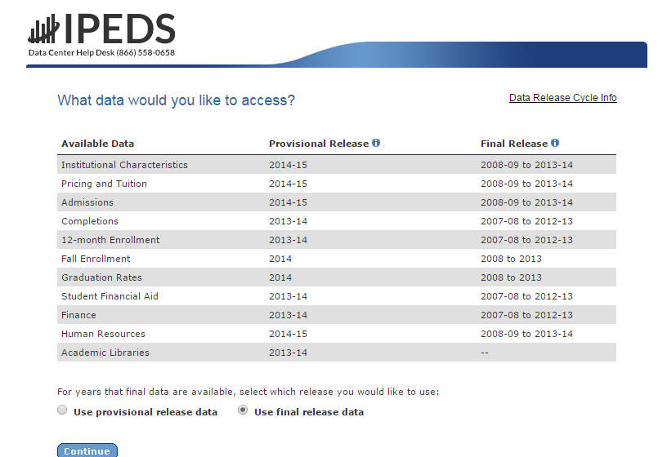
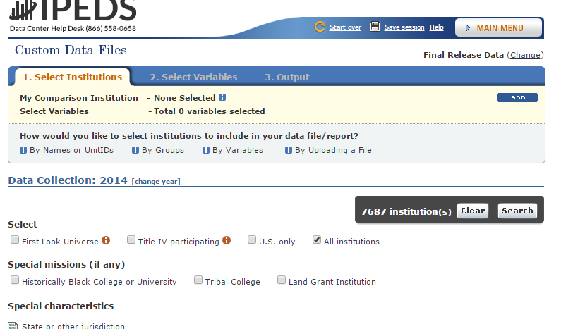
IPEDS Data Center: What’s Available
    Data from all surveys are available (final or provisional)
    Collection level data center allows access to current year (Go back to main page → Click Report Your Data → “Answer The Current Survey” → Log In → Click “Tools” → Click “Go to Collection Level Data Center)
    Select institutions: can create groups, use groups, or download all (By groups → EZ Group → “All Institutions”)

Slide 9
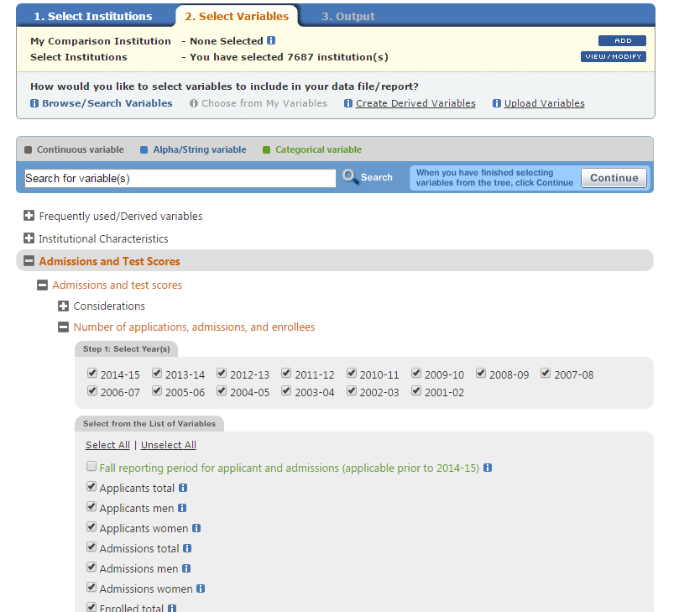
IPEDS Data Center: Exporting Data
    -Select the variables you would like (up to 250 for “Compare Institutions”)
    -Click continue
    -Download a CSV file
    -You can create derived variables if you desire

Slide 10
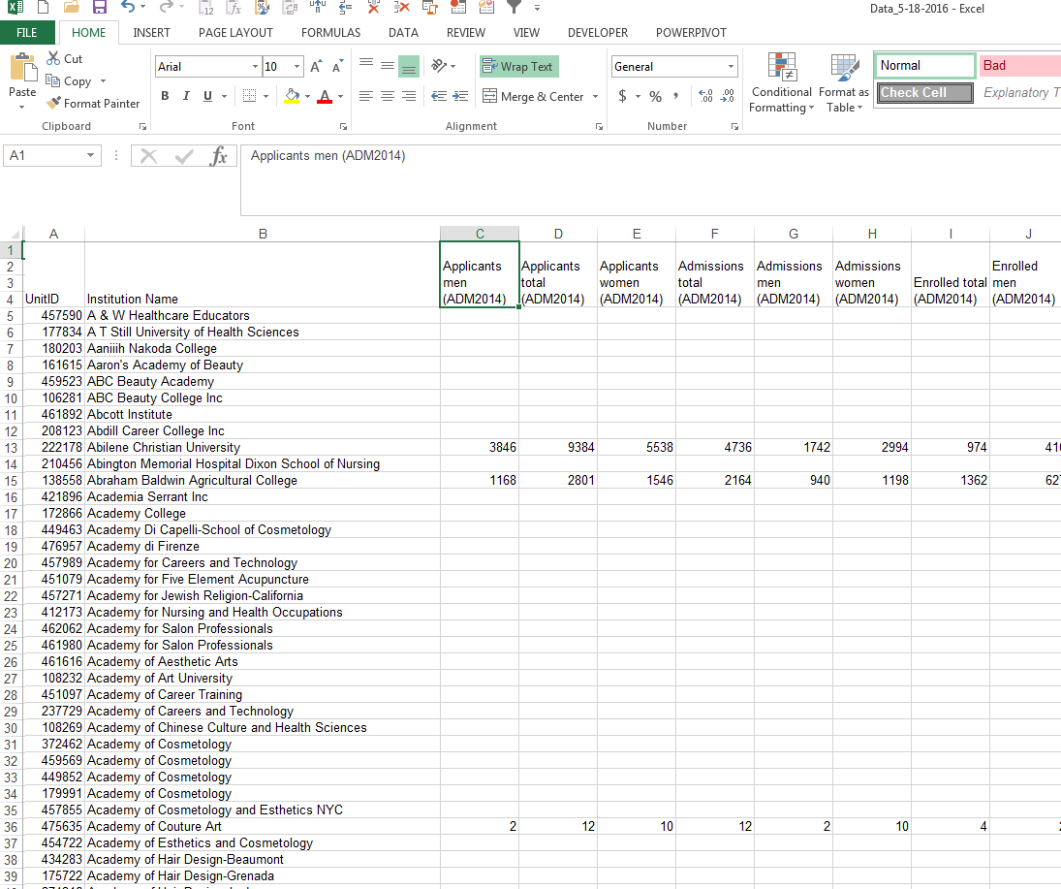
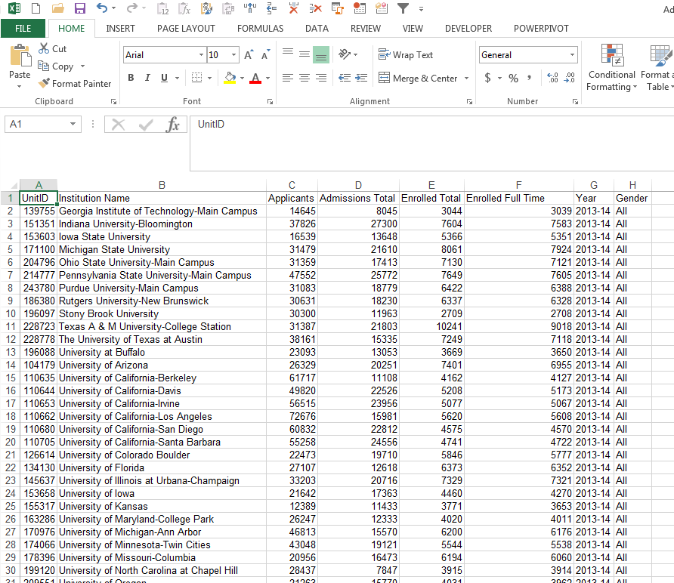
IPEDS Data Center: Exporting Data
    CSV from IPEDS Stacked Panel
    -Each element is downloaded as a separate column. This file can be quickly chopped up to work well in Tableau.
    -For this example, we can stack the panel based on year and gender, leaving only 8 columns. This will allow for a better layout in Tableau.

Slide 11
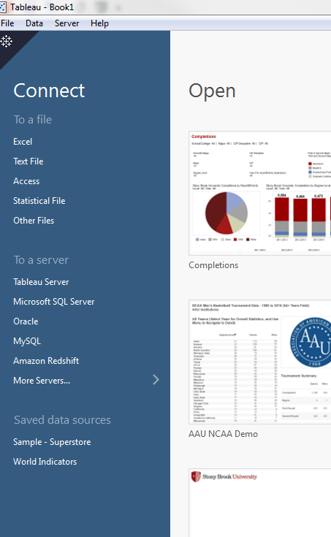
Basic Dashboard: Importing Data
    Connect to a file →
    -You can edit the file and refresh
    once you’ve started.
    Connect to a server →
    -Need Tableau Desktop
    Professional
    -Can create an extract

Slide 12
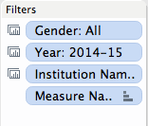
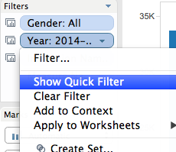
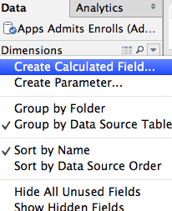
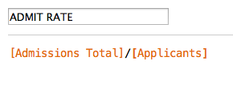
Basic Dashboard
    Let’s begin with:
      Filters
        Filters are based off of certain fields (columns)
        Because of the way we stacked the example panel, we can filter, gender, year and school
        To create, drag the item to the filter shelf. To show, right click and choose “Show Quick Filter”
      Calculated fields
        Calculated fields are similar to excel formulas
        We can create fields to calculate admit rate and yield
        To create, right click in the data tab and select “Create Calculated Field”
    Now let’s create two charts based on the items we have:
      A column chart to display Applications, Admissions and Enrollments
      A table to display Admit rate and yield

Slide 13
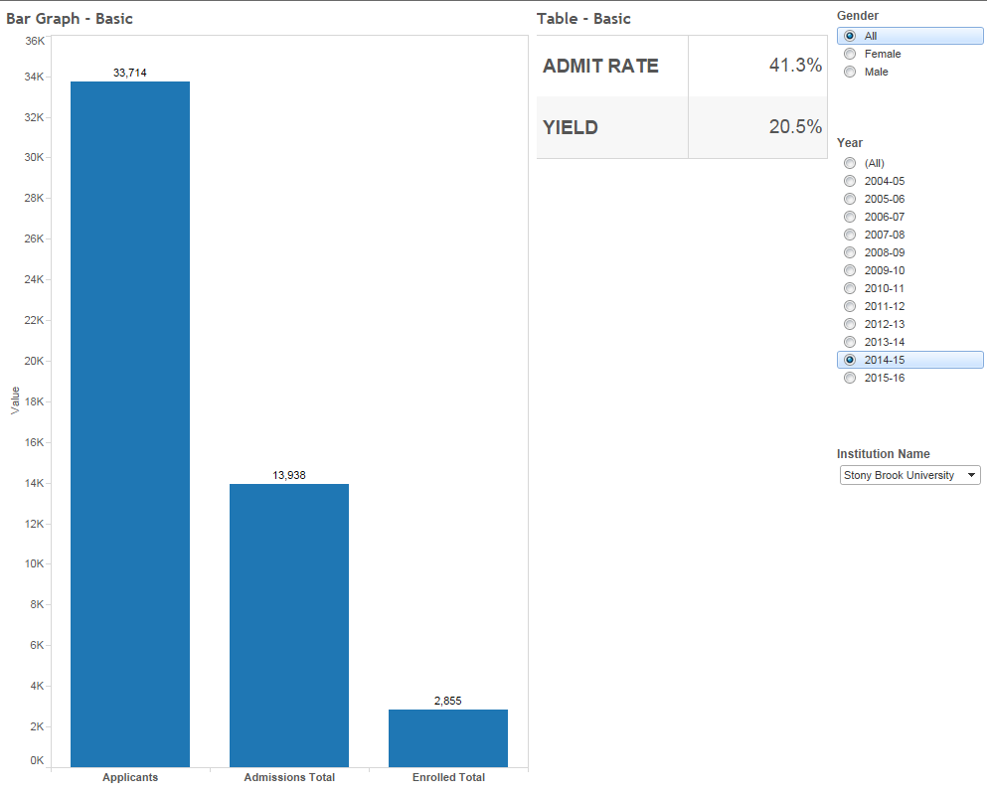
Basic Dashboard
    Now, we can create a new dashboard and add the two charts to it
    Drag the sheets from the dashboard shelf to the dashboard page
    All charts and filters from the sheets will be brought to the dashboard
    We can select each object, and use the dropdown menu to choose to make the object floating (free placement)

Slide 14


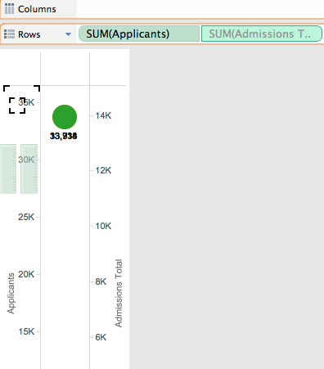
Some Reference Notes
    Notes about filters:
    A filter can be set to apply to a sheet, or all sheets using the same source. This allows for you to only need one filter with multiple charts
    A filter can be set to only show relevant values. This is helpful with long lists of related items. Example: Colleges/Schools and Majors
    Filters can be set to include an “All” option. In this example, it has been deactivated, as the data set already has an all option
    All options can be accessed from the drop down menu on the quick filter
    Notes about the charts:
    To add multiple measures to the measure shelf, start by adding two measures to the row shelf. Then drag one from the row shelf into the axis of the other. This will bring the measures shelf up, and allow you to add more measures directly to it.

Slide 15
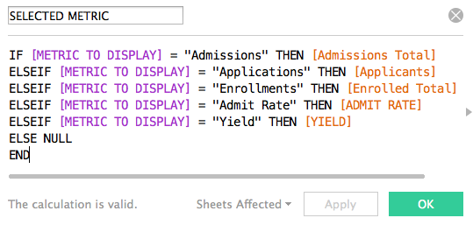
Intermediate Dashboard
    Here is another step to add some functionality to our dashboard. We will use a parameter and calculated field to select one metric to display at a time.
      Parameter
        Parameters allow you to create more complex filters
        Let’s create a parameter to choose what specific metric we want to look at in a chart
        Create a parameter that allows you to choose from the strings: “Applications”, “Admissions”, “Enrollments”, “Admit Rate” or “Yield Rate”
        To create, right click in the data tab and select “Create Parameter”
      Calculated field
        We can now create a calculated field that uses the
        parameter to select the item. For example, this field
        will show Admissions if parameter selected is Admissions.
        This will be a multiple IF statement. In Tableau you must
        end an IF statement with “END”
    Now let’s update our dashboard!

Slide 16
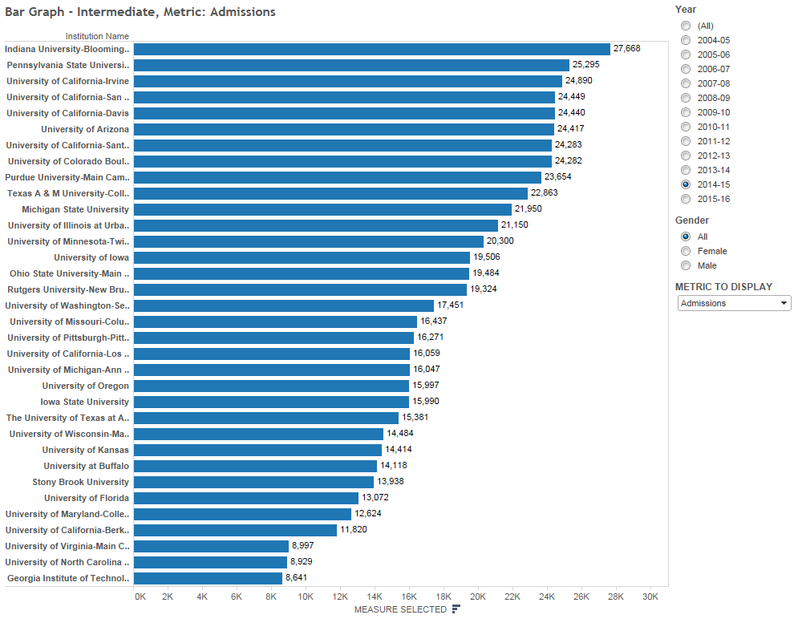
Intermediate Dashboard
    Observe that we do not need to store multiple metrics in multiple tables (or one table with multiple columns)
    This can help when space is limited
    This allows for easy benchmarking on one metric

Slide 17
Limitations
Limitations of the dashboard
Benchmarking: What if we want to focus on our institution, or another selected institution?
Data types: Our graphs and labels will not work for multiple data types
Size and content: How much is too much for one dashboard?
Advanced techniques to address the limitations
Comparison Charts – Create a benchmarking chart
Chart Switching – Select a chart based on the data you wish to display
Dashboard Actions – Switch between dashboards (or other links) and create filters that pass between charts

Slide 18
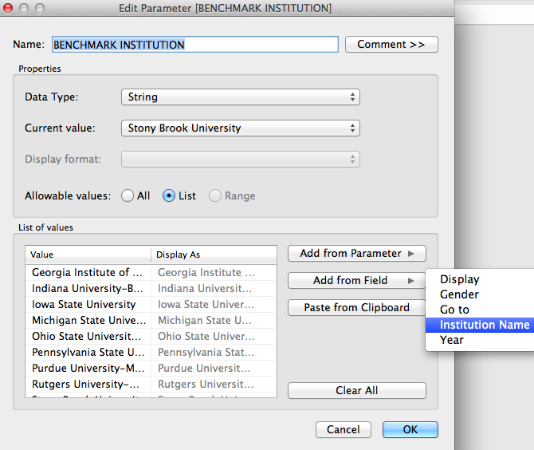
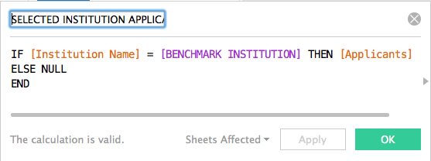
Advanced: Comparison Chart
Goal – Highlight a selected institution and compare to the average (quartiles also possible)
Solution – Create a comparison chart
Step 1 – Add a parameter using the institution names field
Step 2 – Create a calculated field that sets its value based on the parameter. For example, create a parameter called: “Selected Institution Applications”
Step 3 – Set this field to be equal to the number of applications when the Institution Name field is equal to the parameter, and null otherwise. This will make sure this field only displays data for the institution you are interested in
Step 1
Step 2/3

Slide 19
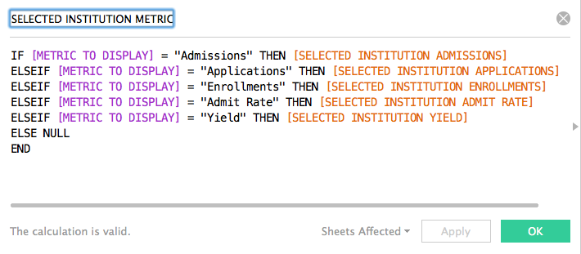
Advanced: Comparison Chart
Let’s examine how to merge this with the chart we created in the intermediate dashboard
In that chart, we created a calculated field to display our metric of choice.
Now, we will create another calculated field to display our metric of choice for our focus institution. For example, call the calculated field: “Selected Institution Metric”
We can then add both metrics to a chart, and create a dual axis chart.
To merge both axis, ensure both calculated fields are the same data type, by adding the float function to your calculated field: ( FLOAT(calculation) ) Not applicable for this data set.

Slide 20
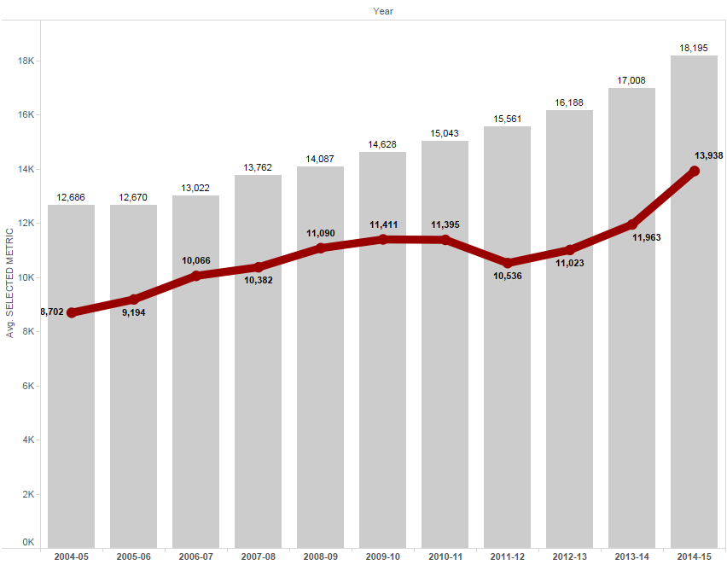
Advanced: Comparison Charts
Gray = Average selected measure for all institutions – this is determined by the metric parameter
Red = Selected measure for our focus institution – determined by the metric and focus institution parameters

Slide 21
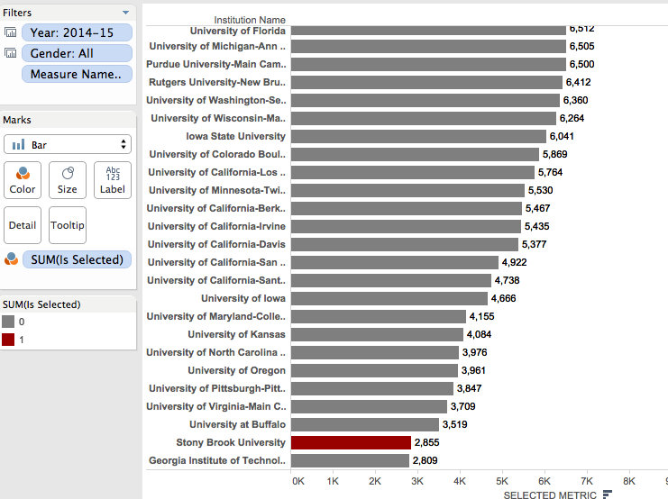
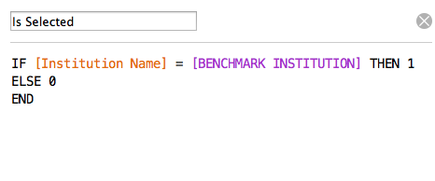
Comparison Charts
Alternate Comparison Chart
Highlighting the selected institution
Create a calculated field called
“Is Selected”. This will be
binary ( 1 or 0 )
Drag the field over to the
color shelf, change it to
discrete, and assign a
highlight color to 1 and
standard color to 0.
1
2
3

Slide 22
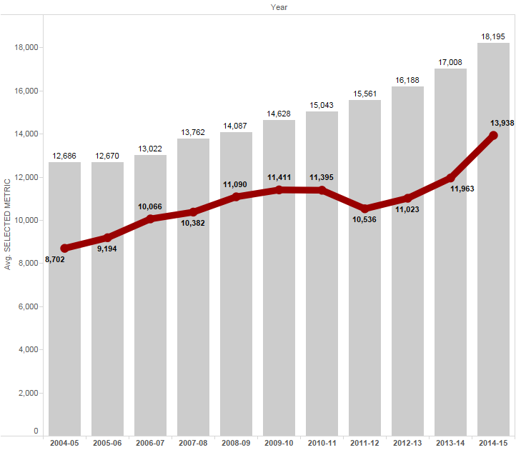
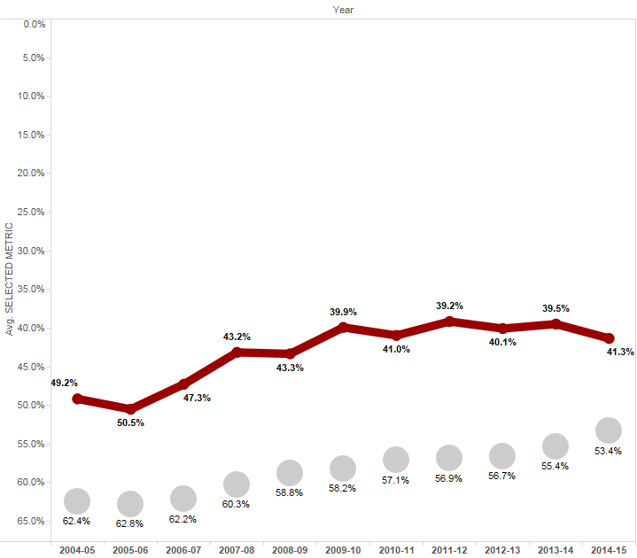
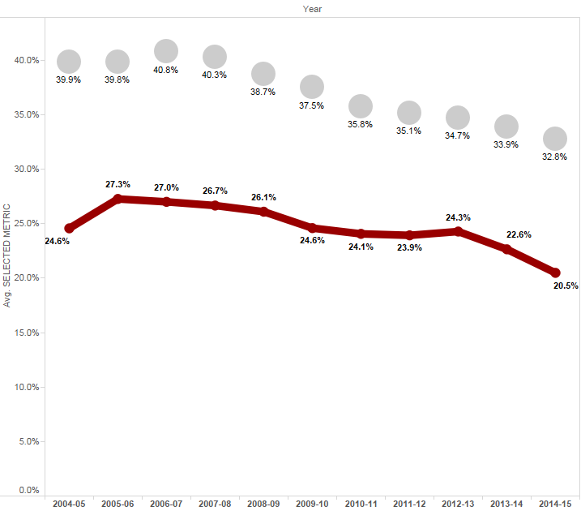
Advanced: Chart Switching
Goal – Display all metrics in one chart area
This is made challenging by different data types, and different trend representations (we would like to trend admit rate along a reversed axis and yield along a regular axis).
Solution – Place multiple charts in the same location on the dashboard, and display only one at a time
This is will be done through the use of a parameter, a calculated field, and custom list filters.
For this dashboard, there will be three charts
    Admissions, Applications, and Enrollments displayed as numbers, trended along a regular axis
    Admit Rate displayed as a percentage, trended along a reversed axis
    Yield displayed as a percentage, trended along a normal axis
1
2
3

Slide 23
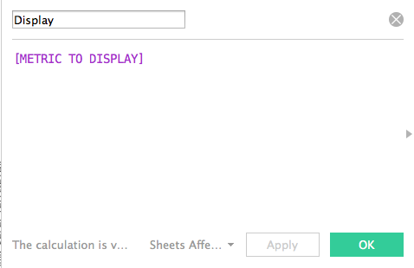
Advanced: Chart Switching
Step 1 – Create all charts needed for the dashboard
Three, as mentioned previously
Step 2 – We will need a parameter that has the values we want to switch between
Use the parameter created in the intermediate dashboard
Step 3 – Create a calculated field that is equal to the parameter
This will help to switch between charts

Slide 24
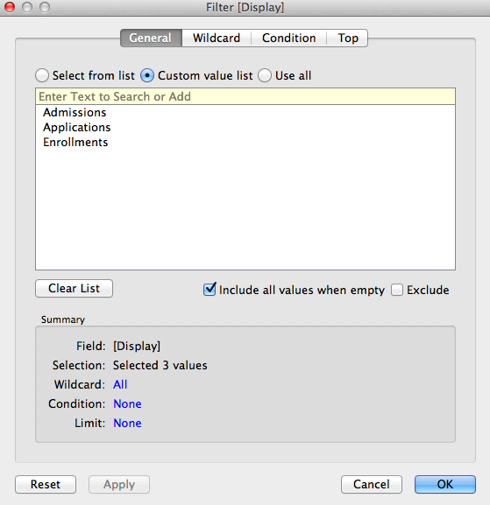
Advanced: Chart Switching
Step 4 – On each chart, add the calculated field as a filter, using a custom list. Set the custom list to the appropriate metrics for the chart
For example, the Admit Rate chart should have the calculated field filtered only on “Admit Rate”. When the parameter is switched to “Admit Rate”, it will trigger the calculated field filter and display any chart with “Admit Rate” filtered
Step 5 – Apply filters to all charts, and stack them on the dashboard
As long as each value in the parameter is included in only ONE of the stacked charts, then only one chart at a time will be visible
Note: if chart titles are different, hide the titles, and use a separate sheet to create a universal title
To stack, set all charts to “floating” and place them at the same coordinate location, using the manual coordinate entry section of the dashboard (bottom left)
Filter for the Applications, Admissions, and Enrollments chart. The Admit Rate and Yield charts will only have one element each.

Slide 25
Advanced: Dashboard Actions
Dashboard Actions
Actions allow for dynamic interaction between objects on dashboards
These actions can be used to communicate between sheets, dashboards, and external objects as well
To add a dashboard action go to “Dashboard” → “Actions” → “Add Action”
All actions offer the choice to run on: Hover, Select, or Menu
    Hover – When the mouse hovers over the target, the action will trigger
    Select – When the target is selected, the action will trigger (the target will have to be unselected and then selected again to re-trigger)
    Menu – When the target is selected, a menu will display, giving you the option to trigger the action

Slide 26
Advanced: Dashboard Actions
Dashboard Action – Filter
For passing filters between sheets
Choose a source and a target. The source is the object being clicked, and the target is what will be filtered.
For example, if there is a table showing all institutions, we can use a filter action to display institution detail when the name is clicked.
If the target sheet is on another dashboard, this will switch to that dashboard.
For switching between dashboards
Using the above knowledge, we can use the filter actions to navigate between sheets without passing filters as well. Simply choose all items as targets on the dashboard you wish to navigate to
Instead of using a chart as a source, a navigation button can be created by adding a calculated field with the value of “image”, and setting the mark type to Shape (see example Tableau workbook)

Slide 27
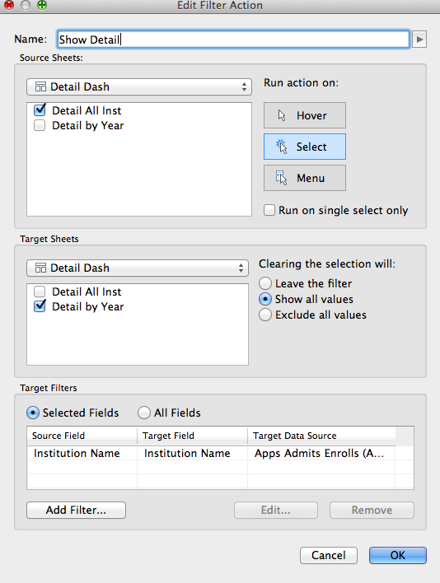
Advanced: Dashboard Actions
Dashboard Action – Filter
“Show all values” will pass the filter when selected, but remove it when the source is unselected (Exclude all will pass the filter as an exclusion filter)
“Leave the filter” will leave the filter until a different element of the source is selected
This filter will show the detail for institution name that is clicked on the “Detail All Inst” chart (Source). It will be displayed on the “Detail by Year” chart (Target).

Slide 28
Advanced: Dashboard Actions
Dashboard Action – URL
URL actions all for navigation to external addresses, such as a webpage or a file on a file share
When adding the action, choose the target on the dashboard that will activate the action, then input the URL.
Dashboard Action – Highlight
Highlight actions allow for focusing on subsets of the dashboards. You can pass the action between sheets to filter a graph based on something clicked in a table
We will not add a highlight action to this visualization, but their uses are well documented in the Tableau forums

Slide 29
Uses for Institutional Research
Planning
Examining position
Trends and projections
Research
Highlights areas of interest
Benefits
Quick, relatively simple, and publicly available
Well populated
Customizable peer groups
Going further
Adding institutional data (dashboard example on next slides)

Slide 30
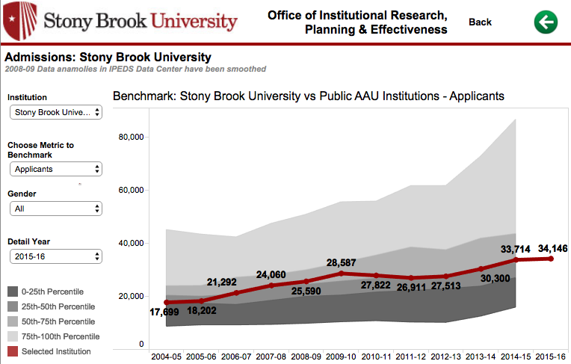
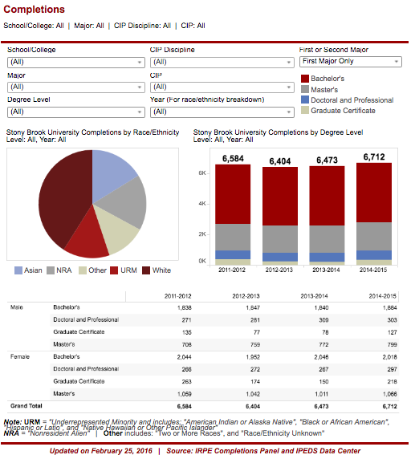
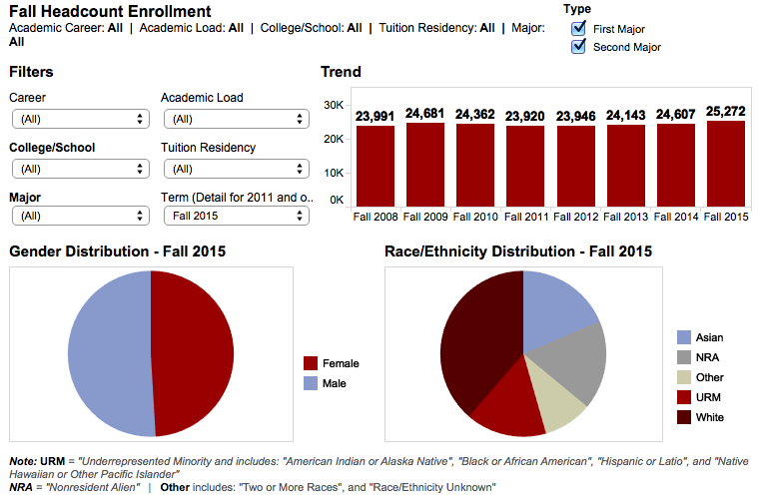
Uses for Institutional Research

Slide 31
Questions or comments?
Feel free to contact me:
Sean Hoffman
Stony Brook University
Office of Institutional Research, Planning & Effectiveness
sean.hoffman@stonybrook.edu
(631)632-1462
http://www.stonybrook.edu/commcms/irpe/index.html (Main IRPE site)
http://www.stonybrook.edu/commcms/irpe/reports/ (Presentations)
http://paintbynumbersblog.blogspot.com/2014/10/a-rough-guide-to-tableau-dashboard.html (Dashboard Actions)
https://community.tableau.com/community/forums (Tableau Community Forums)

