Slide 1

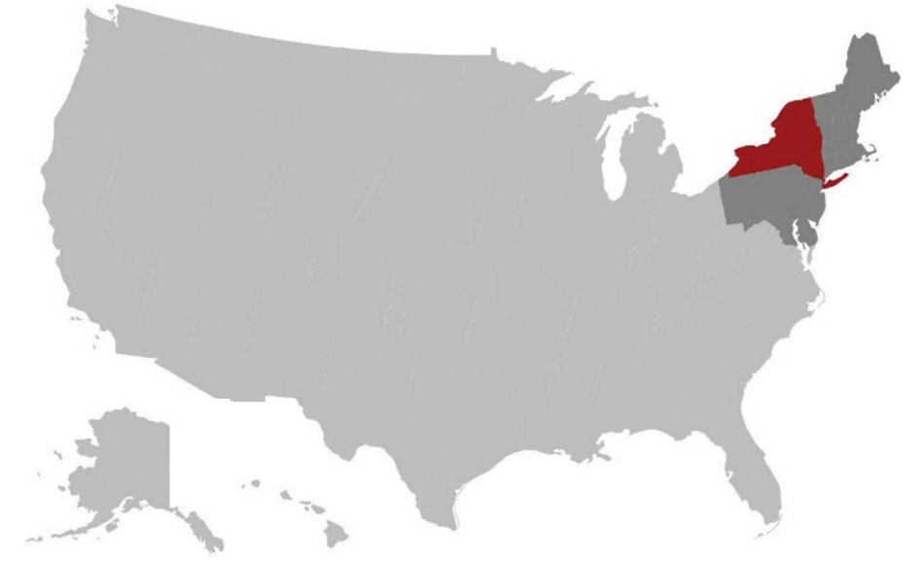

Outcomes of
Bachelor’s Degree Recipients
Outcomes of
Bachelor’s Degree Recipients
Stony Brook University collects information about its graduates in a variety of ways to understand their pathways following graduation. Employment and continuing education are reported by graduates and supplemented with third-party information resources and web searches. For the graduating class of 2025, 467 provided a valid response for a response rate of 10%. Employment locations and employer lists are sourced from third party data systems for graduates 2020-2025.
Aggregated salary data are sourced from the U.S. Census Bureau Post-Secondary Education Outcomes (PSEO) data tool of 43,242 individuals who received a bachelor’s degree from Stony Brook between 2001 and 2022; all amounts are in inflation-adjusted 2023 dollars (release date January 28, 2026). Graduate school placements are from the National Student Clearinghouse and represent 1,205 individuals in the graduating class of 2024-25 pursuing further education in fall 2025.
Employed
Continuing Education
Other
Overall
EMPLOYMENT LOCATIONS
New York 84%
Long Island 47%
NYC 31%
All other NY 6%
Northeast 6%
All other states 12%
International 1%*
* Low response rates from international students in 2025.
Prepared by the Office of Institutional Research, Planning & Effectiveness, April 21, 2026

Slide 2
Reverse
Median Salaries
Stony Brook University participates in the Post-Secondary Education Outcomes (PSEO) through the U.S. Census Bureau and receives earnings information of gradates aggregated by disciplines. In some instances, majors are combined; data are suppressed when earnings from fewer than ten graduates are available. Data below represent salaries of bachelor’s recipients one year and five years after graduation for just over 43,000 Stony Brook bachelor’s degree recipients from 2001 through 2022 and converted to 2023 dollars.
Selected Employers
Amazon | Mather Hospital
American Express | Memorial Sloan Kettering Cancer Ctr
Apple | Meta
Bank of America | Microsoft
Boeing | Morgan Stanley
Broadridge | Mount Sinai Health System
Brookhaven National Lab | National Grid
Capital One | New York Cancer & Blood Specialists
Catholic Health | New York Life Insurance Company
Citi | New York-Presbyterian Hospital
City of New York | North Atlantic Industries
CityMD | North Shore University Hospital
Cold Spring Harbor Lab | Northrop Grumman
Con Edison | Northwell Health
CVS Health | NYC Department of Education
Deloitte | NYC Health + Hospitals
Epic | NYS Dept. of Env Conservation
EY | NYU Langone Health
Fidelity Investments | Optum
GEICO | PwC
General Dynamics Electric Boat | ScribeAmerica
General Motors | State of New York
Goldman Sachs | Stony Brook University
Google | Suffolk County District Attorney
IBM | TD
JPMorgan Chase & Co. | The Estee Lauder Companies Inc.
KPMG | The Mount Sinai Hospital
Lenox Hill Hospital | The Walt Disney Company
Long Island Jewish Medical Ctr | Weill Cornell Medicine
Long Island Rail Road | YAI
Maimonides Medical Center | Zebra Technologies
Selected Graduate Schools, 2025
American University | Syracuse University
Arizona State University | Tulane University
Boston College | University of California-Berkeley
Boston University | University of California-Davis
Brandeis University | University of California-San Diego
Brown University | University of California-Santa Barbara
Carnegie Mellon University | University of Chicago
Columbia University | University of Connecticut
Cornell University | University of Georgia
Dartmouth College | University of Illinois
Emory University | University of Kansas
Florida State University | University of Maryland
Fordham University | University of Massachusetts
George Washington University | University of Miami
Georgetown University | University of Michigan
Georgia Institute of Technology | University of Minnesota
Johns Hopkins University | University of Missouri
Massachusetts Inst. of Technology | University of Oklahoma
New York University | University of Pennsylvania
Northeastern University | University of Pittsburgh
Northwestern University | University of Rochester
Pennsylvania State University | University of South Florida
Princeton University | University of Texas at Austin
Purdue University | University of Virginia
Rutgers University | University of Washington
Stanford University | University of Wisconsin
Stony Brook University | Yale University
SUNY (various) | Yeshiva University

