Slide 1
Stony Brook University Data Strategy
Presented to the Data Governance Council
June 8, 2017, Updated July 3 2017

Slide 2
What is a data strategy?
Intentional action & prioritization plan to:
Harness and integrate data
Create and disseminate information/intelligence
Advance University mission

Slide 3
Why do we need a data strategy?
Support objectives to:
Proliferation of data assets
Increasing organizational size and complexity
Advances in analytical tools
Promote operational effectiveness, excellence & efficiency
Retain and grow revenue
Reduce risk
Drive innovation

Slide 4








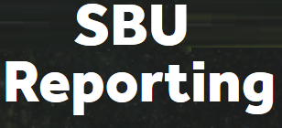


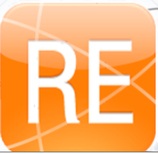








Selected Stony Brook data assets
Assessment Data
Help Desk Tickets
Card Swipes
Surveys

Slide 5
Stony Brook’s mission
The university has a five-part mission to provide and carry-out:
Highest quality comprehensive education
Highest quality research and intellectual endeavors
Leadership for economic growth, technology, and culture
State-of-the-art innovative health care, with service to region and traditionally underserved populations
Diversity and positioning Stony Brook in global community

Slide 6








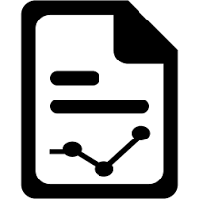
Elements of Stony Brook’s data strategy
 | Data acquisition
 | Data governance
 | Data quality
 | Data access
 | Data usage & literacy
 | Data extraction & reporting
 | Data analytics

Slide 7
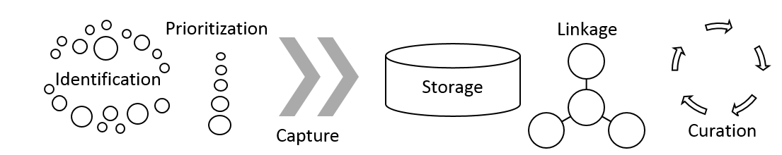
Data acquisition
Data acquisition involves identification, prioritization, capture, storage, linkage, and curation of data assets most valuable to the enterprise

Slide 8
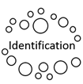

Data acquisition
Identification & prioritization
Establish and maintain an inventory of data assets and assess acquisition maturity
Establish a process to prioritize integration into data infrastructure

Slide 9

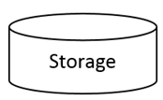
Data Acquisition
Capture & storage
For each data asset identify current and optimal capture procedures
For each data asset identify current and optimal storage areas

Slide 10
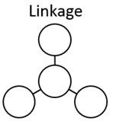
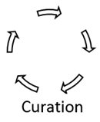
Data Acquisition
Linkage & curation
For each data asset identify current and optimal procedures to link to other data sources
For each data asset identify how data will be updated and maintained to preserve value

Slide 11
Data governance
Data governance formalizes behavior around how data are defined, produced, used, stored, and destroyed to enable and enhance organizational effectiveness.
PeopleSoft and the Data Warehouse are governed by the University Data Governance Council
Establish expectations for all other data assets to have formal data governance

Slide 12
Data governance
Requirements
Stony Brook
Data Governance Framework*
Designated decision-making body
Formal data dictionaries and descriptions of architecture
Individuals designated to provide stewardship
May opt to be governed through the Stony Brook Data Governance Council
Data Governance Council
Finance
Student
Human Resources
Data Stewards
Data Stewards
Data Stewards
SteerCo
*Applies to PeopleSoft and the Data
Warehouse (as of 9/26/16)

Slide 13
Data Quality
Data quality is the state of completeness, validity, consistency, timeliness and accuracy that makes data appropriate for a specific use.
The Data Governance Council is charged with improving data quality for PeopleSoft and the Data Warehouse. A roadmap to achieve this has been developed
For each data asset, develop and execute a plan to maintain and improve data quality; automate when justified by ROI.

Slide 14


Data access
Data access ensures authorized individuals can obtain and use data when and where they are needed and protects privacy and sensitive information by preventing unauthorized use.
Accessibility | Security
Authentication
- Username & password
Authorization
- What you have access to
Accountability/Auditing
- How data have been used

Slide 15
Data usage and literacy
Data usage and literacy entail people regularly obtaining data; understanding them; and using them to improve operational effectiveness .
Establish for all data assets:
Usage metrics
Effectiveness metrics
Training inventory
Data User Responsibilities
1. Recognize data complexities; understand data meanings and limitations
2. Cite sources; assume broad audiences
3. Respect privacy
4. Secure data and reports
5. Report data quality issues

Slide 16
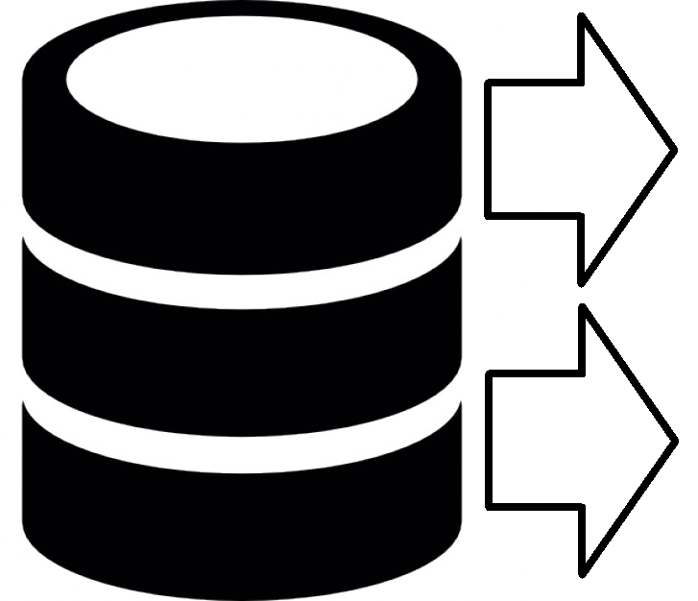

Data extraction and reporting
Data extraction and reporting represent the ways that data are queried and retrieved from storage and then delivered to users through regularized and ad hoc reporting to support day-to-day operations.
Extraction | Reporting

Slide 17
Data extraction and reporting
Methods for querying and extracting data from storage should be identified, including user types associated with each extraction method
Reports should be linked to operational objectives
Report inventories should be maintained in an accessible area.
Reports should be automated depending on ROI
Reports should include effectiveness metrics
Extraction
Reporting

Slide 18
Data analytics
Analytics deliver dynamic and visual analysis of data, internal & external benchmarking, exploratory and causal analysis, and predictive/forecasting capacity
Requirements
Maturity in data acquisition, governance, quality, access, usage, & extraction
Tools capable of performing analyses and communicating effectively
Speed and ease of use

Slide 19
Data asset strategy document compiled for each data asset
Data Asset Strategy Doc
e.g. IPEDS
Description & use
Data acquisition
Priority
Data governance plan
Data quality protocols
Data access plan
Accessibility
Authorization
Security
Data usage and literacy
Data extraction/reporting
Data analytics
 | Current | Plan | Date
Capture
Storage
Linkage
Curation

